Slide 1
WELS WORLD MISSIONS
Notes:
WELS World Missions conducts gospel outreach in 44 countries and is exploring outreach opportunities in 18 prospective new mission fields. World Missions brings the light of God’s Word to the world through evangelism efforts, church planting, training national workers for ministry, and providing religious materials in foreign languages through Multi-Language Productions (MLP). 49 world missionaries partner with over 400 national pastors to conduct outreach and train more than 380 students for service in Christ’s kingdom.
World Mission supports mission work:
on Native American reservations, where the gospel has been shared on the Apache reservations in Arizona for more than 125 years and exploratory mission work is beginning on other reservations throughout North America;
in Africa, where missionaries partner with national church bodies in six countries and are exploring outreach in at least seven more countries throughout the continent;
in Asia, where the two missionary teams have joined together to equip, encourage, and empower others to bring the good news of Jesus Christ to 1.8 billion unreached souls;
in Latin America, where hundreds of thousands of people are being reached through Academia Cristo online courses and more than 40 individuals are being trained to plant a church;
in Europe, where missionaries partner with national churches to train the next generation of church leaders and bring the true gospel to countries without a strong Lutheran presence;
and through Multi-Language Productions, which has produced materials in more than 56 languages and reaches tens of thousands of English-speakers in more than 30 different countries through the TELL online training platform.

Slide 2
Mission partners in 44 countries
49 missionaries (and counting!)
Prospective mission fields in 18 new countries…
Give thanks to the Lord!
WELS WORLD MISSIONS
Notes:
WELS World Missions conducts gospel outreach in 44 countries and is exploring outreach opportunities in 18 prospective new mission fields. World Missions brings the light of God’s Word to the world through evangelism efforts, church planting, training national workers for ministry, and providing religious materials in foreign languages through Multi-Language Productions (MLP). 49 world missionaries partner with over 400 national pastors to conduct outreach and train more than 380 students for service in Christ’s kingdom.
World Mission supports mission work:
on Native American reservations, where the gospel has been shared on the Apache reservations in Arizona for more than 125 years and exploratory mission work is beginning on other reservations throughout North America;
in Africa, where missionaries partner with national church bodies in six countries and are exploring outreach in at least seven more countries throughout the continent;
in Asia, where the two missionary teams have joined together to equip, encourage, and empower others to bring the good news of Jesus Christ to 1.8 billion unreached souls;
in Latin America, where hundreds of thousands of people are being reached through Academia Cristo online courses and more than 40 individuals are being trained to plant a church;
in Europe, where missionaries partner with national churches to train the next generation of church leaders and bring the true gospel to countries without a strong Lutheran presence;
and through Multi-Language Productions, which has produced materials in more than 56 languages and reaches tens of thousands of English-speakers in more than 30 different countries through the TELL online training platform.

Slide 3
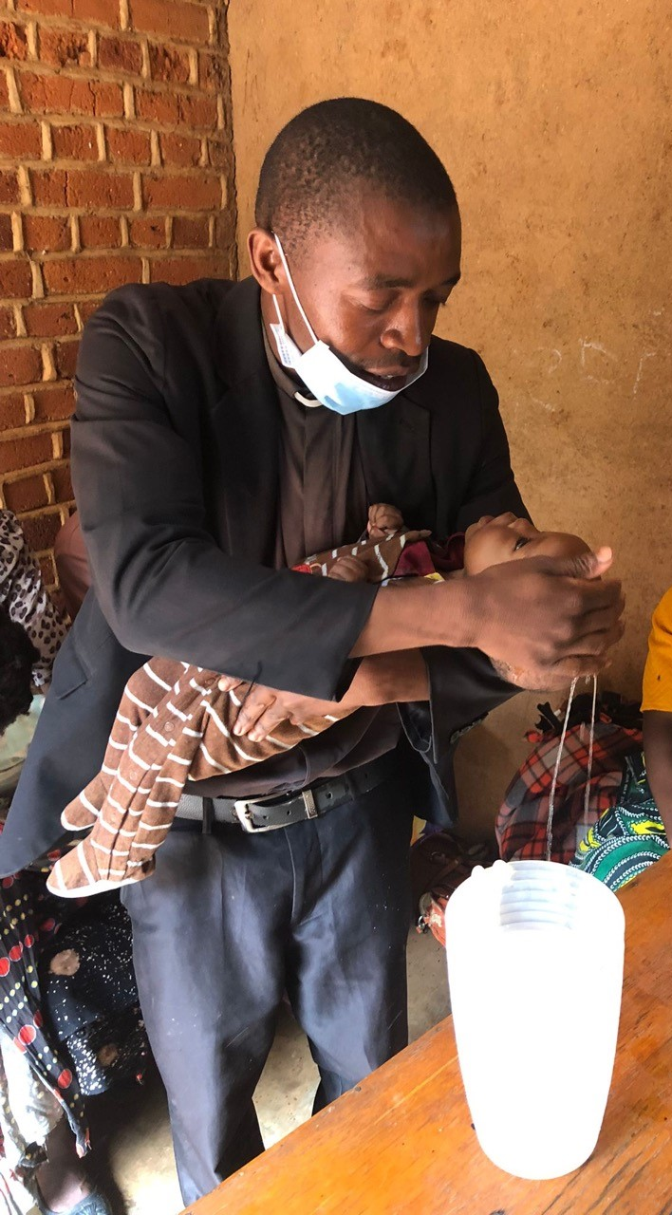
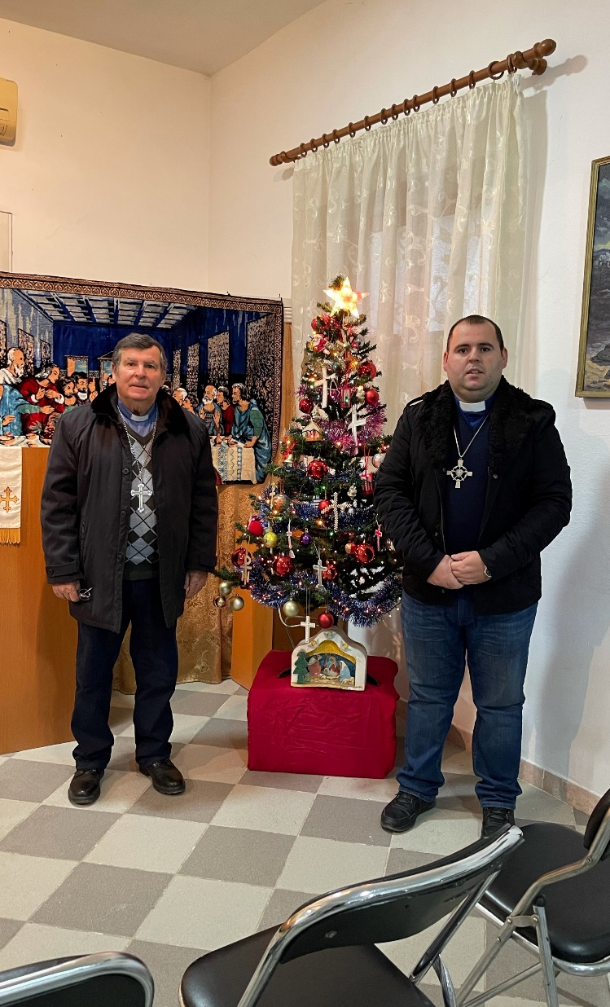
Vietnam
Malawi
Albania
500+ pastors serving well over 1,000 churches and preaching stations around the world
Notes:
WELS partners with 500+ national pastors around the world that serve well over 1,000 churches and preaching stations.
World Missions has changed since it first began over 125 years ago. Previous mission work involved missionaries going out to share the gospel directly and build up church bodies from the ground up. We still do some of that, but most of the time it’s contacts at other church bodies reaching out to us for fellowship and partnership. We’re now working with mature sister synods as we reach out to new locations with the gospel, partner in theological education, and work together to evaluate and train other church bodies who are interested in fellowship.

Slide 4
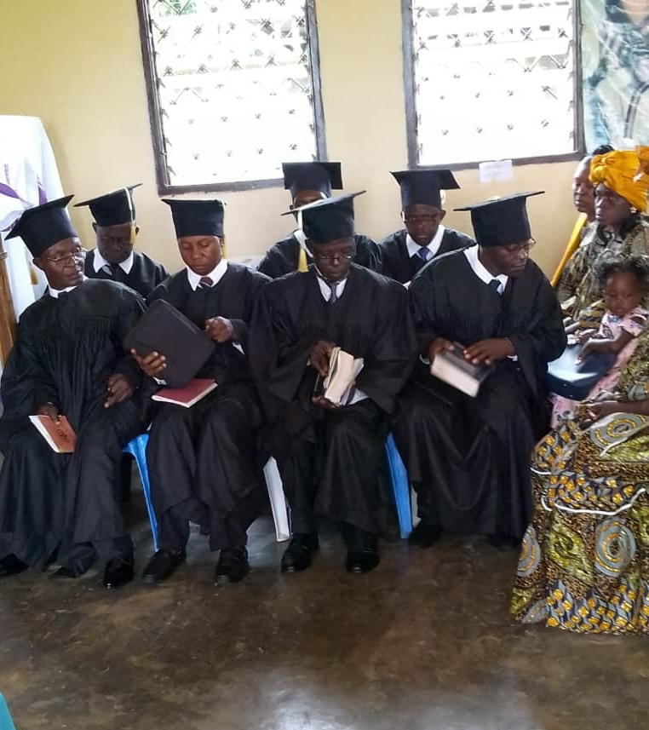
90+ World Mission Seminary Graduates are expected in 2022
Cameroon
Notes:
90+ seminary graduates are expected to become pastors in 2022
Cameroon: On May 27, 2022, the Lutheran Church of Cameroon graduated seven men into the full-time work of the holy ministry.
Nigeria: Two of our sister synods in Nigeria doubled the number of pastors serving in their church body in one day. 18 men graduated from the seminary in Nigeria on June 11, 2022
India: On Friday, March 25, 2022, 18 students from Christ Evangelical Lutheran Ministries (CELM) in India graduated after seven years of study. Over 130 more men have requested to join the next pre-seminary class.
Upcoming graduations will be taking place in Zambia, Vietnam, and at Asia Lutheran Seminary in Hong Kong.

Slide 5
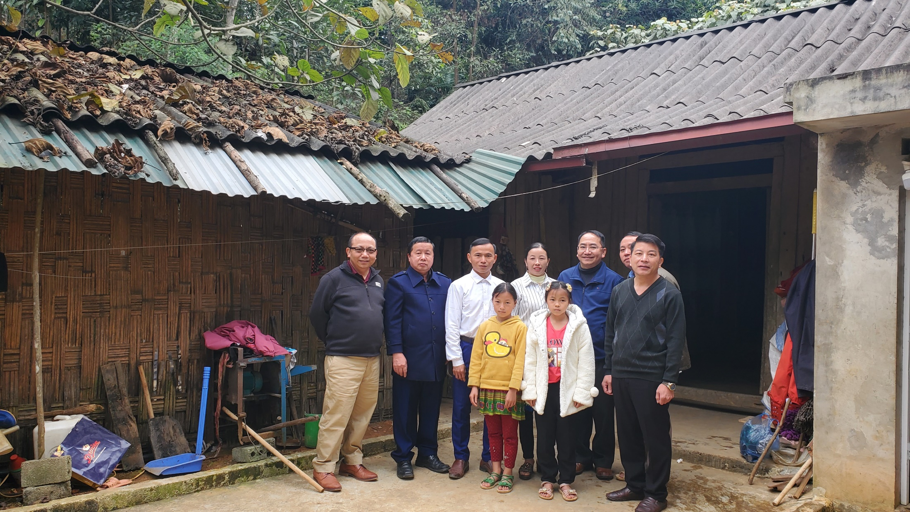
Exciting progress in Vietnam
Notes:
Before construction could begin on the theological education center for ethnic Hmong pastors in Hanoi, COVID made travel to Vietnam impossible. Progress on the building project stopped. But the instruction of Hmong pastors continued by Bounkeo Lor, his brother Pastor Ger Lor, Missionary Joel Nitz, and other guest instructors. Recently, a second cohort of 60 pastors began a six-year course of instruction in biblical doctrine and Lutheran theology. Since 2011 the Hmong Fellowship Church has grown from 55,000 members to 138,000 members, making it nearly half the size of WELS. The church still indicates that it wants to be a Lutheran church body. If the Lord wills it, most likely after the second cohort completes its study, the Hmong Fellowship Church will enter full fellowship with WELS.
An official groundbreaking took place on May 15, 2022. Missionary Bounkeo Lor spoke the words of dedication over Zoom with many WELS representatives online, while the HFC leaders put the shovel in the ground and placed the first stone. Construction is scheduled to be completed by December, when there will prayerfully be a full dedication. Once construction is complete, the center will open for classes.
Stay up to date on progress at wels.net/vietnamhmongoutreach.
PLEASE NOTE – Security precautions prevent us from sharing photos of the groundbreaking or building progress online at this point in time.

Slide 6
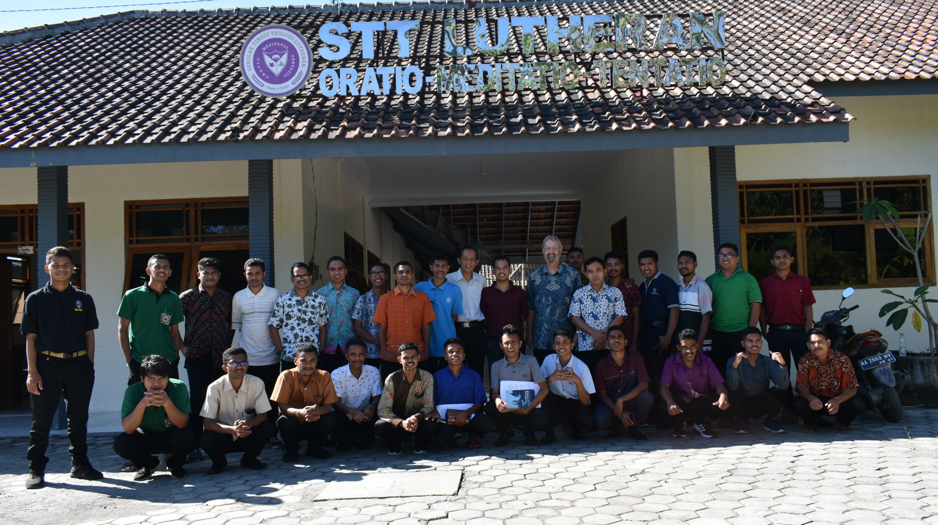
Growth in Indonesia
Notes:
WELS Friendly Counselor Greg Bey was in Indonesia in August visiting leaders and members of our sister church, Gereja Lutheran Indonesia (GLI). He attended their synod convention, visited their new seminary building (Sekolah Tinggi Teologi Lutheran – pictured), celebrated with a congregation at their anniversary service, and taught two different seminars in the upcoming week.
Gereja Lutheran Indonesia, which stands at about 1,650 members, is made up of five congregations and 30 preaching stations that are served by 25 national pastors and even more vicars and seminary students. Greg Bey is currently serving a quarter-time retirement call to Indonesia. Plans are being made to issue a full-time call for a new Friendly Counselor to assist in GLI’s work.
Learn more about mission work in Indonesia at wels.net/indonesia.

Slide 7
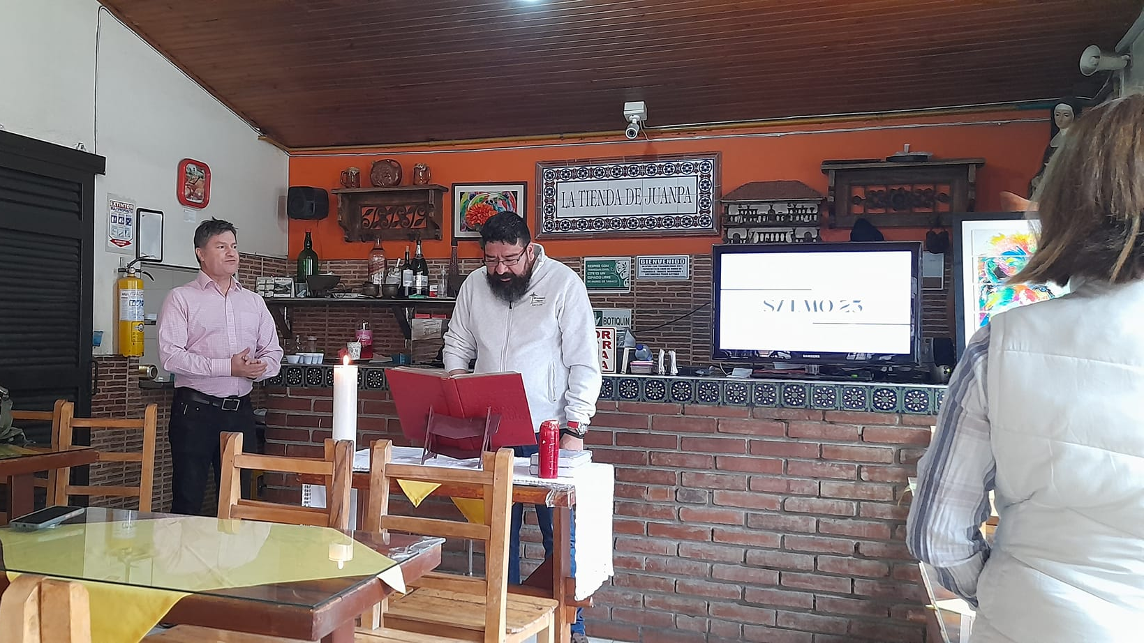
New house churches popping up throughout
Latin America
Notes:
Pictured: Two Academia Cristo students lead worship in a restaurant in Bogotá, Colombia, under the direction of Rev. Henry Herrera from the Lutheran Church of Colombia - May 2022
The Latin America mission team uses Academia Cristo, an online outreach and training tool, to share God’s grace with as many people as possible as well as identify and train potential leaders who can plant churches. 61 people have been confirmed/are in doctrinal agreement with WELS and our Latin American sister churches and are potential church planters. 16 people are already leading groups in their hometowns.
Five new missionaries were added to the Latin America team in 2021/2022 to keep up with the massive growth: Rev. Luis Acosta, Teacher Luke Beilke, Mrs. Elise Gross, Rev. Carl Leyrer, and Rev. Nixon Vivar.
Amazing blessings through Academia Cristo:
1.3 million followers on Facebook
565,000+ people have downloaded the Academia Cristo mobile app that launched in February 2020
1,300+ people have completed the self-led courses on the mobile app since March 2020 and are signed up for live courses
410+ people have completed one live course since March 2020 with a WELS missionary or national partner
58 people have been confirmed as Lutherans through Academia Cristo
There are 73 Academia Cristo students who have said they are currently sharing Bible materials with a group

Slide 8
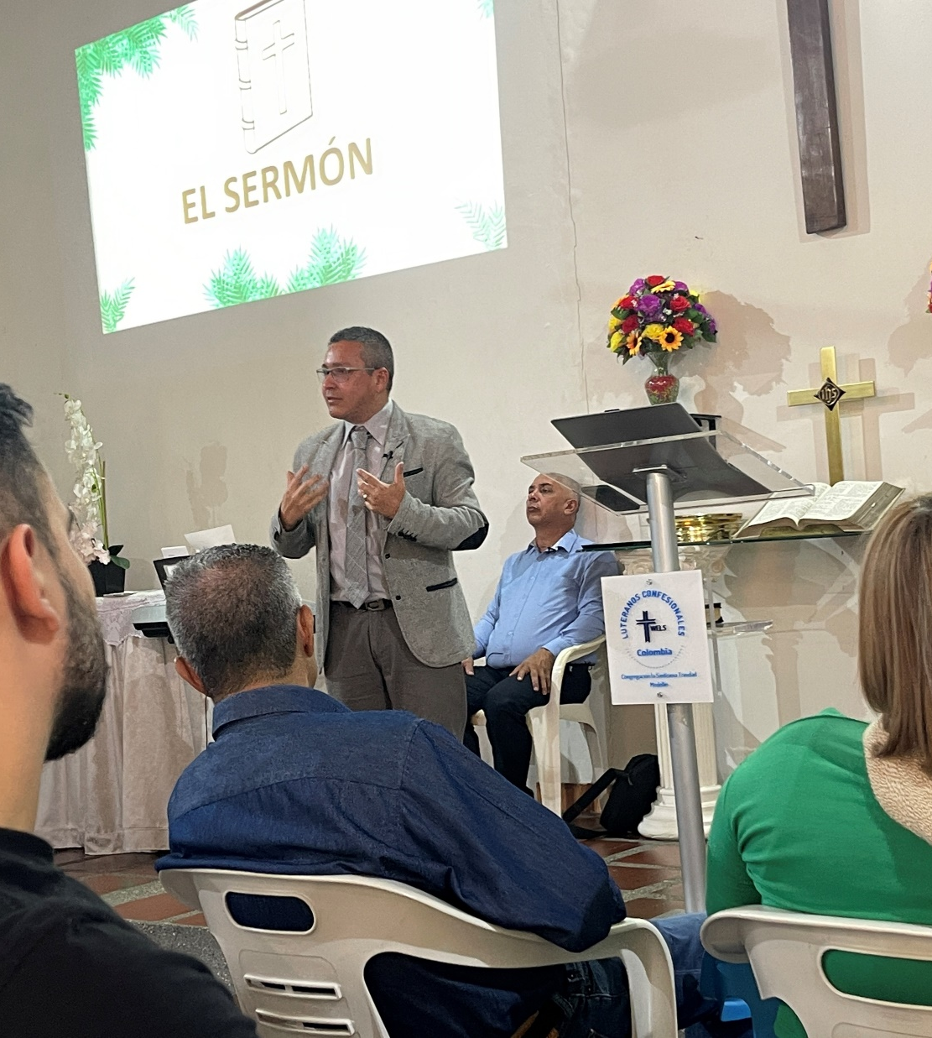
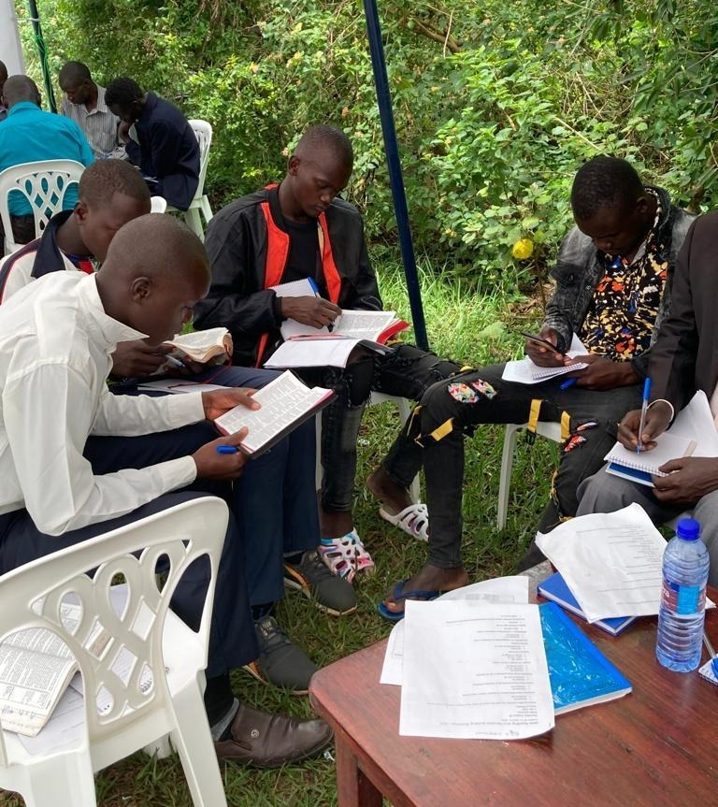
Two new synods expected to be brought into fellowship at Synod Convention 2023
Notes:
The newly formed Iglesia Cristo WELS Internacional (President Henry Herrera pictured left) and Obadiah Lutheran Synod – Uganda (pictured right at recent training with the One Africa Team in August 2022) are expected to be brought into full fellowship with WELS at Synod Convention in 2022.
Iglesia Cristo WELS Internacional: Sister churches in Bolivia, Colombia, and the Dominican Republic formed a new Latin American synod in Fall 2021. This international synod will be for churches to join that, God-willing, form out of Academia Cristo training efforts.
Obadiah Lutheran Church in Uganda recently drafted a request for doctrinal unity/fellowship with WELS, which includes a summary of doctrine and practice and a report describing the relationship between their synod and WELS/One Africa Team. Maksimu Musa and Johnson Balihikya, pastors in the Obadiah Lutheran Synod, visited refugees from South Sudan at the Kiryandongo Refugee Settlement to help a group in the camp organize a congregation. We pray that our Ugandan mission partners will shepherd more and more people with the Word of God. Read more: https://welsfriendsofafrica.com/body-parts/

Slide 9
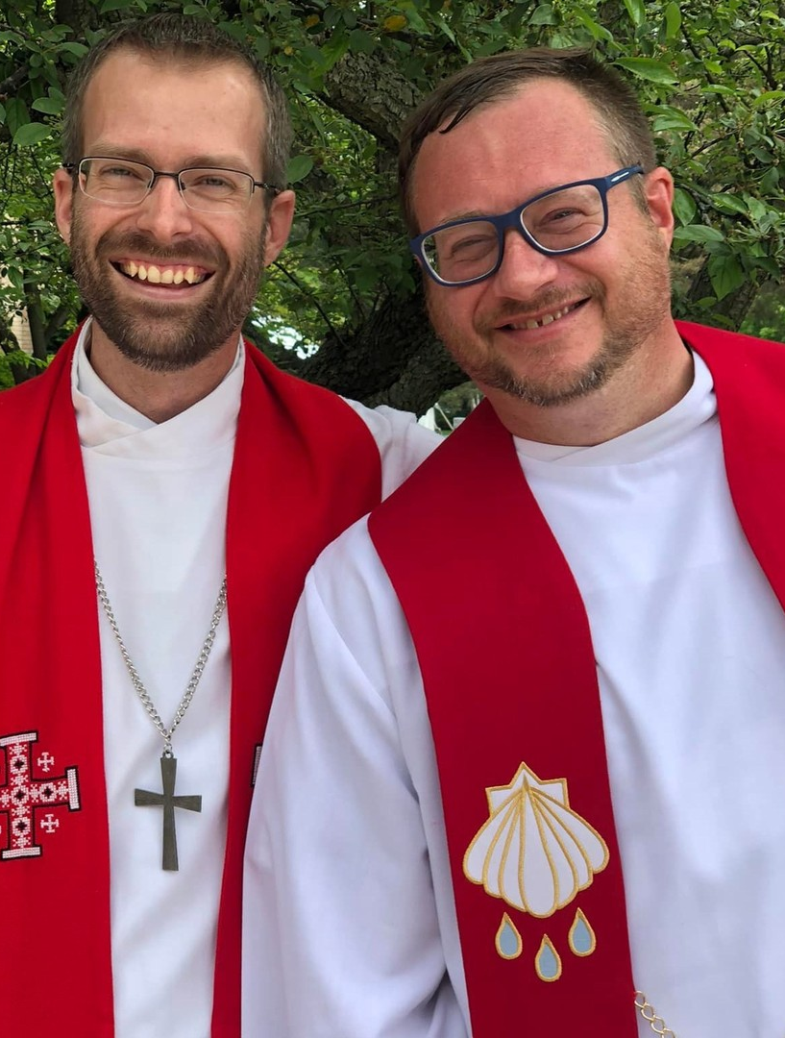
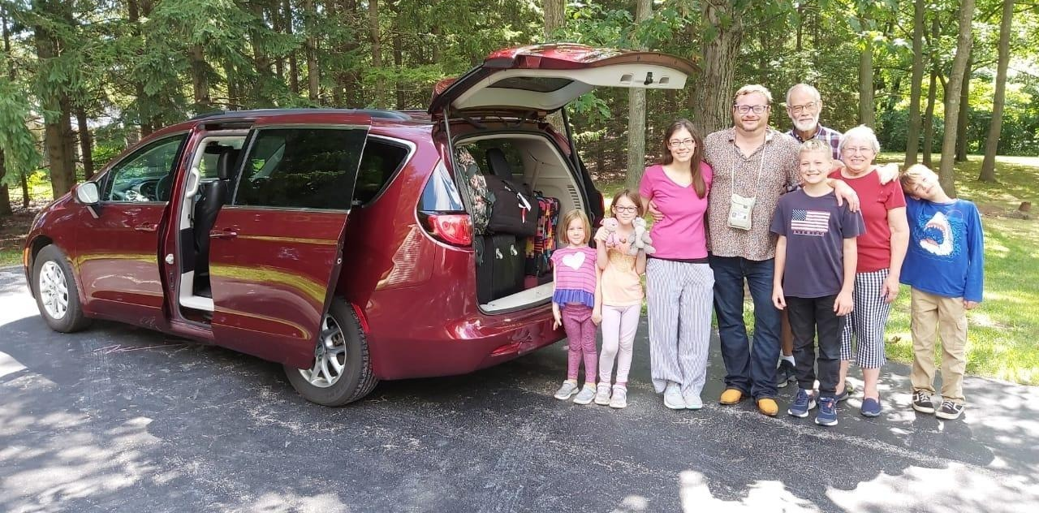
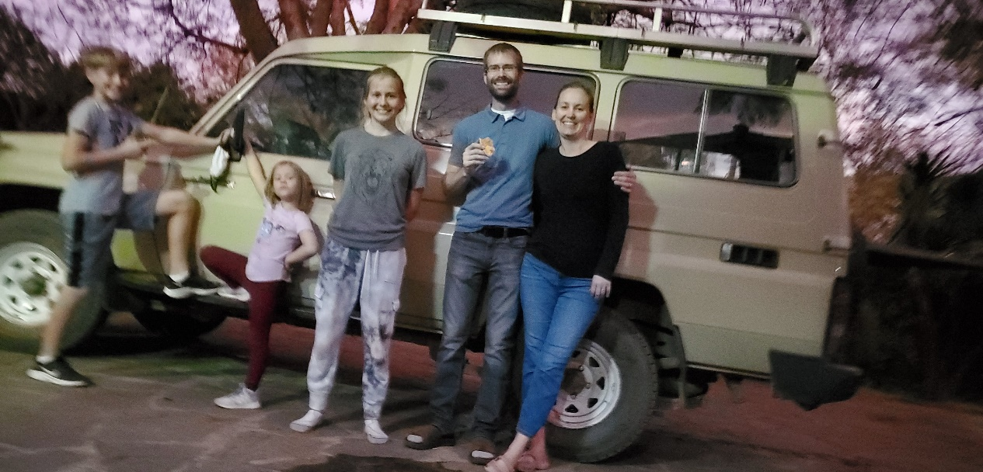
New missionaries in Africa
Notes:
Rev. Benjamin Foxen (Pictured Left) and Rev. Keegan Dowling (Pictured right) were commissioned as new One Africa Team missionaries at Taste of Missions on June 11, 2022. Both families have successfully made the move to Lusaka, Zambia, this summer.

Slide 10
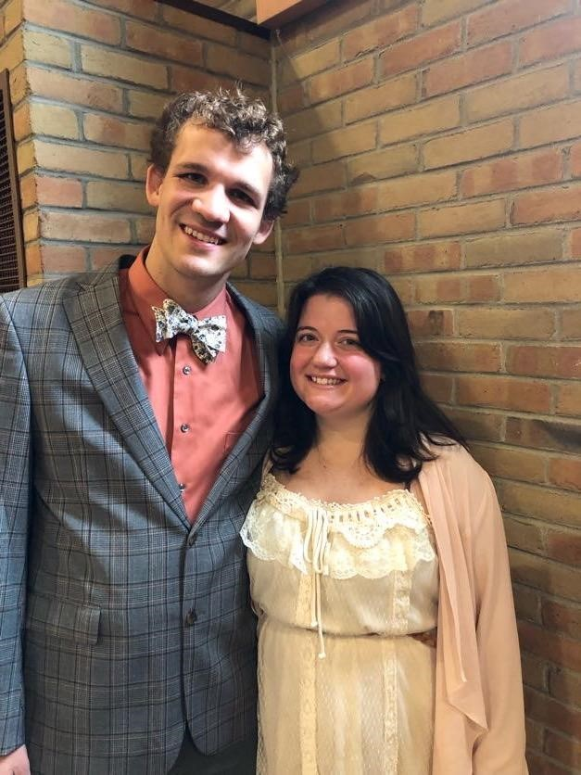
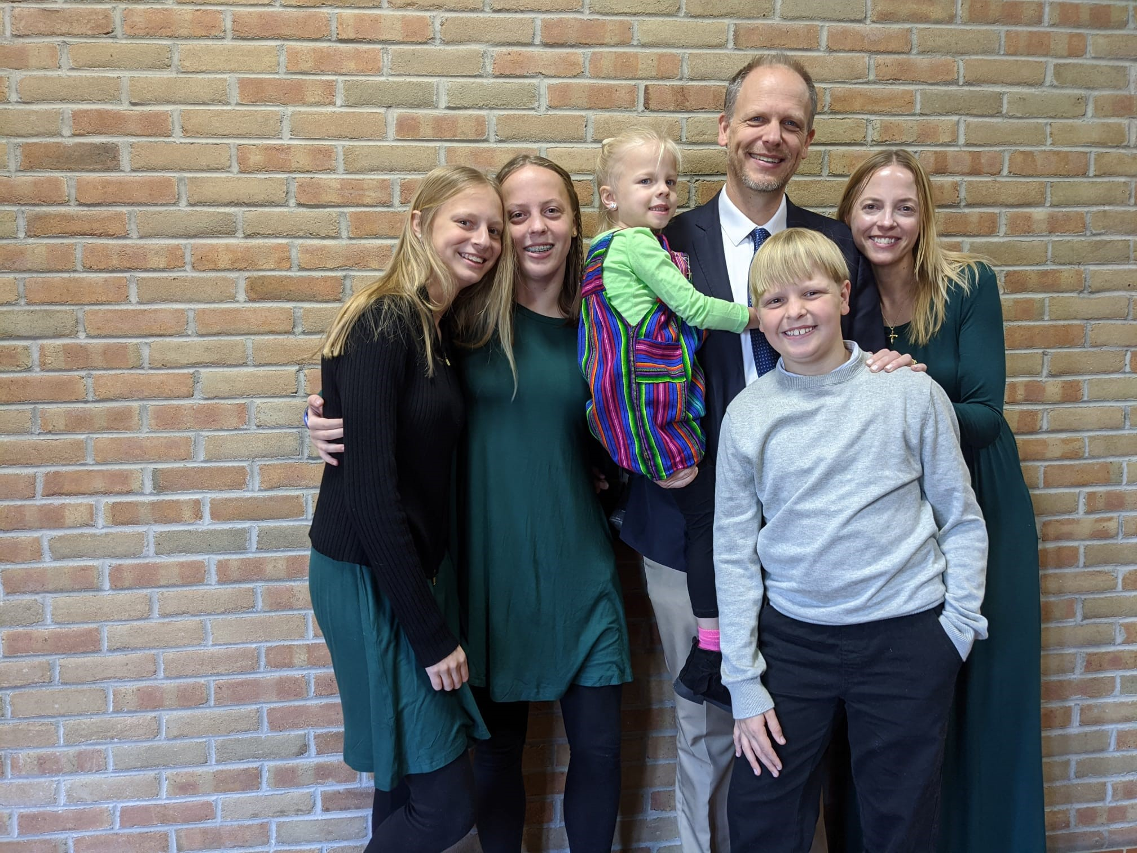
New WELS missionaries to London and the U.K.
Rev. Conifer Berg (left) and Rev. Michael Hartman (right)
Notes:
In February, Pastor Michael Hartman was commissioned as our WELS missionary to London at Wisconsin Lutheran Seminary’s student-led Mission and Ministry seminar. Rev. Conifer Berg was assigned from Wisconsin Lutheran Seminary as a second missionary to London and the U.K. on May 26, 2022.
World Missions will be looking to work with dedicated, generous, outreach-minded Christians (“Priscilla and Aquila” types) who gather friends and neighbors around the Word. Missionary Berg will join Missionary Michael Hartman to begin serving a group already gathering in London, connect with contacts from other sister church bodies, and launch outreach efforts. With the Lord’s blessing, it is the prayer this mission work could provide a springboard for further in the U.K., made up of England, Wales, Scotland, and Northern Ireland, and the entire continent of Europe.
Stay updated on progress at wels.net/london.

Slide 11
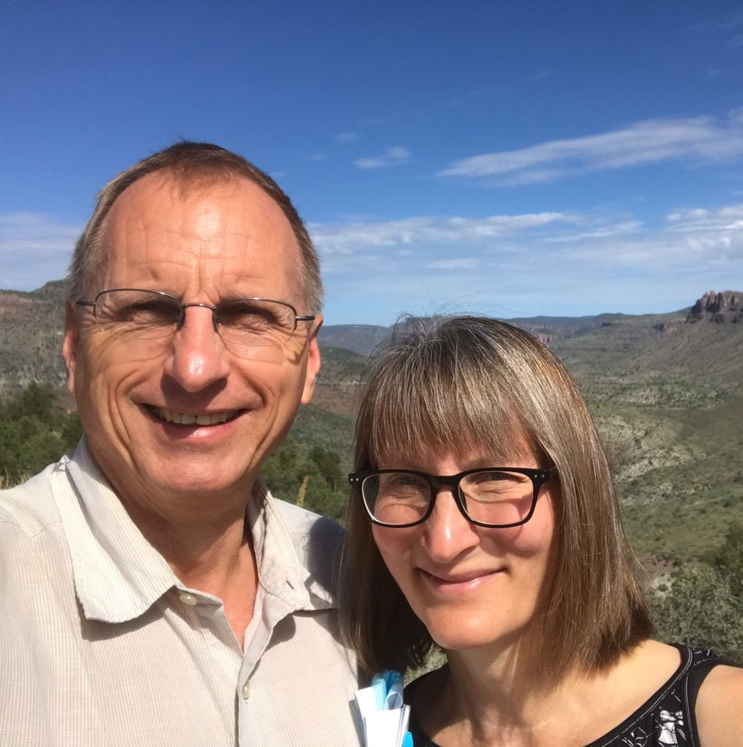
Growth on the Native American mission team
Reaching out to the 500+ tribes throughout North America
Notes:
Missionary John and his wife Mindy Holtz (previously serving in Malawi) were welcomed to the Native Christians team. They will be moving to the White Mountain Apache Reservation in September after their regularly scheduled furlough, where Missionary Holtz will be carrying on the important work of equipping Native American Christians to lead and serve God’s people through the Apache Christian Training School (ACTS).
The Native American mission team also looks forward to adding another missionary to the Native Christians team and expanding our gospel reach to more locations. More than 500 tribes that are overwhelmingly not Christian are still waiting for the life-changing, future-changing seeds of the gospel to be planted in their fields.
Please join us in prayer that our gracious Lord would bless the team, their plans, and the people they will serve.

Slide 12
Notes:
Multi-Language Productions (MLP) has created more than 2.9 million video, audio, print, and online training resources in 56 languages to date. They have also introduced a new online Bible-based training platform called TELL (Think, Evaluate, Learn, and Lead), to bring the gospel to English-speakers around the world. With the Lord’s blessing, the TELL Network will allow for the creation of new TELL platforms in additional languages in the future.
Fast Facts:
MLP is calling a full-time TELL missionary to live in Africa and follow up with TELL contacts made on the continent.
The TELL app has been downloaded over 125,000 times.
There are 32,000 active users on the TELL appl.
250+ students have enrolled in live TELL group classes
There are 30+ countries represented in the TELL student body.
Three self-study audio courses have been translated into Tagalog (spoken in the Philippines) and are now available on the TELL website

Slide 13
Notes:
Just a few reminders of the many ways to stay connected with WELS Missions throughout the year:
Speakers: The WELS Missions office can help you find a speaker for your next church Mission Festival, LWMS circuit rally, school assembly, or small group gathering. Epiphany is a great time to host a mission festival. Speakers are generally more available, and the season is fitting as we are reminded that Christ was born to save all nations, as represented by the Magi who came to worship Jesus after his birth. If you would be interested in having a world missionary present at your congregation, consider requesting a speaker for the summer months (April-August). World missionaries are often in the United States on furlough during that time and available for speaking engagements. Request a speaker at wels.net/speaker-request.
Facebook: Follow us on Facebook at fb.com/WELSMissions.
E-Mails: Subscribe to weekly Missions Blogs and quarterly Missions Update E-Newsletters at wels.net/subscribe.
Faces of Faith: The 5th annual edition of Faces of Faith is now available. This is a great overview of the work we’re doing in Home, World, and Joint Missions, and you can learn more about the 100 missions in 10 years initiative in this magazine.
It is available online and by request at wels.net/facesoffaith. Any congregation OR LWMS circuit is welcome to request up to 50 copies of the magazine, and we are also offering large home and world mission maps (24” x 36”) free of charge. Note – Faces of Faith is automatically sent to any congregation hosting a Mission Festival.

