Slide 1
The Passion of Christ
Its implication for Christian living and congregational ministry
By Rev. Donald Patterson
Pacific Northwest District Convention – WELS
2014

Slide 2
Introduction
This is a:
Heart to heart talk
Between yoke fellows
With guided discussions
So you can take a home a plan for positive change.

Slide 3
The Pattern for Our Time Together
Presentation
Guided Discussion
Recorded Take Away(s)

Slide 4
Passion
An ardent desire that leads a person to suffer greatly in order to fulfill it.
Notes:
As a leader I am troubled by how many of our churches seem to have lost their passion for ministry. And I want to help us get it back.

Slide 5
Our Outline
Christ’s Passion for us.
Passionate Leadership
Passionate Churches
Our Passion for Christ.
Making it Stick

Slide 6
Christ’s Passion for Us
Genesis 3:15
John 3:16
Spirit of Prophecy Rv 19:10
John 12:24,27
Hebrews 5:7-9
Rev. 5:6-10
Notes:
Jn 3:16 – I am going to die for you – and rich ruler and pilate and judas and peter and every single one – herod too -

Slide 7
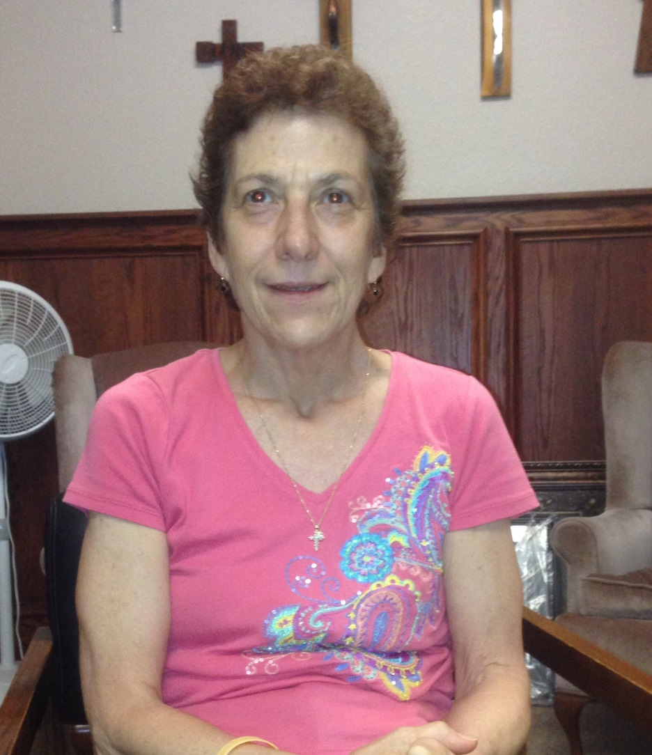
I am a forgiven child.
Susan said, “When I understood that Jesus Christ died for me personally, I was freed from my slavery to myself. I no longer felt I had to judge myself, fix myself or punish myself.”

Slide 8
Our Passion for Christ
Freed from guilt
1Jn1:8-9
Power over sin
Rm 6:1-4
Leadership
Jn 21:18
Love
1 Pt 1:22
Purity
1 Jn 3:1-3
Sacrifice
Rm 12:1-3
The cross
Notes:
1 Peter really outlines this cycle – first the lord teaches us his gospel of Christ’s sufferings for us and his resurrection which gives us a living hope, then we are led to purify ourselves (later in chapter 1) and then we are passionate about growth in the word (cha 2) and then we are lead to use our gifts for ministry instead of worlldy passions chapter 4) - all in a book about suffering under oppression because it is all about the gospel – our passion.
Sacrifice – , Romans 12:1-3, 1 Cor 15:58

Slide 9
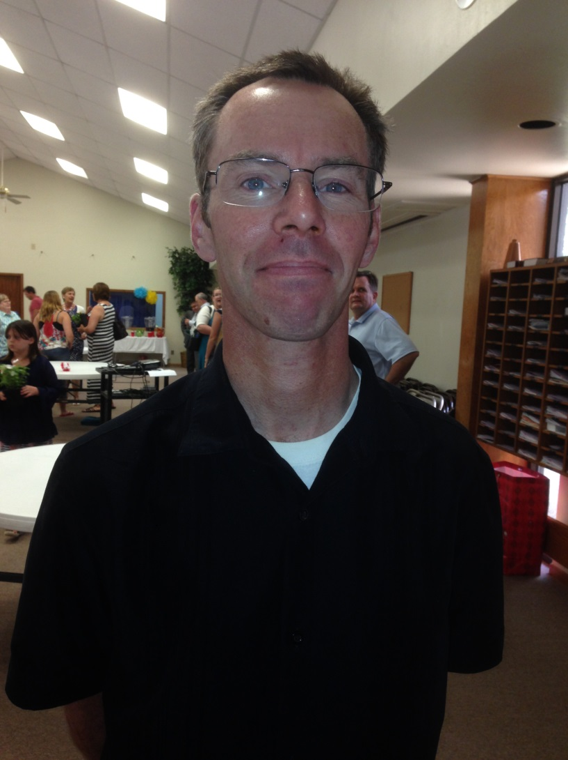
Christ Needs No Supplement
“I was an officer in the Masons and they told me that they were not a religion but that they supplemented religion. But then I started studying Scripture and one day it hit me; God doesn’t need any supplement!”
Notes:
Steve went from fear and worry about God to peace in Jesus and it led him away from the Masons and into a purity and love live – recently gave up wanting t a new self defence calss (cost money) to asking for his family to join him at church for Father’s day.

Slide 10
Discussion – Session One
What points from the last session made an impact for you and why?
How did Jesus’ passion show up in the Old Testament?
What application of Christ’s passion will you share with someone you love when you get back home?

Slide 11
Discussion – Session One
How does Christ’s passion make you passionately trust him?
What does a passionate Christian life look like?
What does suffering with Christ have to do with sustaining a good attitude in hard times?
In what area of your life do you have a renewed desire to serve God passionately?

Slide 12
Break

Slide 13
Passionate Leadership
Every Christian is a leader of some sort
Isaiah 32:1-2
Christ gets his work done through leaders Ephesians 4:11-13
Leaders live on the cross with Christ
John 21:18
Leaders never retire from leading – Rev. 1:9-11
Leaders welcome insight into their own behaviors – (Abraham, Moses, David)
Notes:
Joey koelpin email
I am going to die for you – mark feldman

Slide 14
Passionate Leadership
What does a passionate leader look like?
Driven by Christ’s passion
Living on the cross of self sacrifice
Committed to the cause until death
Notice: We did not talk about personality and intelligence.

Slide 15
Passion Needs Knowledge
“It is not enough to do your best. You must know what to do and then do your best.”
– W. Edwards Deming

Slide 16
The Great Passionate Commission
Go and make disciples of all nations, baptizing them in the name of the Father and the Son and the Holy Spirit, teaching them to keep safe as a treasure everything I have handed down to you. And surely I am with you always to the very end of the age.”
What do these words mean for passionate ministry?
Notes:
Our mission is to make disciples – that is to find the lost, give them the gospel, baptize them into the church and teach them what Jesus taught us that saves their lives – teach and reteach. – keep safe not build buildings, sustain institutins, play social clubs – these can fit into making disciples but if they don’t then shoot the dog

Slide 17
Passionate Leaders Constantly Grow
A Christian is in a constant state of repentance and change.
Passionate Leaders constantly grow in knowledge.
Passionate Leaders constantly grow in skills.

Slide 18
Discussion Session Two
What points from the last session made an impact for you and why?
Tell of a passionate Christian leader you know and how that person has changed you?
What will you do to recapture your passion for Christ’s ministry when you get back home?
What ministry knowledge or skills do you hope to improve after today?

Slide 19
Break

Slide 20
Revelation 2-3- Letters to the Churches
“You abandoned the love you had at the first”
- Ephesus
“You have a reputation of being alive and are dead” – Sardis
“You are neither cold nor hot” – Laodicea
“I stand at the door and knock.” - sanctification

Slide 21
3. Passionate Churches
Persistent Gospel Outreach – Saving Lives
Well Rounded Spiritual Growth – Changing Lives
Affecting Culture – Changing the world. (Acts 2)

Slide 22
Asking the Right Questions
I am more concerned about the questions you are asking than I am about the individual answers you will find along the way.
If you ask the wrong questions you will get the wrong answers every time.

Slide 23
Persistent Gospel Outreach
What does it take to gain an audience from the lost
around your church?
What are you doing to get an audience from the
lost?
Come strategies
Go strategies
How effective are you at getting an audience from
the world?
Notes:
This would be a good place for nate wordells email with Darin Wrnecke.
For robust teaching – matthew 28:19-120 – Jesus said to make disciples by teaching them to treasure and keep safe everything he handed down to us.

Slide 24
Persistent Gospel Outreach
Describe your evangelism follow up system? (defined, repeatable,
traceable process)
Who is in charge of your outreach ministry? (Champion)
How will you measure effectiveness accurately?
What will it take to change the way you do things in order to get a
bigger audience from the world?
How many people have taken Bible Information Class at your church
in the past three years?
What is your system for moving a visitor toward membership?

Slide 25
Well Rounded Spiritual Growth
How many different ways are you teaching God’s word?
(Forms, forums, media, approaches, teachers)
How are you connecting people with God and each other? (Small groups,
midweek Bible study, social media)
How can you have more compelling worship at your church? (preaching,
music, communication forms)
What group in your flock is getting the least amount of the word? How will
you change this?
What will you do to help more members live on mission passionately? (1 Cor 15:58)
What is your continuing education policy, culture or expectation for
your staff?
Notes:
Here are some questiions for evaluating your situation not to establish whether you are to be encouraged or discouraged - we get our encouragement from Christ’s promises not from our evaluations –
About “what group” you could divide the flock into age groups nd list what you are doing for each one to see how you are doing.

Slide 26
Numbers – are an indirect measurable that tell you some things but don’t tell you everything.
How many outreach calls does your pastoral staff make each month?
How many outreach calls does your laity make each month?
How many members have you lost each year over the last five years?
How many members have you gained each year over the last five years?
How many of your members are in weekly, monthly worship?

Slide 27
Numbers – are an indirect measurable that tell you some things but don’t tell you everything.
How many of your members attend Bible Study each week?
How many people are involved in active Christian ministry?
(1 Cor. 12:1-11)
How many lives have been changed in the last 3 years at your
church?
How will you measure “changed lives”?
How many young people have left your church to study for ministry
in the last ten years?

Slide 28
Affecting Culture
If I asked people in a five mile radius around your church how you have loved them in the last five years what would they say?
What are the biggest social issues in your neighborhoods and how can you find this out?
What troubles are your members having when they let their light shine in the world?
Notes:
Jesus said – you are the salt of the earth – if you lose your saltiness you will be worthless
Aaron glaeske “if we went away would anyone miss us in this neighborhood?

Slide 29
What will it take?
A passion driven by the Christ in us (Galatians 2:20)
An optimism protected by biblical promises and not experiences.
A passion that will not let us be dissuaded by hardship inside or outside of the church.
An ever increasing improvement of our ministry skills.
All hands on deck (body ministry)

Slide 30
Anticipate Resistance
Expect swelling anxiety whenever there is talk about falling short, needing to improve or changing what we do or how we do it.
Expect some to blame synod, the mission board, their pastor, the past or culture as if that settles the argument with resignation of defeat.
Expect some to assume that growing WELS congregations must be compromising doctrine or godly practice in order to grow
Expect some to say they will gladly accept change and then will resist it passively or aggressively later.
Expect some to demonstrate an attitude of indifference with no sense of urgency in making disciples.
Expect some to express fear of a slippery slope associating change with unfaithfulness to the Scriptures
Expect some to talk more about those initiating change than talking to them for understanding
Expect to lose some “members” of the visible organization but not necessarily the “una sancta.”
Expect some to get it and to join you with hearts excited by the gospel to make disciples.
Notes:
Sunday schools in the same church – that’s what we are --

Slide 31
Case Study - Nehemiah
Case Study - Nehemiah –
Leaders have a passion for Christ’s kingdom
Leaders depend on God in prayer
Leaders face the reality of their situation
Leaders challenge other leaders to join them
Leaders recognize the efforts of their team
Leaders enter their people’s world
Leaders engage and endure resistance
Leaders encourage the downhearted
Leaders celebrate the Lord’s victories
Leaders rebuild spiritual walls in the word of God
Leaders let the gospel predominate
Notes:
Leader engage and endure resistance – I was complaining about a job I have and thinking my leader frriend would give me permission to quit and he said ‘that sounds like a wonderful leadership challenge to grow through”

Slide 32
Case Study – Holy Word
The state of the congregation in 1992 (good, bad, ugly)
Then Started other Churches
Served the FRAN network
Neglected the Community
Developed culture but not systems
In the process of change to a neighborhood church

Slide 33
Discussion Session Three
What points from the last session made an impact for you and why?
Which of these two: outreach or spiritual growth, needs special attention right now in your church? Explain why?
List for each other what your church is doing to reach out with the gospel and steal each other’s ideas.
List for each other what your church is doing for spiritual growth of various groups and steal each other’s ideas.
What areas of worship at your church need significant change? (preaching, music, communication forms)
What are some of your fears about leading changes in your home congregation?
What will be your first steps to change the ministry of your congregation when you get back home?

Slide 34
Break

Slide 35
Making It Stick
How do we get un-stuck?
Convicted leadership – what keeps you up at night?
Honest assessment (quantifiable, – is it working?)
Outside Consultation (Jethro, CCC, Crossroads, . H.W. story)
Rejection of status quo (3 change questions)
How do we keep making progress?
1. Define the plan – what are you doing to make disciples?
2. Develop a support group – who do you hang out with?
3. Remain accountable - for working the plan -
4. Frequently and consistently measure effectiveness
Notes:
Andy Stanley – what keeps you wake at night? 150 people moving to Austin every day and in the last two years fastest growing – and we have had only 5 adult confirmands? “I see dead people.” - under conviction – getting unstuck is a choice – asking someone to help with accountability after you are convicted to get unstuck
Honest assessment – is it working – the curse of anecdotes
Rejection of Status quo? - what must not change, what can change? What must change?

Slide 36
A Take Home Plan
What three things will we do to convict our leadership of the need for change?
What three things will we do to honestly assess our effectiveness in making disciples?

Slide 37
A Take Home Plan
Who are the three possible consultants that we could get from outside our congregation to give us an objective evaluation of our ministry?
How and when will we create a ministry plan for our congregation?
Name three people that will be an outside support group for ongoing ministry enhancement.

Slide 38
A Take Home Plan
What three things cannot change about the status quo of my congregation’s ministry?
What three things may need to change about the status quo of my congregation’s ministry?
What three things must change about the status quo of my congregation’s ministry?

Slide 39
A Take Home Plan
What are the indirect measurables we will use to know that our disciple making plan is working?
Where are the benchmarks we hope to realize if our plan is effectively working?
In what leadership groups will we evaluate the measurable data and adjust the ministry plan?

Slide 40
Closing Encouragements
Stay on point - Making Disciples
Leadership MUST be convicted and convinced
What “should be” trumps “what is”
Growth and change are not optional
Mission trumps institution
We have to gain an audience
Vocation trumps organizational mission
The means of grace will work if you let them
Notes:
Check out bluefish on Nehemiah
The marks of the church and confidence – Romans 10:17 it is the word that creates faith, 2 Cor 4 – we speak for God, prophet to Mannasseh – I can only say what God tells me to, Hebrews 4:12 – It is living and powerful, 2 Timothy – you have known since birth and it is able to make you wise to salvation – I am dying and this is what I say. – useful for all these things.
Stay on point – making disciples teaching them to treasure everything I handed down to you – it is way it works – God’s word changing lives – John 17 – sanctify by truth your word is truth – robust teaching ministry

Slide 41
Never in Vain
“Therefore, my beloved brothers, be steadfast, immovable, always abounding in the work of the Lord, knowing that your labor in the Lord is not in vain.”
– 1 Corinthians 15:58
“The kingdom of God is as if a man should scatter seed on the ground. He sleeps and rises night and day, and the seed sprouts and grows; he does not know how. The earth produces by itself, first the blade, then the ear, then the full grain in the ear. But when the grin is ripe at once he puts in the sickle, because the harvest has come.”
– Mark 4:26-29

Slide 42
Consulting Resources
Commission for Congregational Counseling –
Rev. Jonathon Hein – pastorhein@gmail.com
Crossroads Ministry –
Rev. Elton Stroh – ecstroh@frontier.com
Your District Officers –
Presidium, Circuit Pastors, Mission Board, Mission Counselors, District Coordinators for Evangelism, Worship, Discipleship

Slide 43
Reading List
Advanced Strategic Planning – by Aubrey Malphurs – 9 steps model
Breakout Churches - by Thom S. Rainer – churches from mediocre to great without changing pastors
Dangerous Calling – by Paul David Trip – a compelling devotional book for pastors (Amazon)
Faithfulness and Fruitfulness – Rev. Jonathon Hein - theology versus methodology - (scd website)
Fusion – by Nelson Searcy – taking people from visitor to member (Amazon)
The Word Works – by Rev. Jonathon Hein – theology and methodology (scd website)
Traction – Gino Wickman - a plan for effective meetings and strategic organizational success (Amazon)
Turn Around Churches in the WELS – Elton Stroh – Research with insights (scd website)
Worship and Outreach , a Lutheran Paradigm – Rev. Jonathon Schroeder – (scd website)
Notes:
Christ made a promise that the gates of hell will not prevail against his church – he was not speaking of historical institutions like our indivdually named congregations or denominations. He was speaking of the una santa – the living organism of present beleviers – history has shown that church organizations and forms come and go – and ours is not immune – our goal is to reamin in Christ by remaining in his words from the heart, to share his love and truth with all our hearts and lives and to die a thousand deaths to complete the mission of living for him – knowing that his church is much bigger than us and will far outlast us – to really live is to live soley for Christ in everything who lived soley for us in everything – to advance his gospel and to die in the faith – under that goal we can imporve our minsitries – every one of us can improve our ministtry and with Christ promises to belss.

