Slide 1


We Plant Churches

Slide 2
Luke 14:23
Then the master told his servant,
Go out to the roads and country lanes and compel them to come in, so that my house will be full.

Slide 3

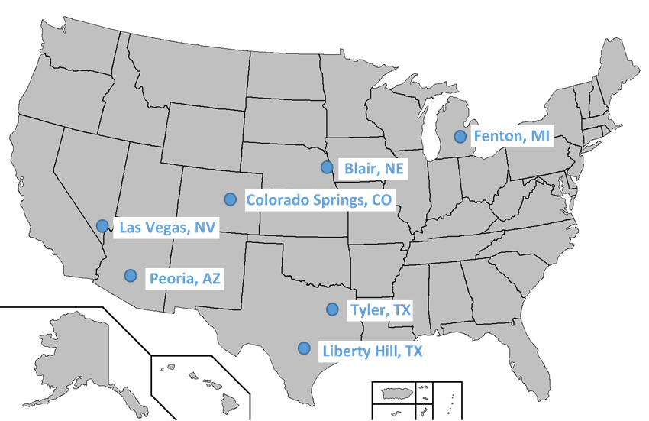
Board for Home Missions 2015

Slide 4
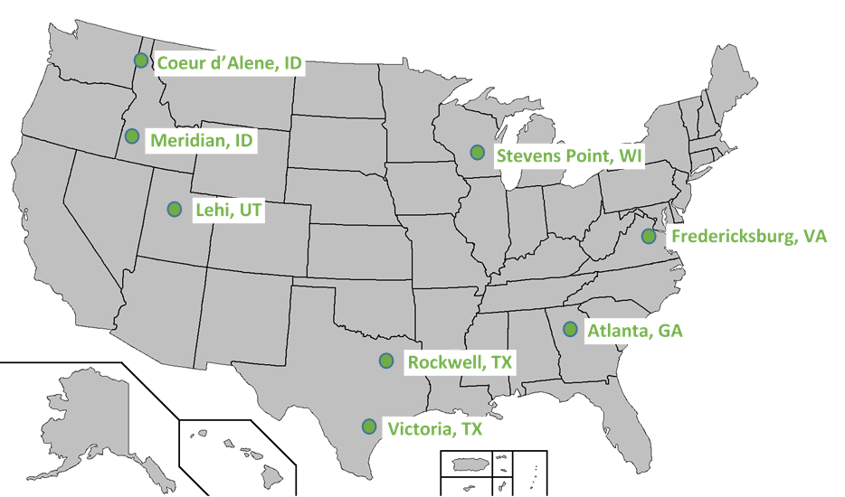
Board for Home Missions 2016

Slide 5
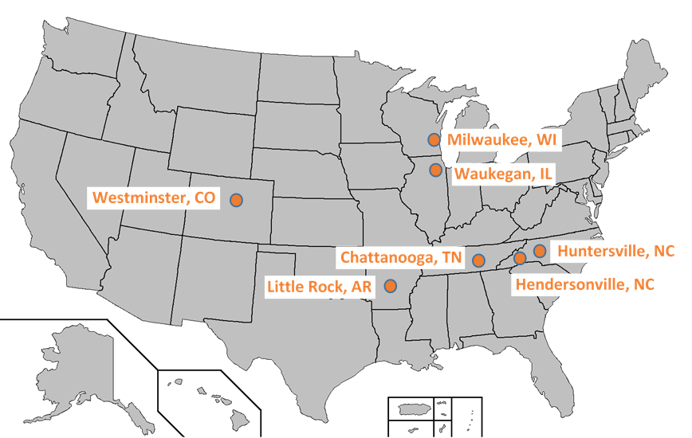
Board for Home Missions 2017

Slide 6
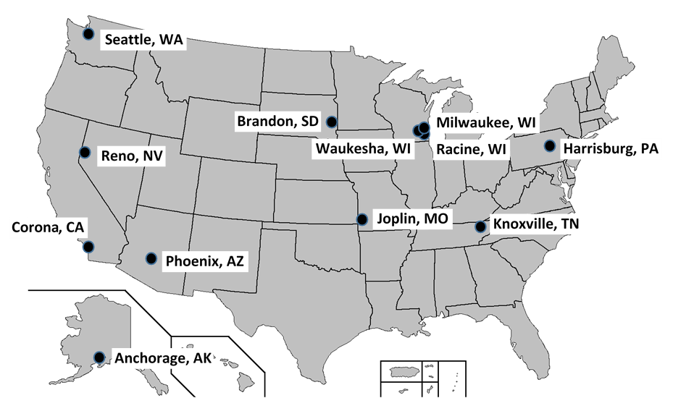
Board for Home Missions 2018

Slide 7
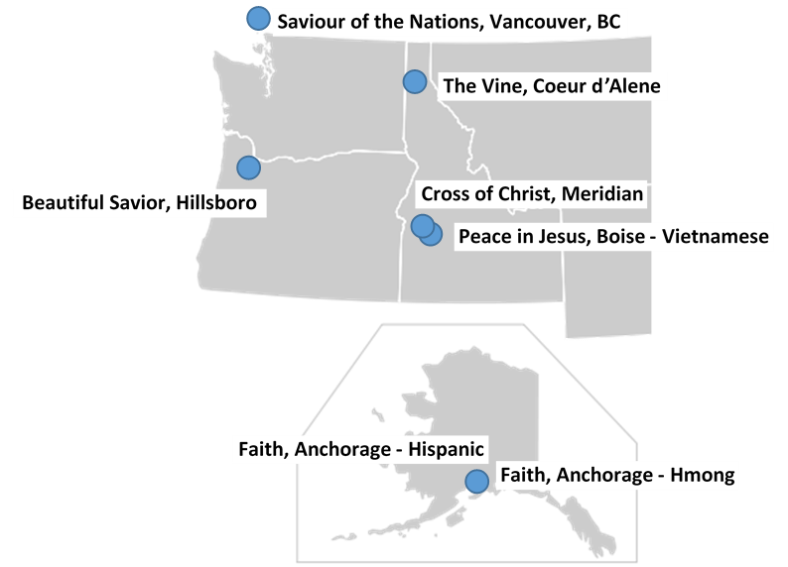
Pacific Northwest Missions

Slide 8
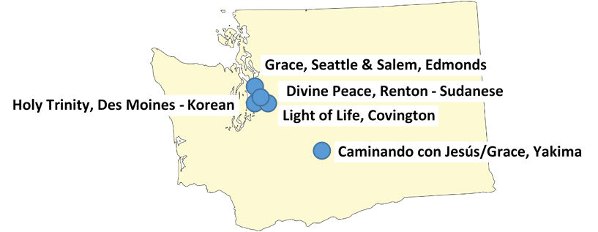
Missions in Washington

Slide 9
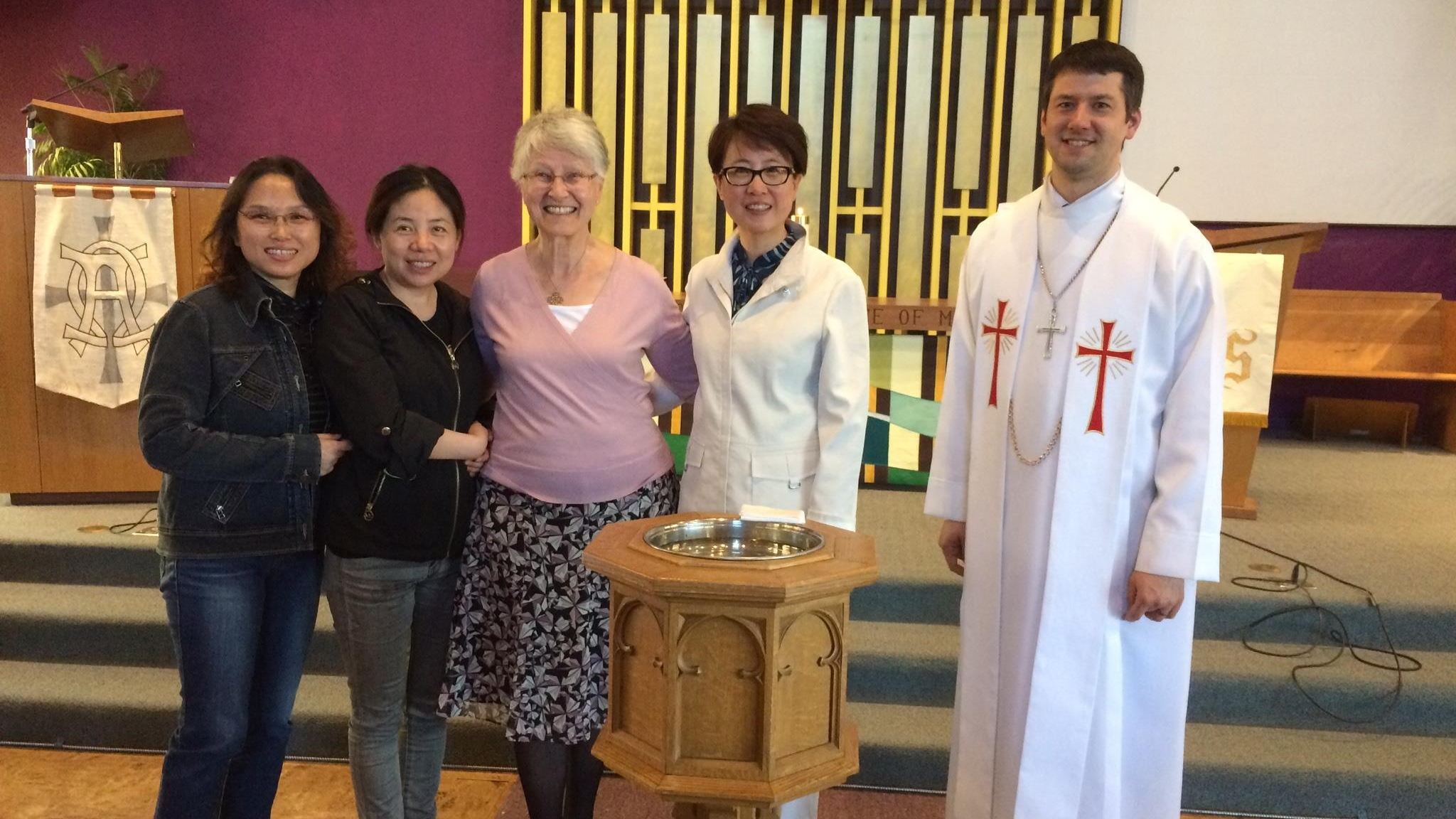


Saviour of the Nations
Vancouver, Canada
Notes:
Saviour of the Nations – Canada

Slide 10
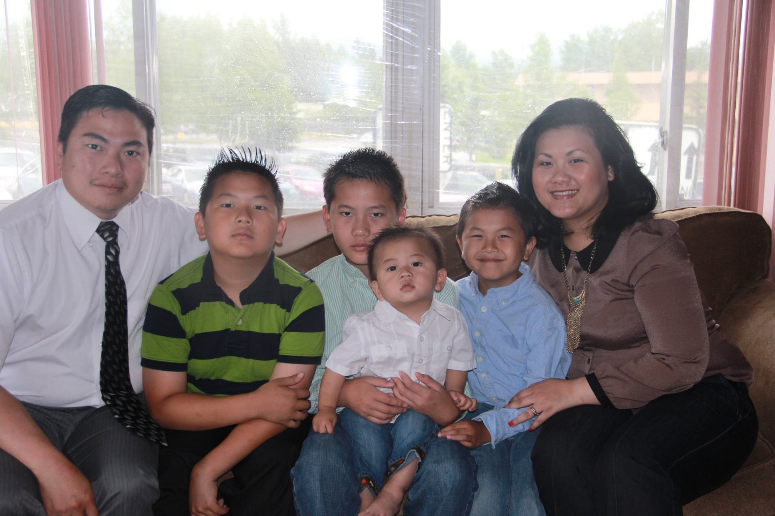


Faith - Hmong
Anchorage, AK

Slide 11
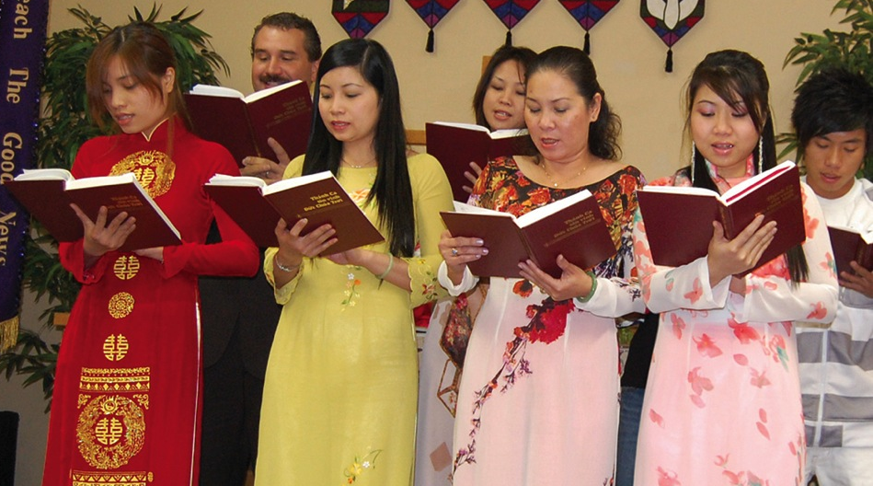

Peace in Jesus
Boise, Idaho
Notes:
Dan Kramer (in the back row) is the pastor at Peace in Jesus Vietnamese Lutheran in Boise ID. This is the only WELS Vietnamese ministry. Thanks to
a generous grant from CEF and generous gifts from WELS members, this mission has its own ministry center. Again through Pastor Kramer and members,
the life-saving gospel is reaching back to family and friends in Vietnam.

Slide 12
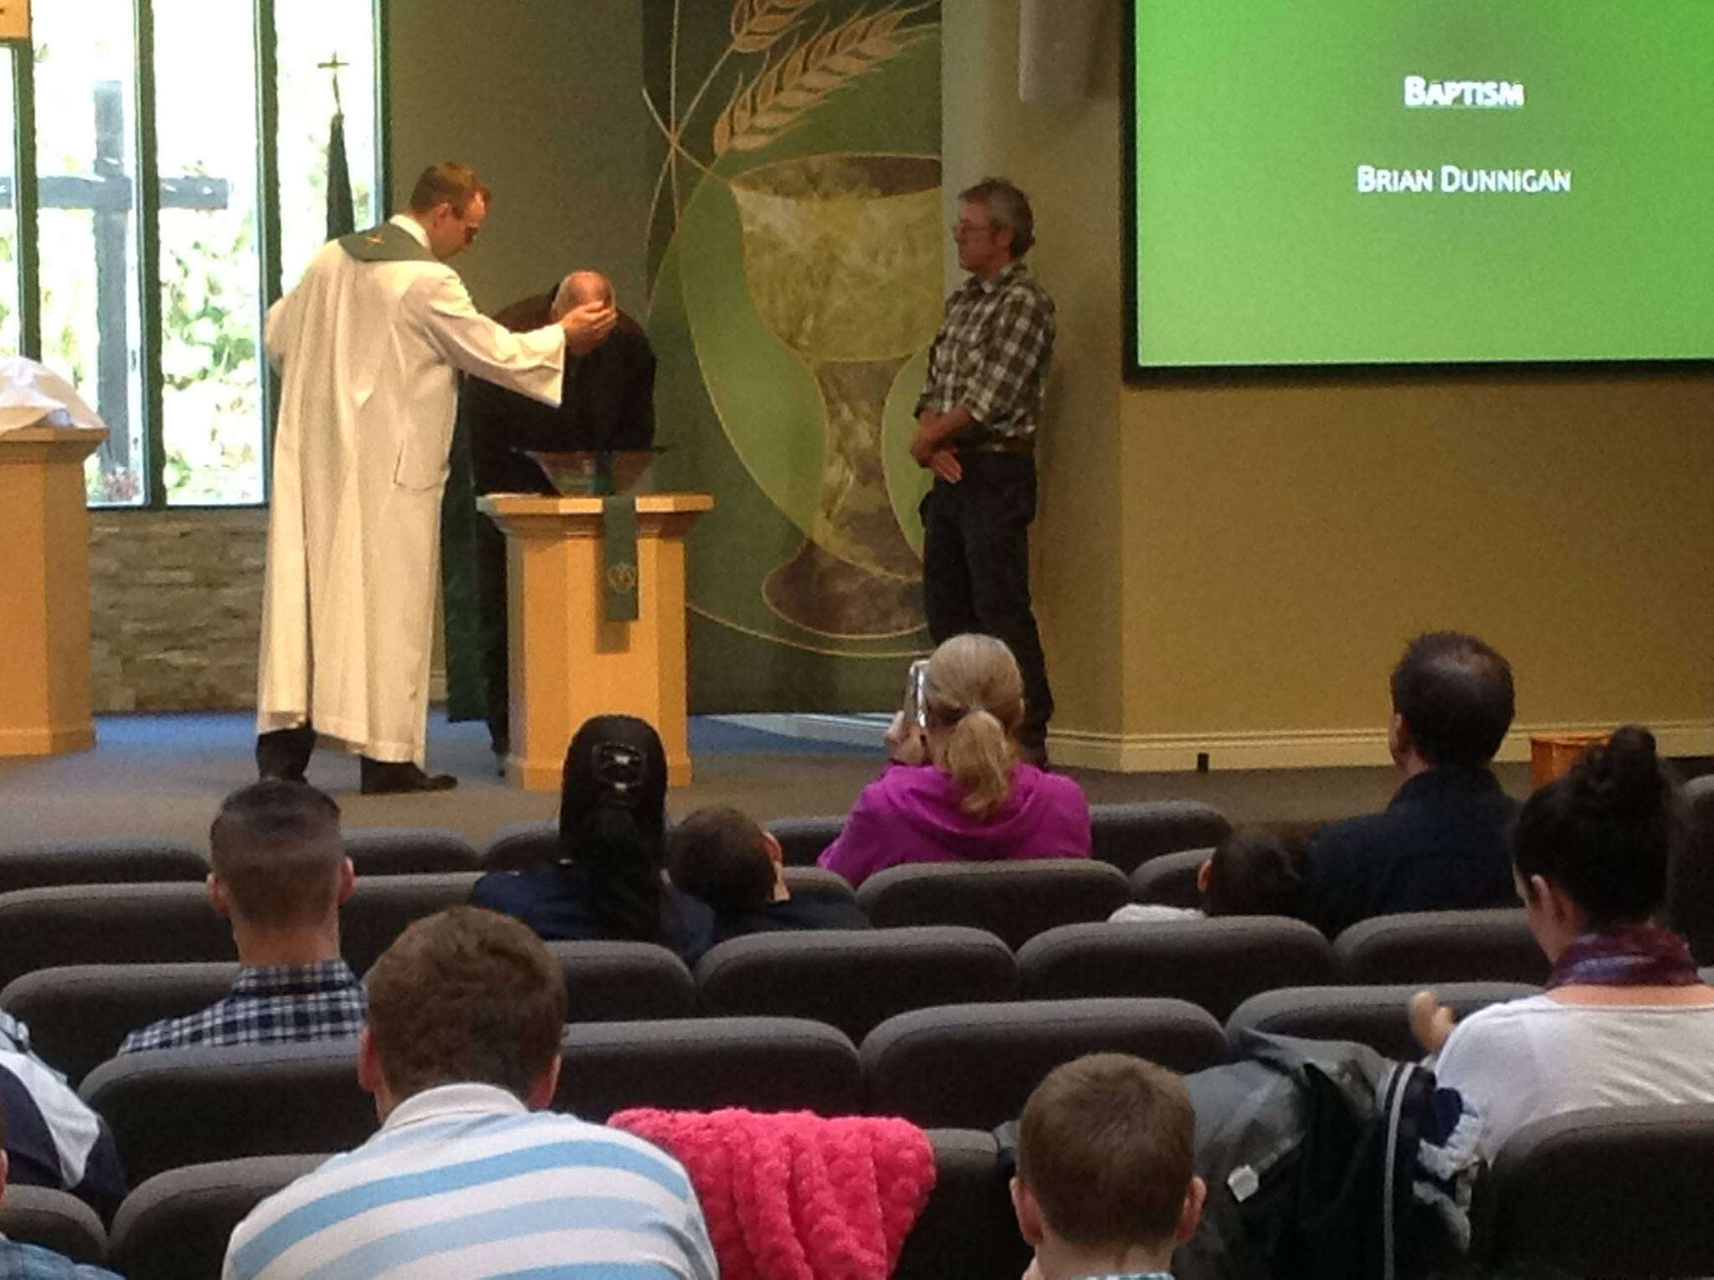
Light of Life
Covington, WA

Slide 13
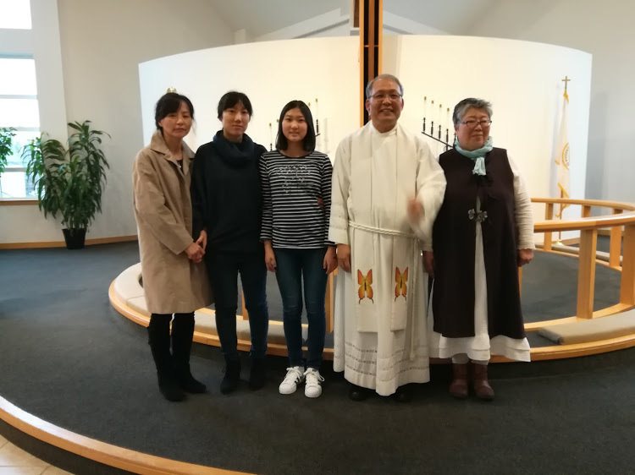
Holy Trinity – Korean
Des Moines, WA

Slide 14
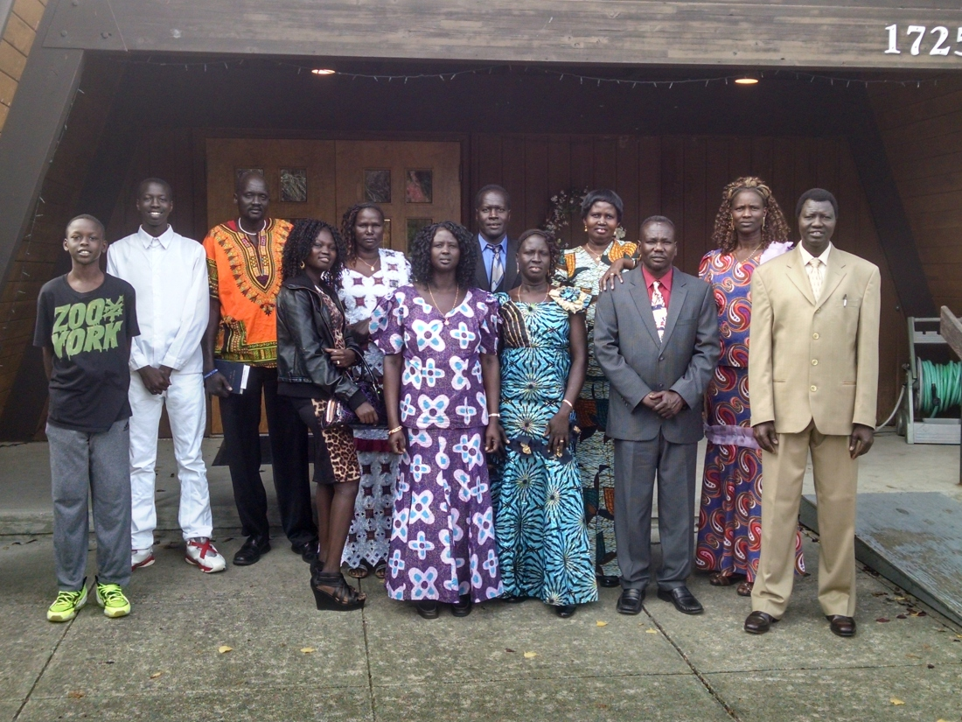
Divine Peace - Sudanese
Renton, WA

Slide 15
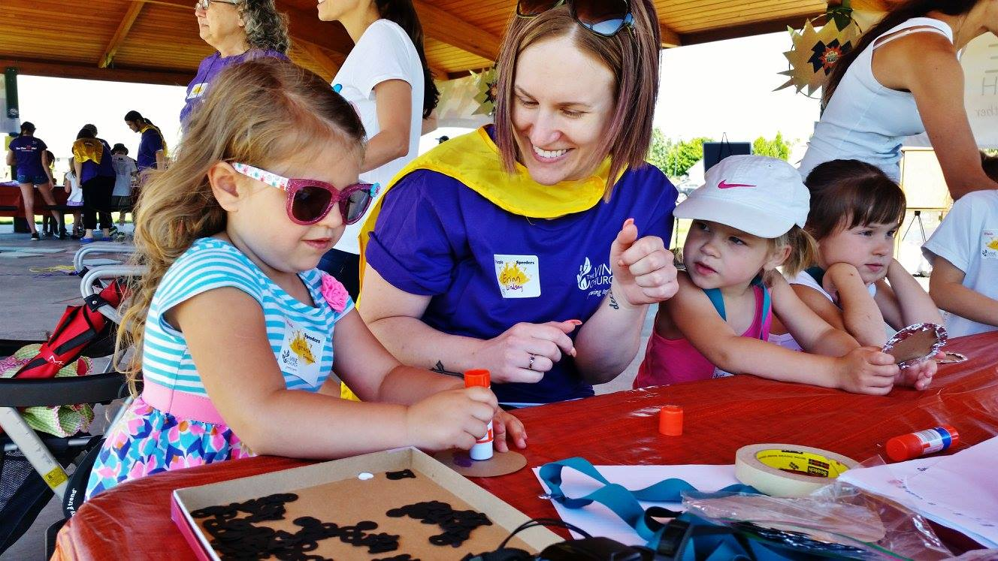
The Vine Lutheran Church
Coeur d’Alene, Idaho
Notes:
Photo: From a Saturday Bible Camp at our home mission congregation, The Vine Lutheran Church, in Coeur d’Alene, ID

Slide 16

The Eternal Question
Where will we start the next mission?
Wherever God leads us

Slide 17
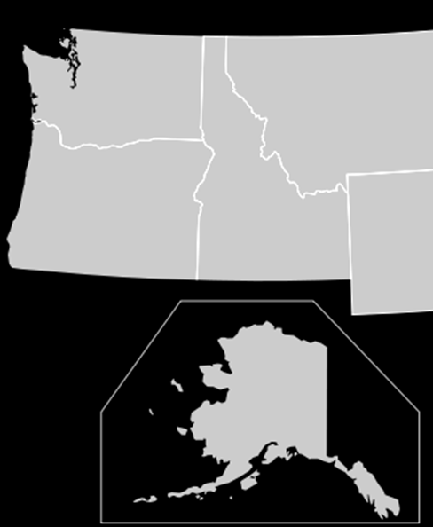
EXPLORE
Interstate 5/90/84
Population
Fastest Growing
Core of WELS People
Partnering Churches

Slide 18
ANALYZE
Community Profile
Churches in the area
Trivia: What is the ratio of Churches to population determining “churched community?
1 church for every 1000 people
Missouri Synod Churches
Nearby WELS
Growth – WELS Members – Assets- Partners

Slide 19
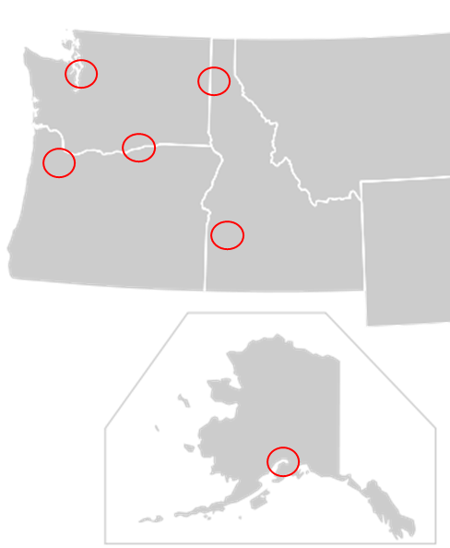
IDENTIFY
Tri-Cities,WA
Kennewick, WA
$100,000 +

Slide 20
IDENTIFY
Spokane, WA
Funds
Multi-site/Partner
No Core

Slide 21
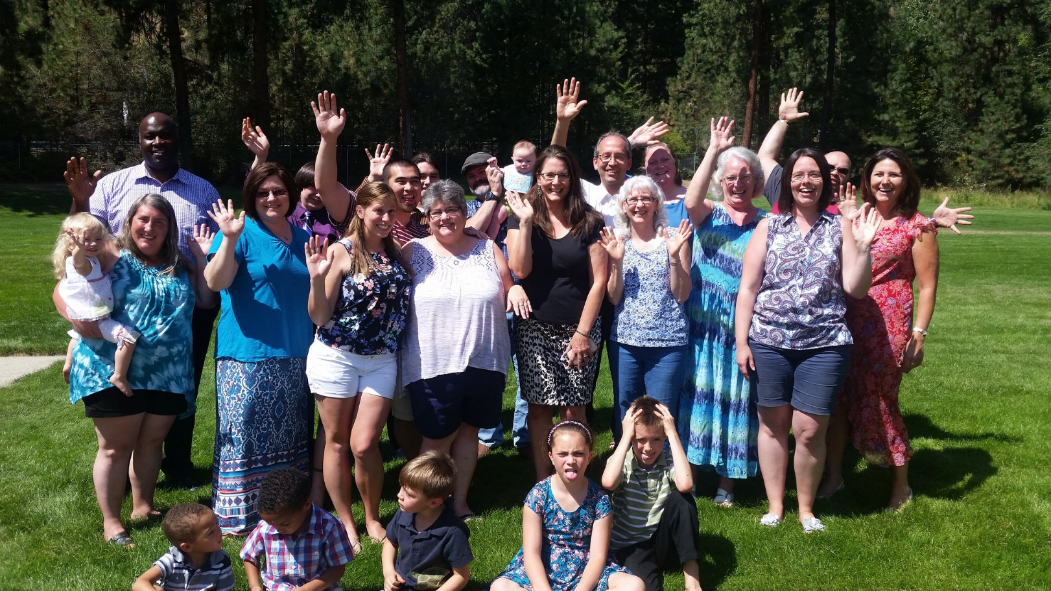
PARTNER
Core Groups
or
Launch Team

Slide 22
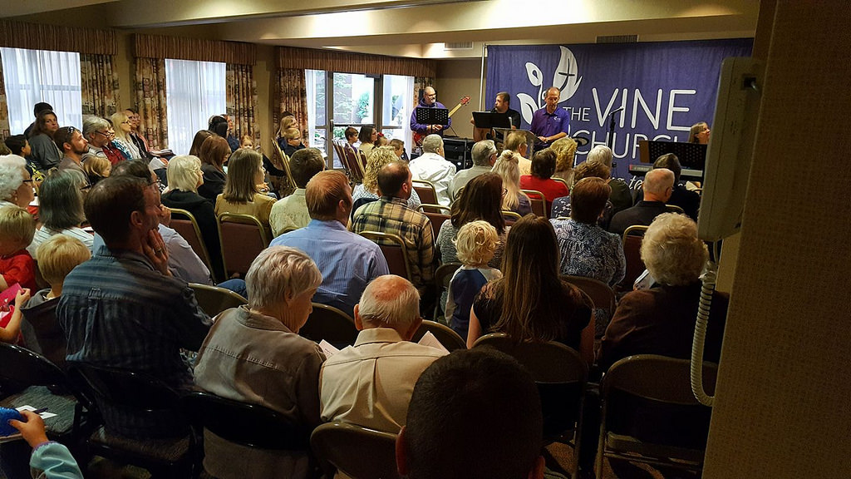
The Vine Lutheran Church
Coeur d’Alene, Idaho

Slide 23
IDENTIFY
Meridian, ID
Nampa ID
Meridian, ID
Star, ID

Slide 24
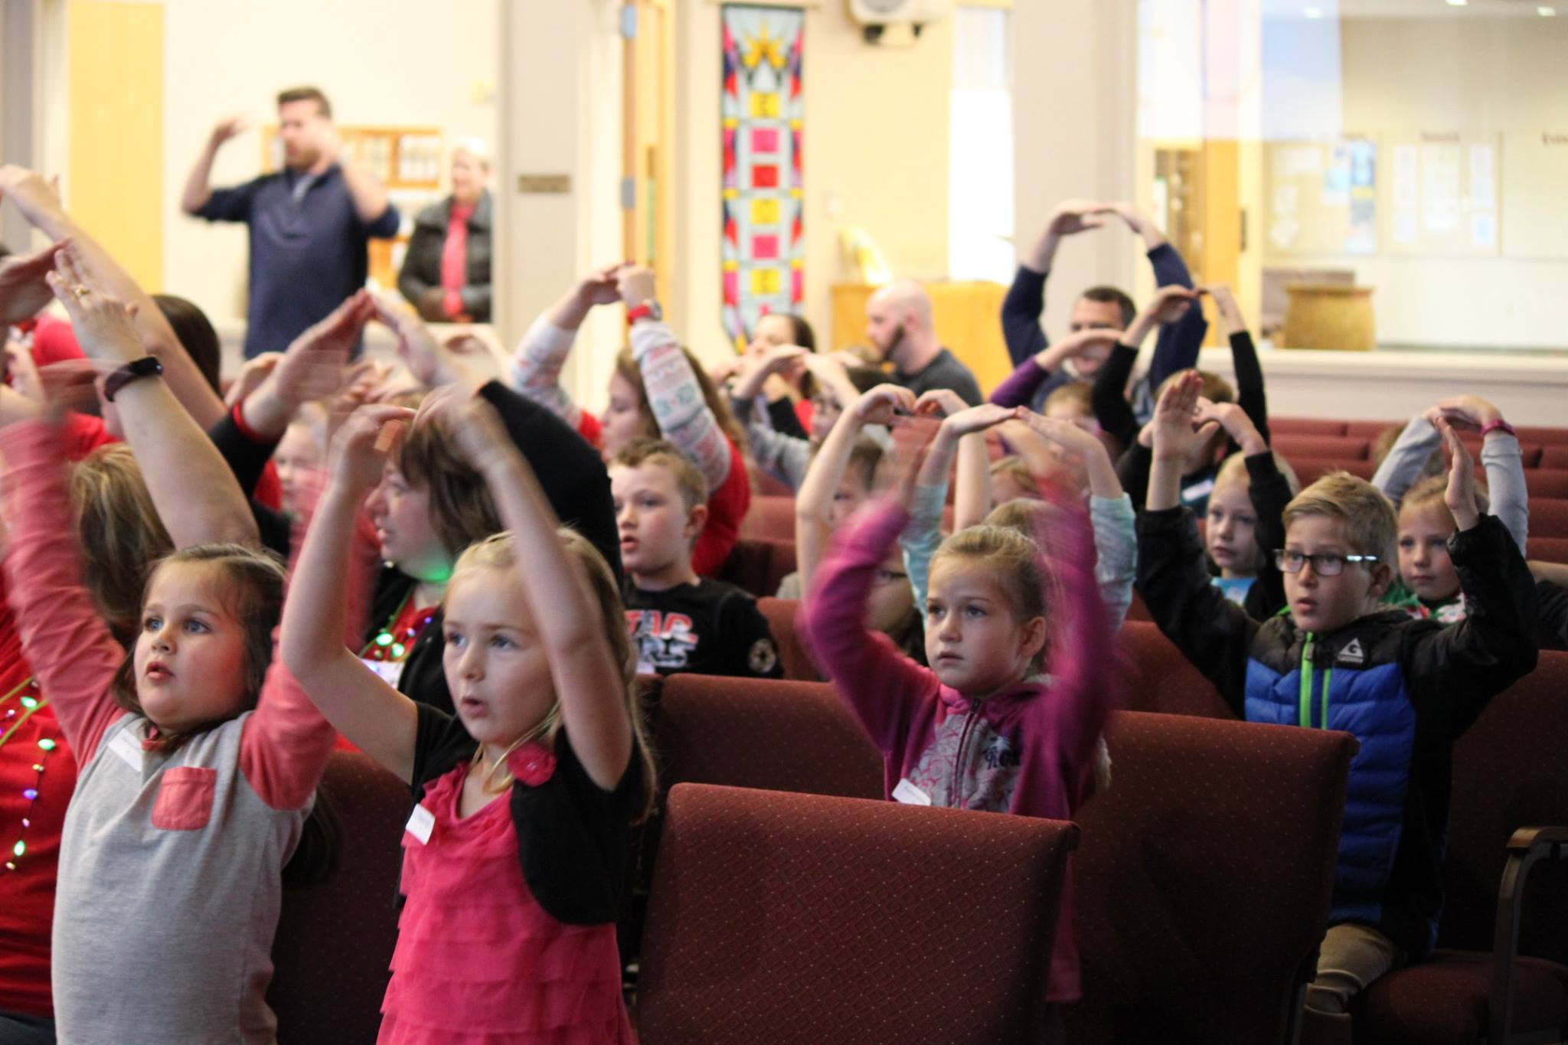
Cross of Christ
Meridian/Star, Idaho

Slide 25

Cross of Christ
Meridian/Star, Idaho

Slide 26
IDENTIFY
Alaska – Hispanic
Self Plan
Partner
Enhancement

Slide 27
Seattle, WA
Retirement
Restart
2011
2015
2017
2018
IDENTIFY

Slide 28
Board for Home Missions: BUDGET
Annual Budget:
CMO = $5,556,000
(Reductions of $150K)
CEF Endowment Distribution =
$1,137,000
Endowment Payment: = $50,000
Total: $6,693,000 million

Slide 29
REQUEST
March 1 – Deadline!!!!
28 Requests from 14 Districts
14 Funded
2 PNW Grace/Salem Seattle & Hispanic Anchorage

Slide 30
APPROVE … OR DENY
We Sit in the room and we wait for a decision: No Appeal
Example 2009

Slide 31
The Eternal Question
Where will we start the next mission?
Wherever God leads us

