Slide 1
Pacific Northwest District Convention
Wisconsin Evangelical Lutheran Synod
WELS Ministry of Christian Giving

Slide 2
Christ’s giving is joyful
For the joy set before him [Jesus] endured the cross, scorning its shame, and sat down at the right hand of the throne of God (Hebrews 12:2).
Notes:
When we consider that Jesus – God’s Son and the world’s Savior – is our Great Heritage (a heritage to treasure and share), we will look to him for pardon, power, and perseverance when it comes to growing in the grace of giving.
The heritage of Christ’s giving is one of joy regarding his status before God, his task, its fruit, and his victory.

Slide 3
A Christian’s giving is joyful
Joyfully [give] thanks to the Father, who has qualified you to share in the inheritance of his holy people in the kingdom of light (Col. 1:11-12).
Notes:
The heritage of Christian giving is joyfully thanking the Father for our blessed status and the privilege of living as his children of light – including the way we manage all that he’s given us.

Slide 4
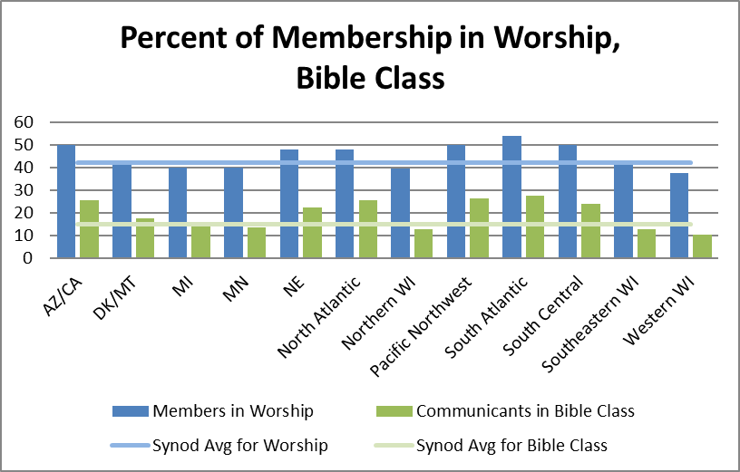
Worship and Bible study 2017
42% in worship
15% in Bible class
2.5% of income to offerings
6.5% of church offerings given as CMO
Notes:
Note the fruit of those who rejoice in the Lord! Average worship attendance and Bible class attendance in 2017 hold steady from 2016. Personal income to offerings stayed the same. Church offerings given as CMO is slightly down from 6.6% in 2016. (CMO + Other gifts to WELS = 7.1%.) There’s room to grow in all these areas; let’s ask our gracious Savior to increase our joy in his salvation!
2.5% income figure—based on WELS 2017 Statistical Report and the U.S. Dept. of Commerce Bureau of Economic Analysis (divided per communicant giving figure for synod by U.S. per capita income). 6.5% CMO figure—based on figures from WELS 2017 Statistical Report.

Slide 5
Congregation Mission Offerings
2017 offerings totaled $21.4 million. This was 0.7 percent above commitments and 1.4 percent above prior year receipts. Pacific Northwest District: $525,334 (106.9 percent).
2018 subscriptions point to a decrease of 0.5 percent from 2017 actual offerings.
We thank the Lord and his people for these gifts and commitments.
Notes:
We’re truly grateful to our heavenly Father for the wonderful thank offerings his congregations gave him in 2017 for his worldwide work through our church body--$21.4 million.
Pacific Northwest District in 2017 gave $525,334 in offerings, 106.9 percent of the $491,538 projected – an average per communicant of $100.81.

Slide 6
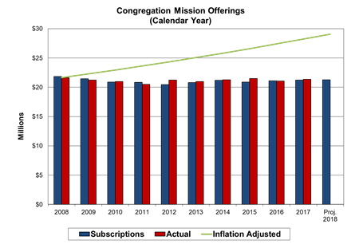
Congregation Mission Offerings
Year to year CMO have remained level while communicant membership has gradually declined.
Notes:
It is evident that God’s people glorify Jesus through their Congregation Mission Offerings. When we consider the gradual decline in our communicant population, we do well to praise our Savior for enabling his people to give as generously as they do. At the same time, let’s also recognize that our CMO aren’t keeping up with the approximately 3.5% annual increase in the cost of maintaining our present level of ministry. Let us ask God for his blessings of contentment, trust, and joy as we encourage growth in CMO and additional gifts from individuals.

Slide 7
Congregation Mission Offerings
When setting CMO, aim for 10% of offerings.
If at or above this goal, encourage your congregation to maintain its generous support or consider increasing it as you’re able with God’s blessing.
“Excel in this grace of giving….For you know the grace of our Lord Jesus Christ” (2 Corinthians 8:7,9)
Notes:
When setting CMO, we encourage all our congregations to joyfully consider designating 10+percent of general offerings for CMO. The reason? Because you know the grace of our Lord Jesus Christ! Also, it’s the foundational source of synod support.

Slide 8
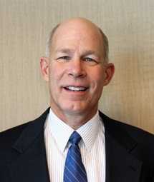
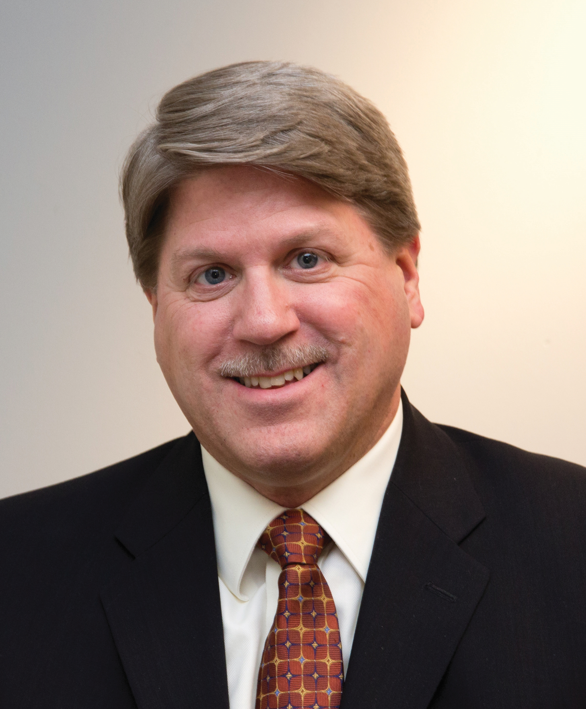
Individual offerings
Your giving counselors:
Rev. Phil Spaude, Current Gifts
Phone: 612-720-1323
E-mail: philip.spaude@wels.net
Rev. Michael Hatzung, Deferred Gifts
Phone: 612-280-4491
E-mail: michael.hatzung@wels.net

Slide 9
Individual offerings
In fiscal year 2016–17, WELS Christian giving counselors (11.8 full-time equivalents) conducted 3,119 free, confidential visits with God’s people that helped facilitate $5.4 million in gifts received and $45.8 million in gifts expected for WELS.
Notes:
In fiscal year 2017–18 (through March), WELS Christian giving counselors (12.52 full-time equivalents) conducted 2,420 free, confidential visits with God’s people and 244 presentations (Christian stewardship, Christian estate planning, or WELS Mission and Ministry) that helped facilitate $4.8 million in gifts received for WELS and $16.4 million in deferred expectancies for congregations, synod, and other WELS organizations.
Jesus is blessing our service to his people and him!

Slide 10
Individual offerings
Notes:
Numbers from WELS Statistical Reports. Individual offerings are offerings to WELS beyond those remitted by active congregations or their sub-organizations. These include gifts from individuals, foundations, closed congregations, etc. What amazing evidence of joyful generosity!

Slide 11
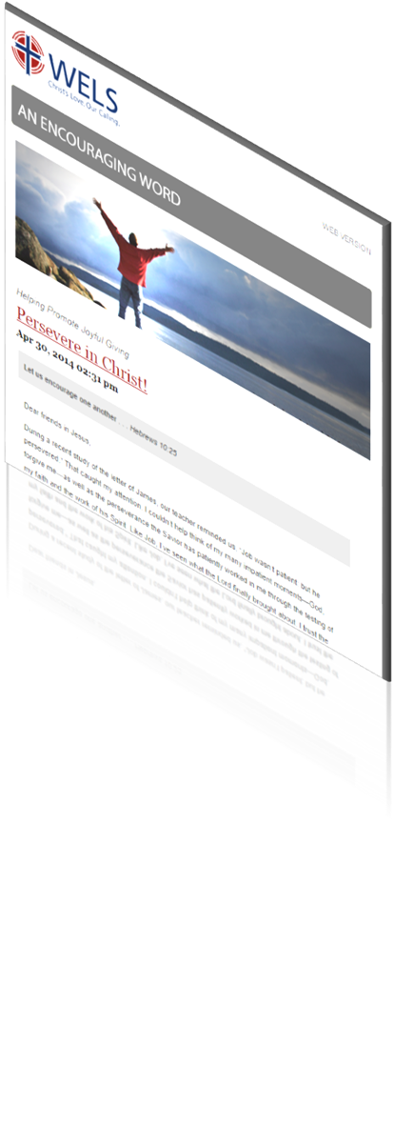
Resources
An Encouraging Word
Stewardship tips
News and updates on resources
Prayers for synod ministry
“Stewardship by the Lectionary” devotionals based on weekly readings share God’s stewardship truths according to the pericope
Cut and paste planned giving articles
wels.net/subscribe
Notes:
We feel privileged to provide biblical resources for stewardship encouragement. For all of these resources go to Ministry of Christian Giving’s resource center on wels.net. To subscribe to Encouraging Word go to wels.net/subscribe.

Slide 12
Resources
Stewardship program: Joyful Generosity
Worship helps
Bible study
Personal devotions
Shares the Bible’s clear teachings on the management of our possessions
wels.net/stewardship
Notes:
This program was written by two MN District pastors, and is based on the WELS School of Stewardship materials (2008).
WELS Ministry of Christian Giving, WELS Discipleship, and Northwestern Publishing House worked together to prepare and send a survey to parish pastors in April to learn the needs of congregations related to teaching stewardship. The results of the survey will guide the planning of the next stewardship program in 2019.

Slide 13
Resources
Congregational planned giving program
A guide for encouraging planned giving in your church using synod resources and the assistance of your local giving counselor
Includes “quick starts” to promoting planned giving and setting up an endowment as well as more complex options
wels.net/plannedgivingprogram
Notes:
The congregational planned giving manual gives practical advice for regularly encouraging planned giving in your congregations and lists the free resources that are available to you. (It also explains how to set up a congregational endowment fund, whether doing this quickly and easily through WELS Foundation or administering your own.)

Slide 14
Resources
Mission and Ministry Sunday, October 21, 2018
WELS will provide worship, Bible study, and other resources to aid in a traditional-style mission festival.
Let’s recommit ourselves to Christ’s Great Commission locally and through the opportunities God gives us as a synod.
Special offerings can go to a designation chosen by the congregation or to “WELS Mission and Ministry” that supports our daily gospel work.
mcg.welsrc.net/mission-festival

Slide 15
Scriptural encouragement
Rejoice in the Lord always. I will say it again: Rejoice (Philippians 4:4)!
Notes:
As we grow in the grace of Christian giving, may the Holy Spirit enable us to rejoice in Jesus always to his glory, our good, and the benefit of souls around the world!

