Slide 2
Improved Church Communication
CORNER
TECH
With FREE Technology
With Rob Guenther

Slide 3
Ever hear something like this…?
“The meeting was last night? I thought it was next Thursday. Why didn’t anyone tell me when it was?”

Slide 4
Ever hear something like this…?
“I didn’t know we had a financial shortfall. If only someone would communicate these things, I would give more.”

Slide 5
Ever hear something like this…?
“Pastor, I never know what’s going on around here. If I’m not on the council no one tells me what’s happening.”

Slide 6
Improved Church Communication
CORNER
TECH
With FREE Technology
With Rob Guenther

Slide 7
Improved Church Communication
“Come” Strategies
“Go” Strategies
Evangelism Strategies
Christmas for Kids
Community Parade
Oktoberfest
Saturday Market
Communication Strategies
Website
Emails
“Intranet”
Facebook

Slide 8
Improved Church Communication
“Intranet” Defined
vs. Internet
Merriam Webster: “a network operating like the World Wide Web but having access restricted to a limited group of authorized users (such as employees of a company)”
Open access (no logins), but not advertised.
e.g. www.GraceLutheranKenai.com/Minutes

Slide 11
Improved Church Communication
“Intranet” Examples
e.g. www.GraceLutheranKenai.com/Worship
e.g. www.GraceLutheranKenai.com/Ushers
e.g. www.GraceLutheranKenai.com/Thanksgiving
e.g. www.GraceLutheranKenai.com/Minutes (Digital File Cabinet)

Slide 12
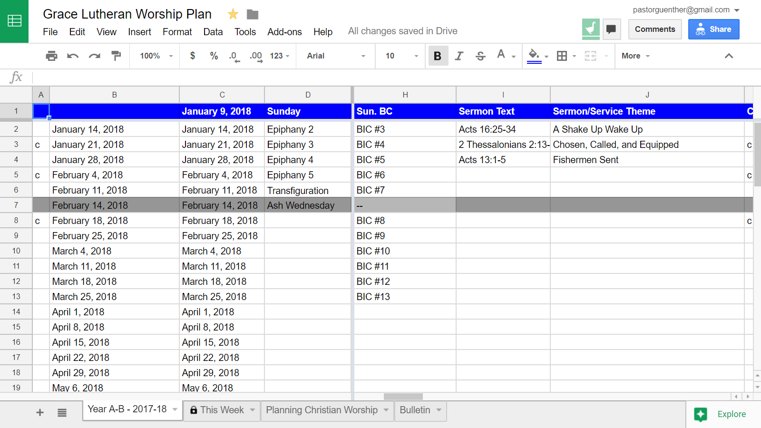

Slide 13
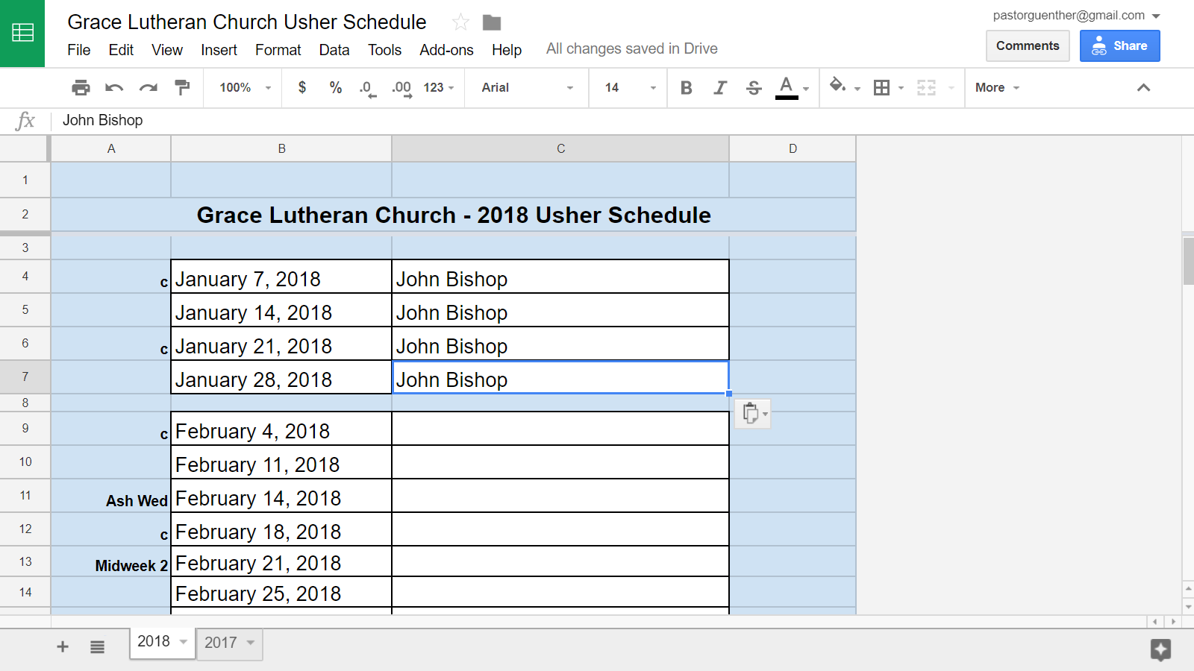

Slide 14
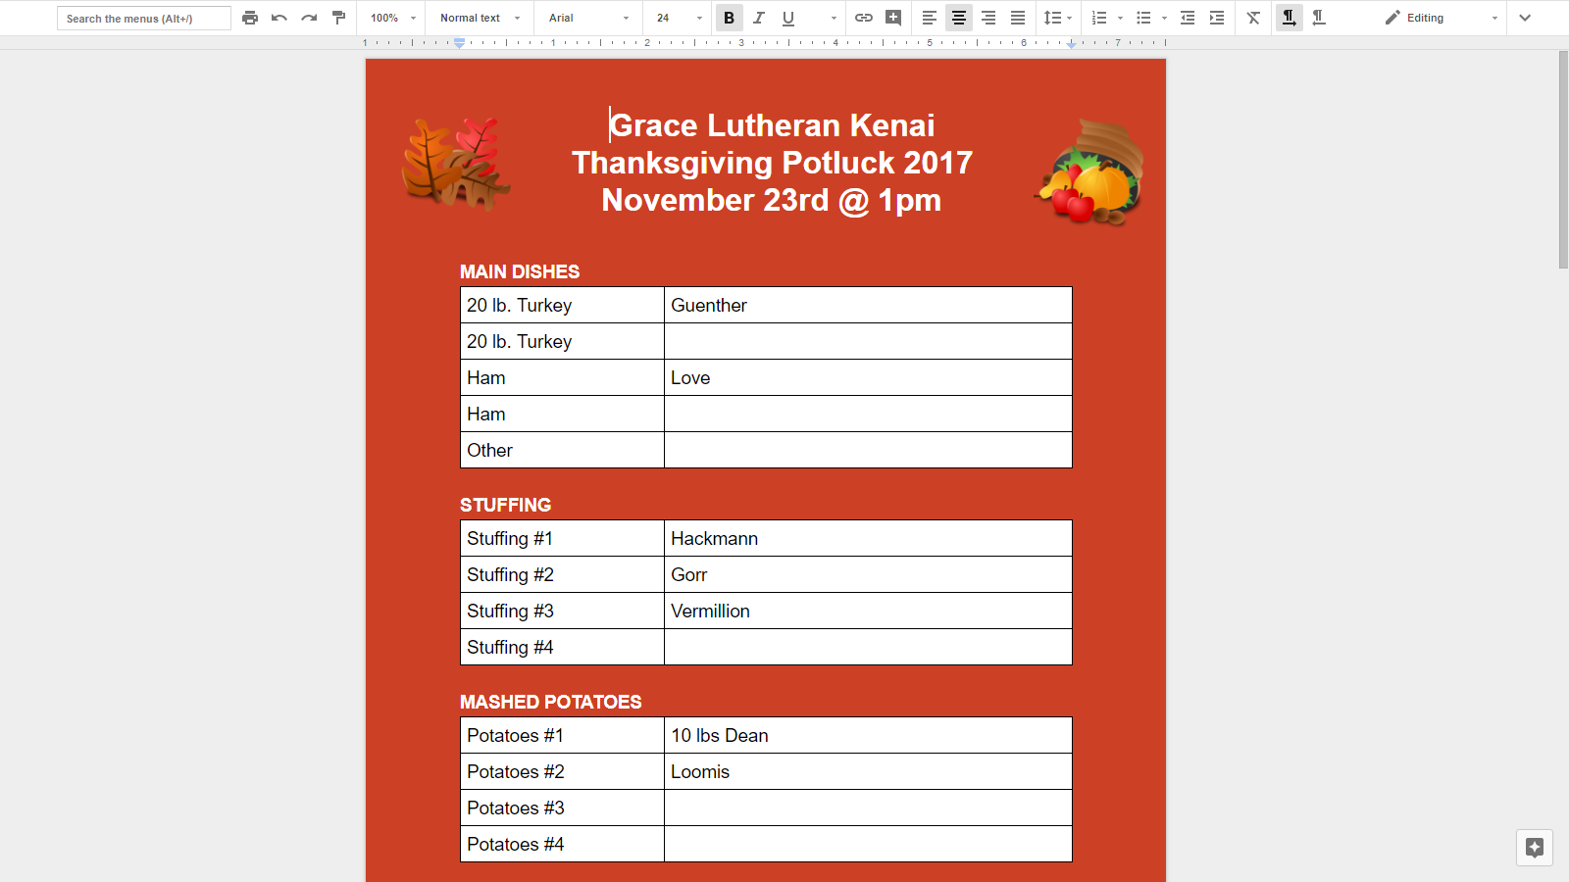

Slide 15
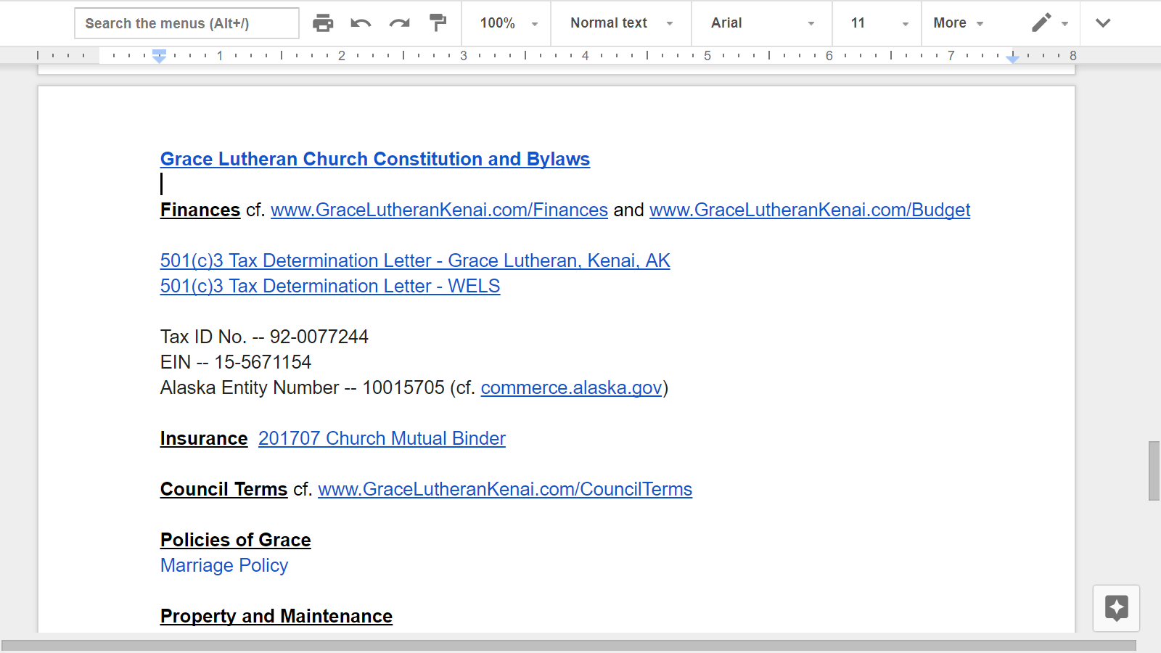

Slide 16
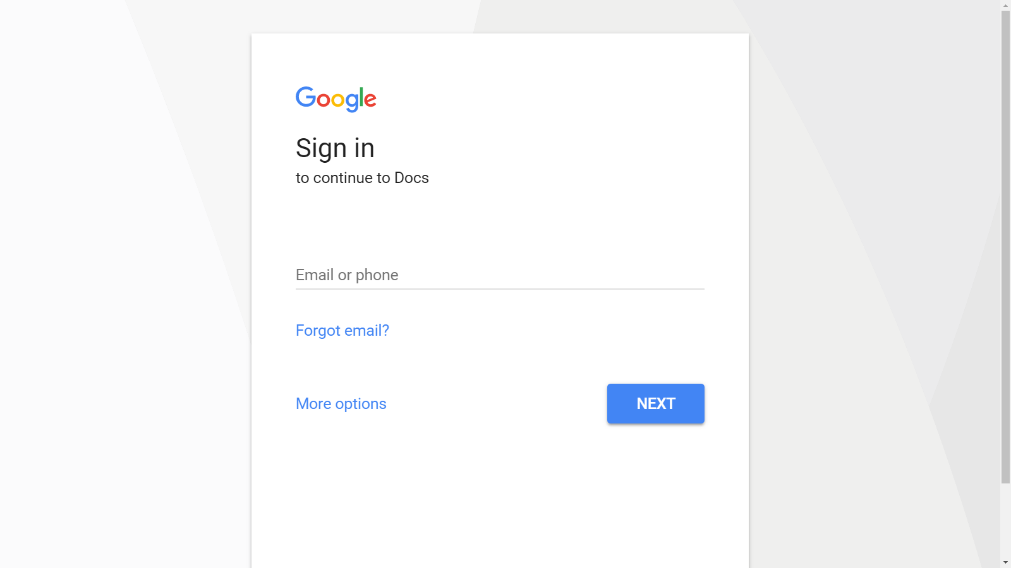

Slide 17
Improved Church Communication
Other “Come” Strategies
e.g. www.GraceLutheranKenai.com/Webcast
e.g. www.GraceLutheranKenai.com/Podcast
e.g. www.GraceLutheranKenai.com/Sermons

Slide 18
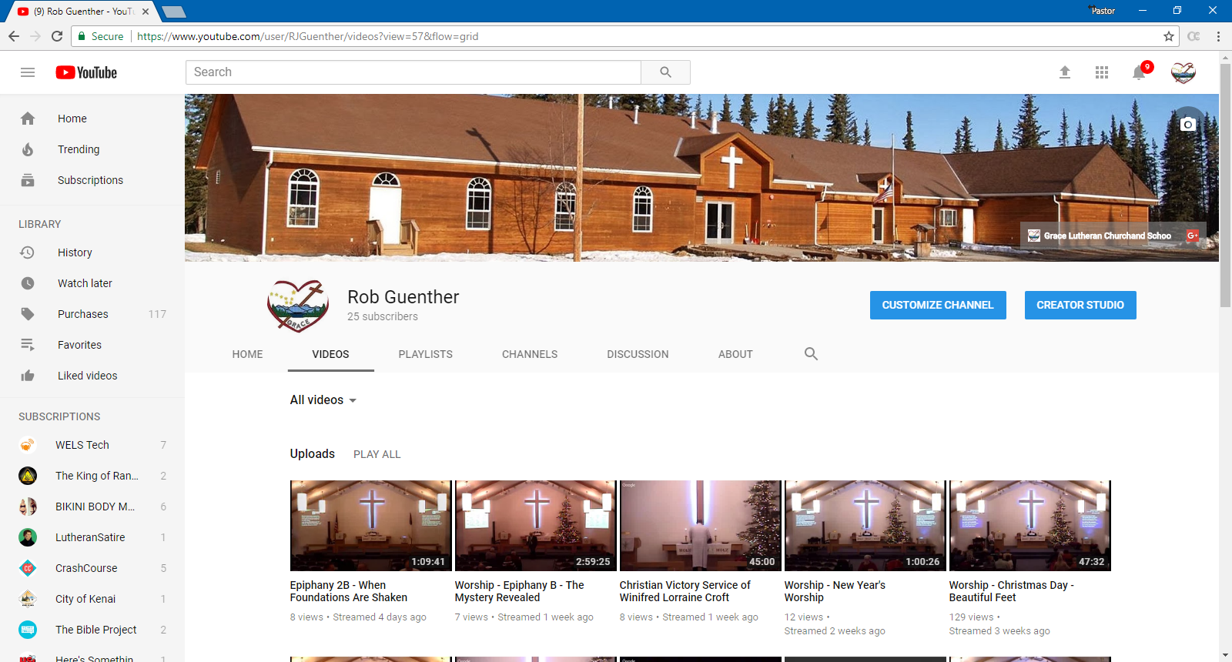

Slide 19
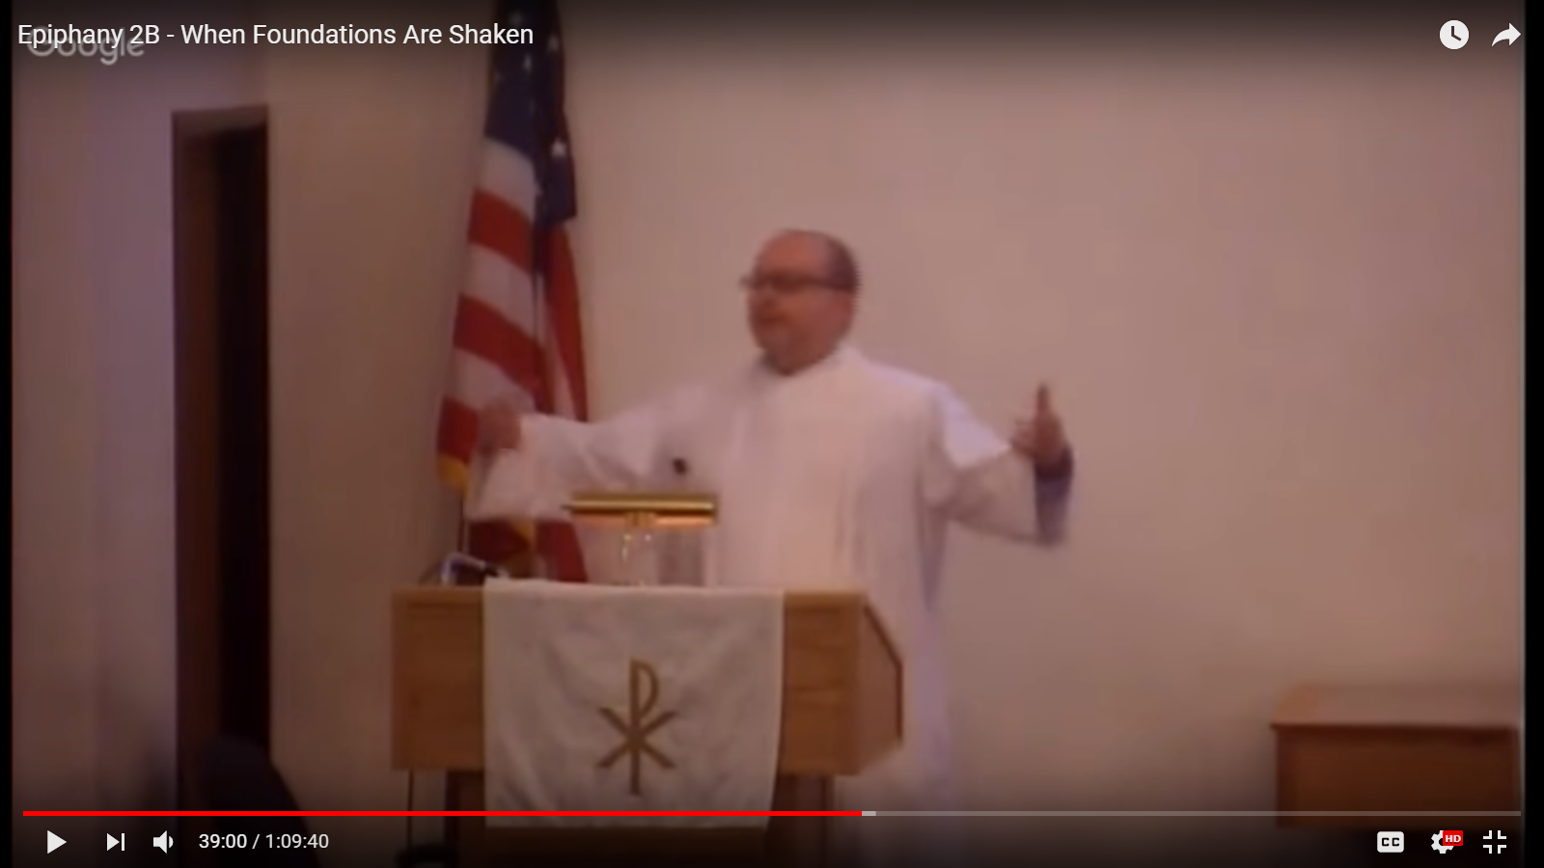
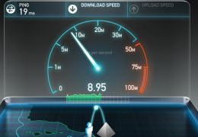

Slide 20
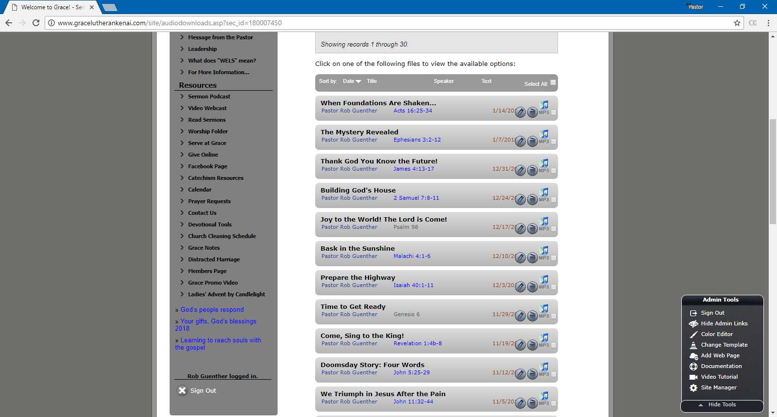

Slide 21
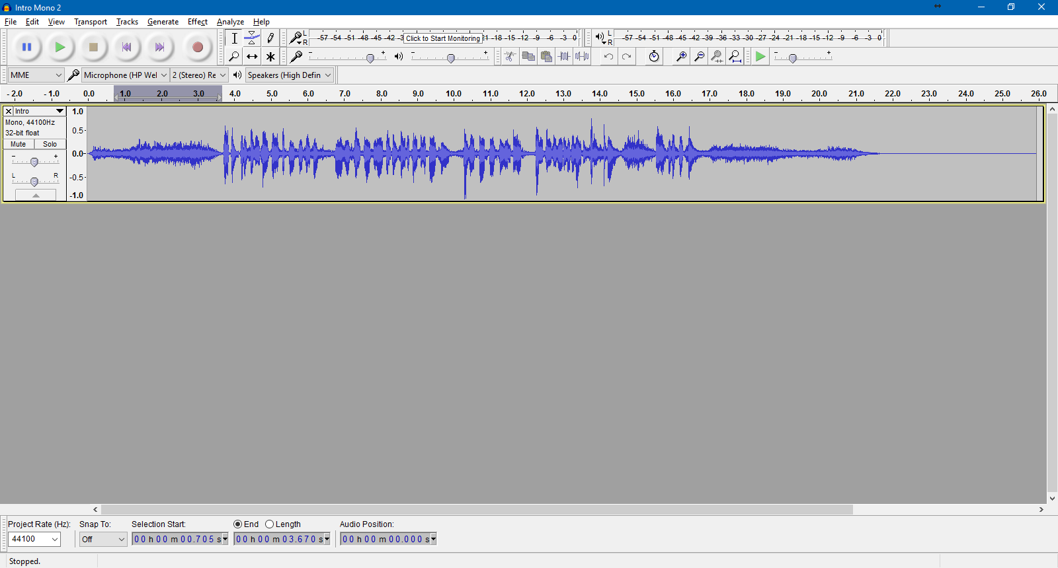

Slide 22
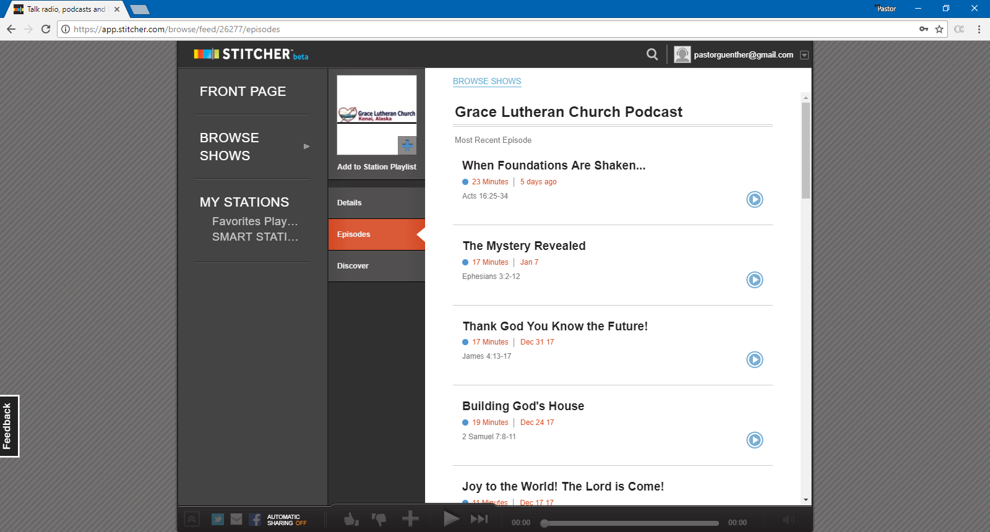

Slide 23
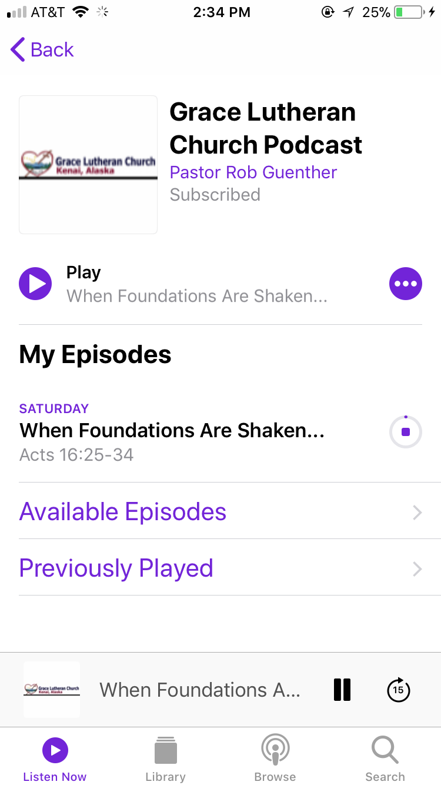

Slide 25
Improved Church Communication
Some “Go” Strategies
Email your sermons.
Post your sermons to a blog. (Blogspot.com)
Twitter, Facebook, Pinterest, Google+

Slide 26
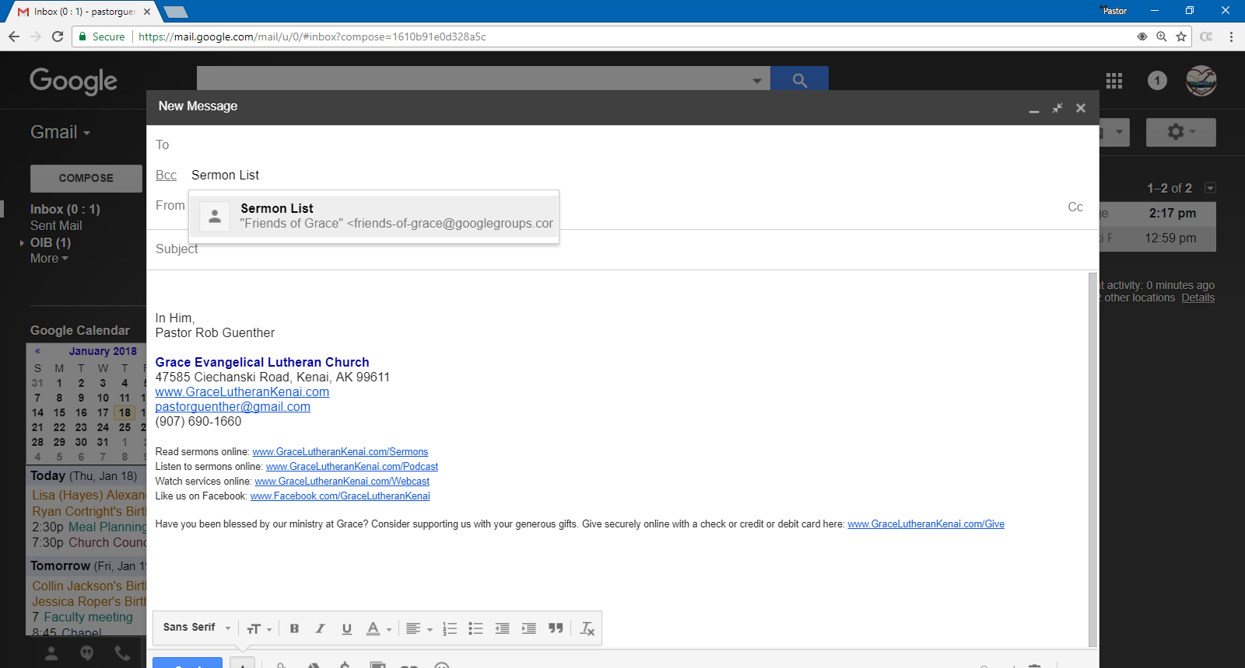

Slide 27
Sermons < @blogger.com>

Slide 30
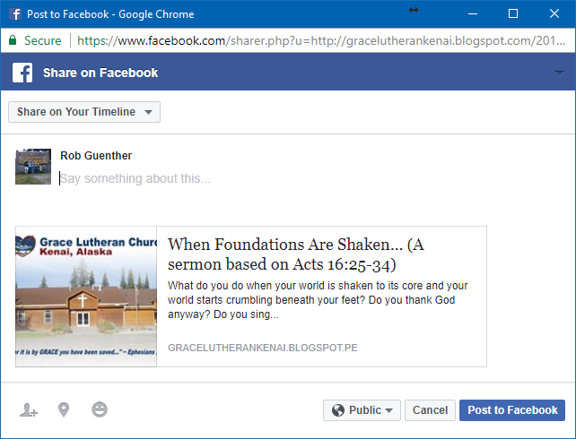

Slide 31
Improved Church Communication
Some “Go” Strategies
Mailchimp

Slide 32
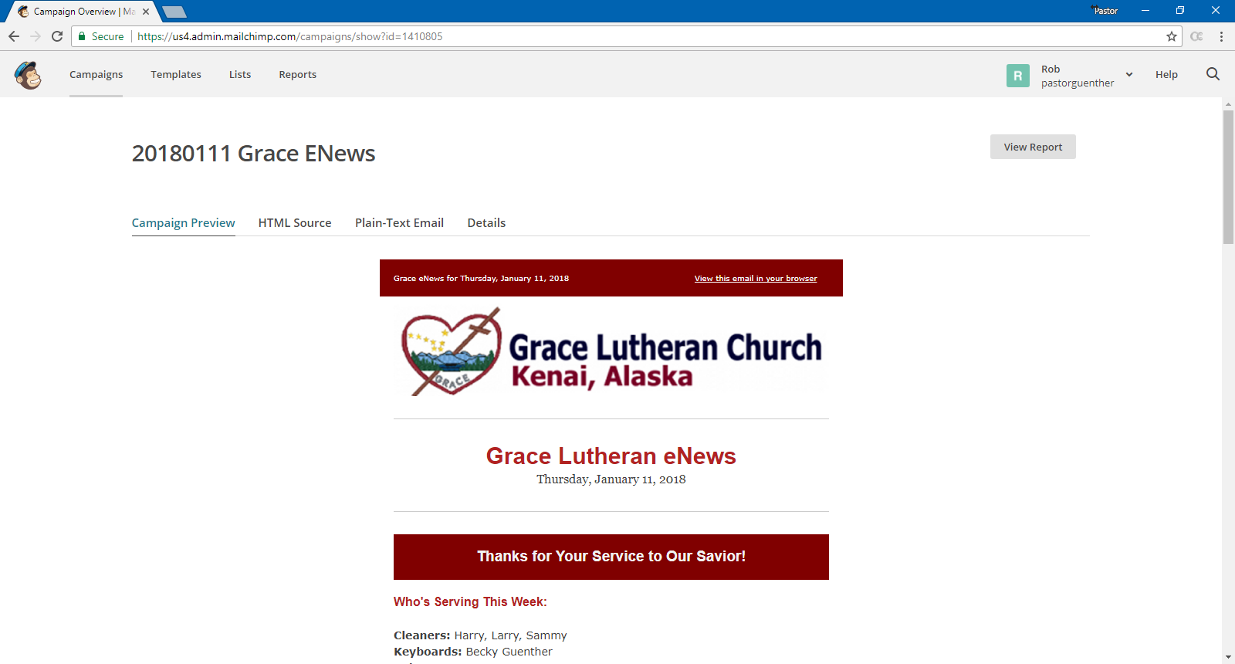

Slide 33
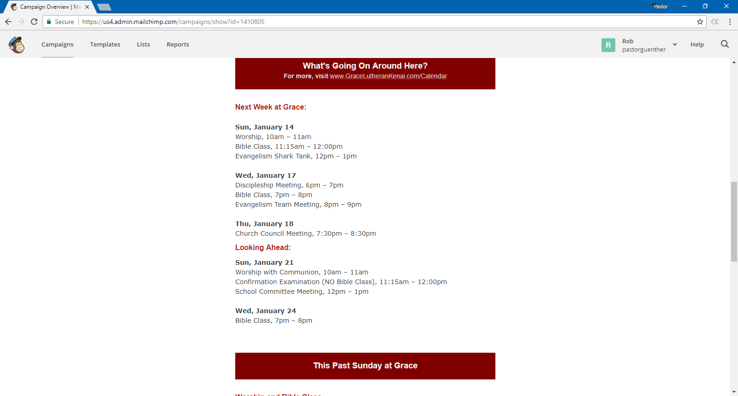

Slide 34
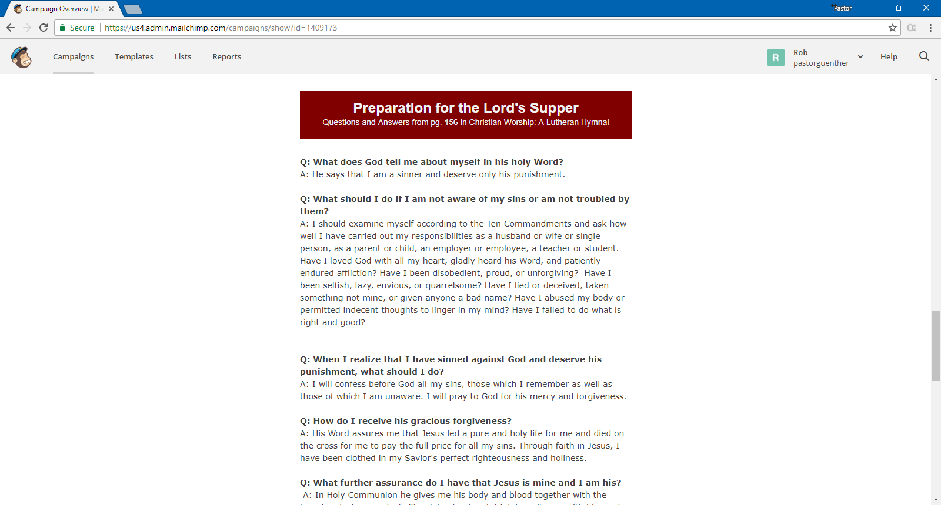

Slide 35
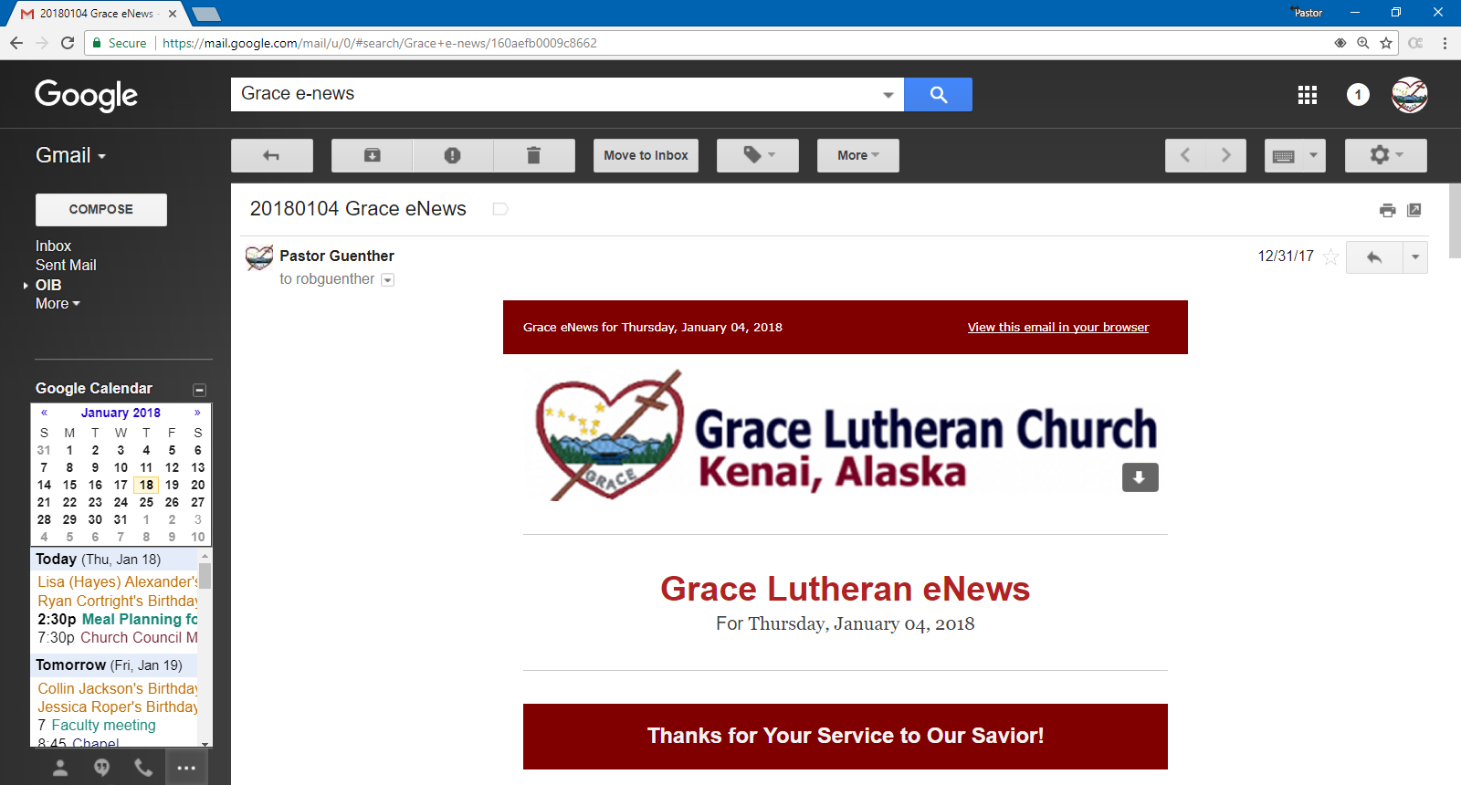

Slide 36
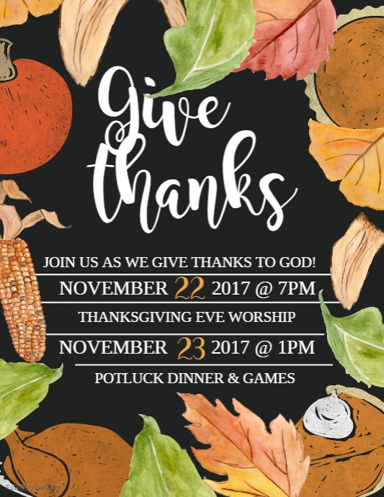
Improved Church Communication
Some “Go” Strategies
PosterMyWall.com

Slide 37
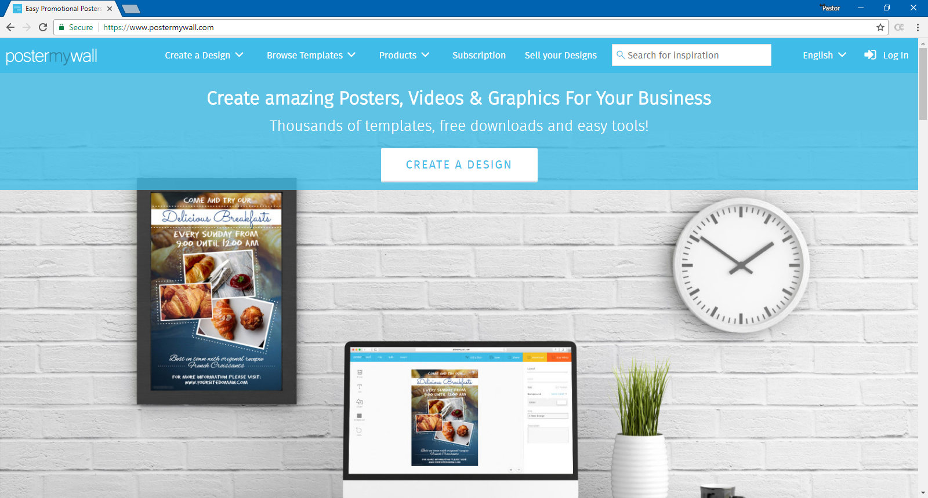

Slide 38
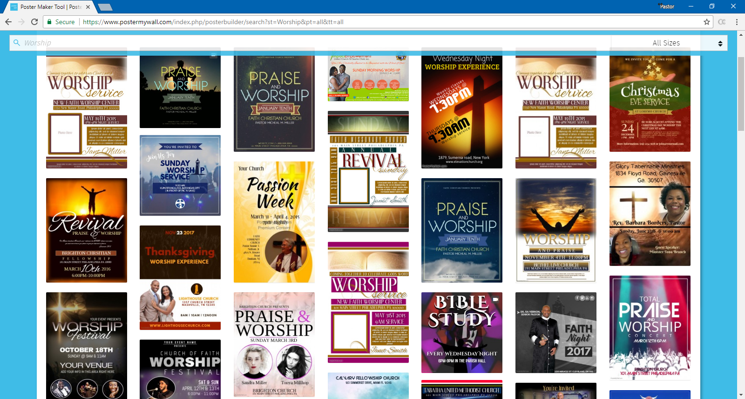

Slide 39
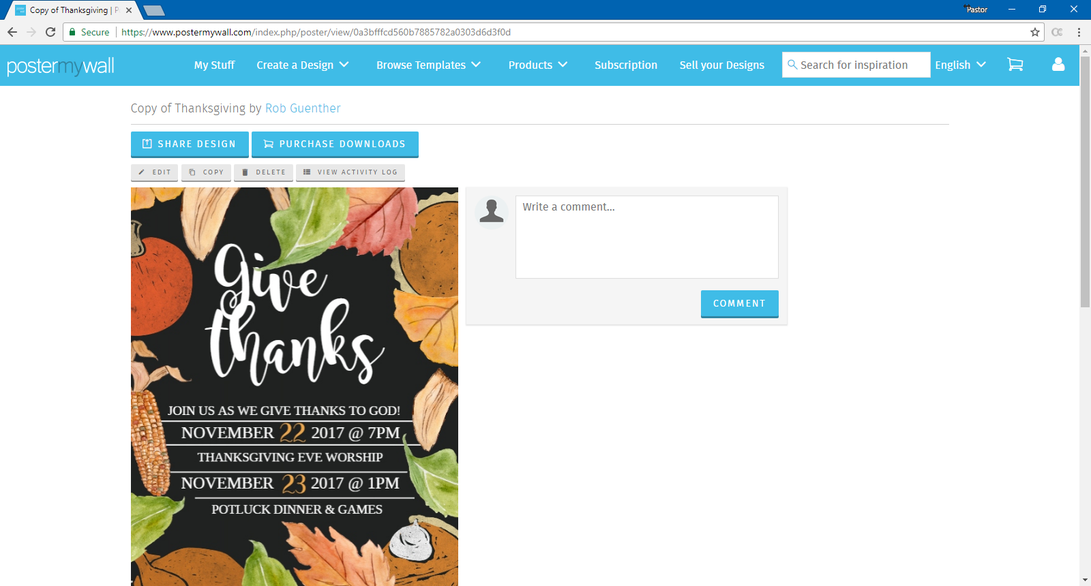

Slide 42
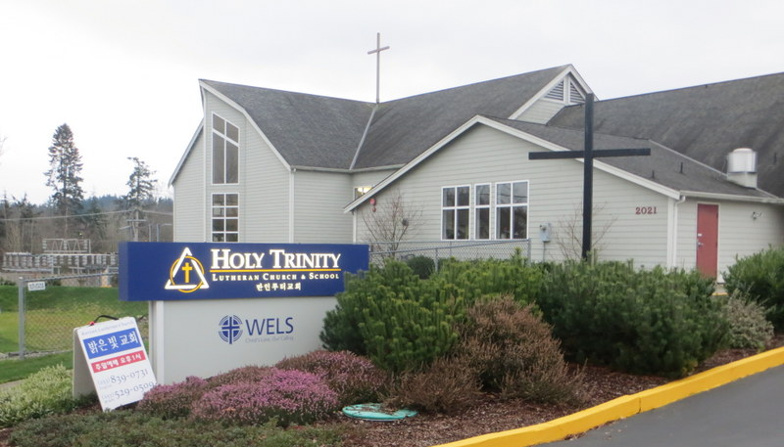

Slide 43
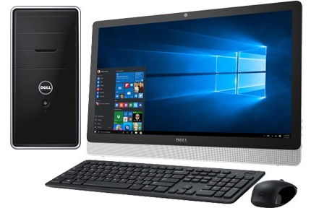

Slide 44
Ever hear something like this…?
“The meeting was last night? I thought it was next Thursday. Why didn’t anyone tell me when it was?”

Slide 45
Ever hear something like this…?
“Here I am for the meeting. I already read the minutes and everyone’s reports. Now I’m ready to really get some things done!”

Slide 46
Ever hear something like this…?
“I didn’t know we had a financial shortfall. If only someone would communicate these things, I would give more.”

Slide 47
Ever hear something like this…?
“Pastor, I saw we were a bit behind budget this month. But no worries, I put an extra offering in the plate. I’ve been so blessed, I just want to thank Jesus.”

Slide 48
Ever hear something like this…?
“Pastor, I never know what’s going on around here. If I’m not on the council no one tells me what’s happening.”

Slide 49
Ever hear something like this…?
“Pastor, thanks for all you do around here. I’m thankful for all the ways you communicate so I always know what’s going on. Thank you.”

Slide 50
Improved Church Communication
CORNER
TECH
With FREE Technology
With Rob Guenther

