Slide 1
Ministry of Christian Giving – Communication Services
pgs. 32-40

Slide 2
Ministry of Christian Giving – Communication Services
As of Jan. 1, 2017, the synod’s $4.7 million debt was eliminated. - 18 months ahead of schedule - $3.1 million in gifts (573 congregations / 2,275 individuals/groups directly to WELS) and through planned payments.
pgs. 32-38

Slide 3
Ministry of Christian Giving – Communication Services
Mission & Ministry Sundays
pgs. 32-38

Slide 4
Ministry of Christian Giving – Communication Services
Mission & Ministry Sundays
Stewardship Resources –
“Joyful Generosity”
pgs. 32-38

Slide 5
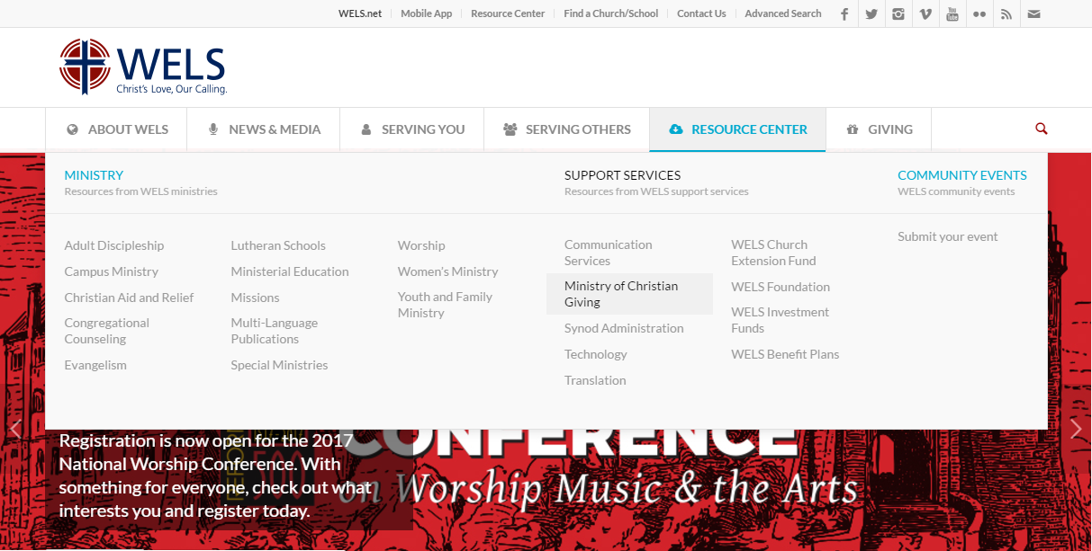

Slide 6
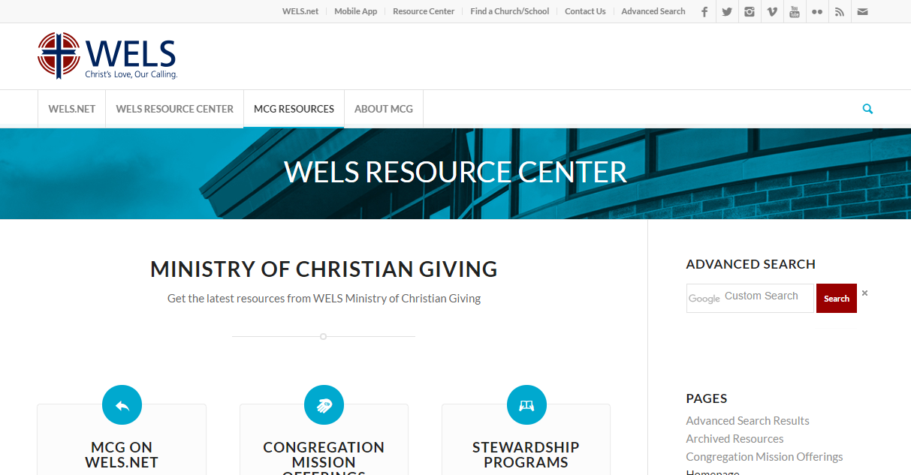

Slide 7
Ministry of Christian Giving – Communication Services
pgs. 32-40

