Slide 1
Increase Your Volunteer Participation
With Free Google Tools

Slide 2
Introduction
Would you like to increase the number of volunteers at your church?

Slide 3
Introduction
Would you like to increase the number of volunteers at your church?
Thank You!
Would you like to help more members use their God-given abilities to serve him in thanks?

Slide 4
Introduction
Would you like to find a cost effective (free) way to do this?
Would you like to find a simple way to do this—a way so simple that anyone can do it?
Simple.

Slide 5
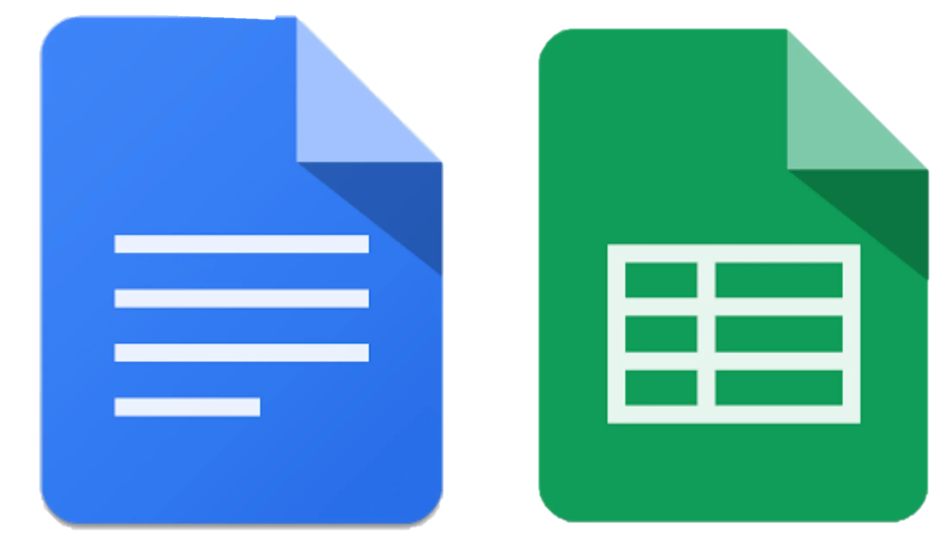
Introduction
The solution: Online sign-up sheets with free Google tools!

Slide 6
Benefits of Online Sign-Up Sheets
Access anywhere.
For You
For Your Members
Midweek Encouragement
Midweek Participation

Slide 7
Benefits of Online Sign-Up Sheets
Why Google?
No login required.
Simple to use.
Simple to print.
Simple to reuse.

Slide 8
Benefits of Online Sign-Up Sheets
Guenther
Joel Nitz
Jason Strong

Slide 9
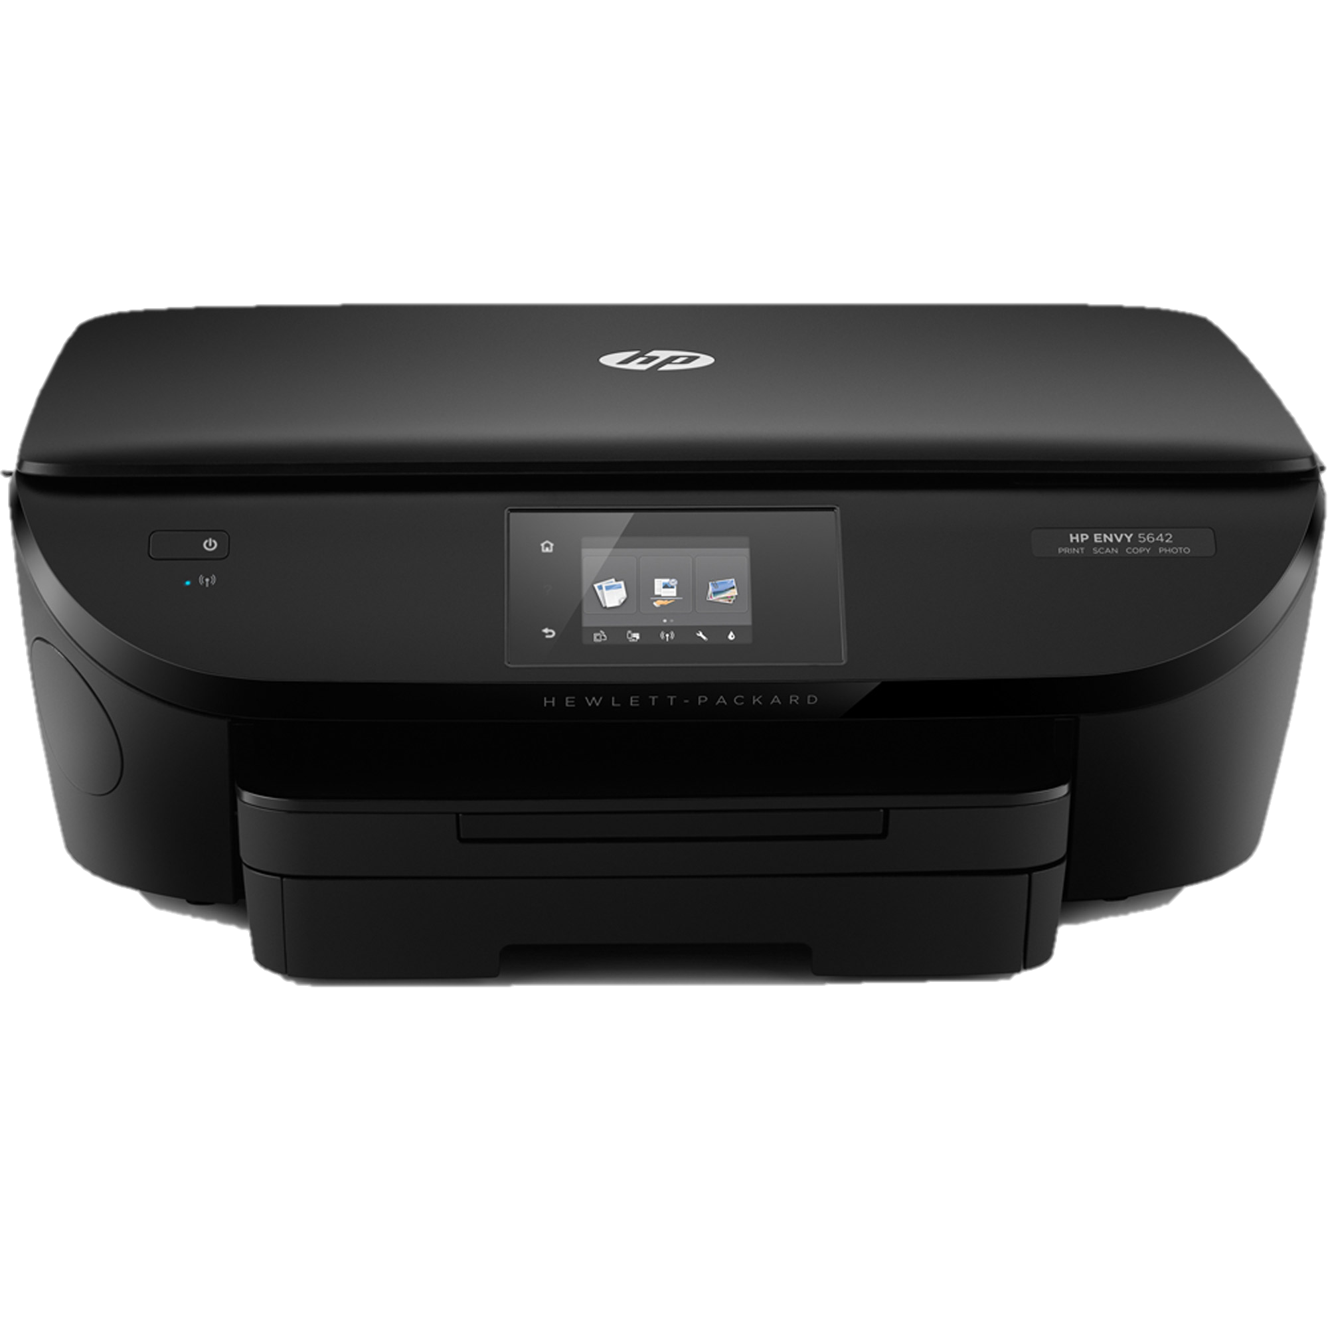
Benefits of Online Sign-Up Sheets
Matt Zimpelmann

Slide 10
Benefits of Online Sign-Up Sheets
Thanksgiving Potluck 2017
November 22nd @ 11am
Guenther
Joel Nitz
Jason Strong

Slide 11
Law/Gospel Warning

Slide 12
Law/Gospel Warning

Slide 13
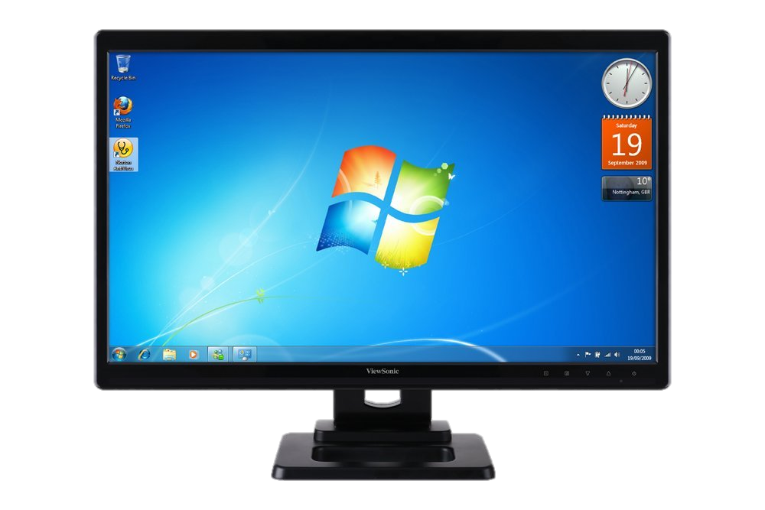
Synchronizing
Matt Zimpelmann
Matt Zimpelmann

Slide 14
Walkthrough

Slide 15
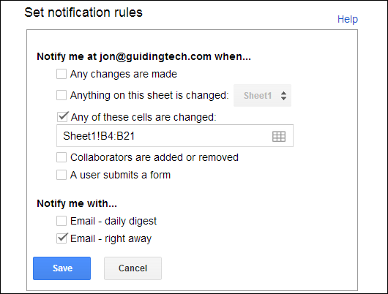
Walkthrough
Sheets has notifications, Docs does not. →

Slide 16
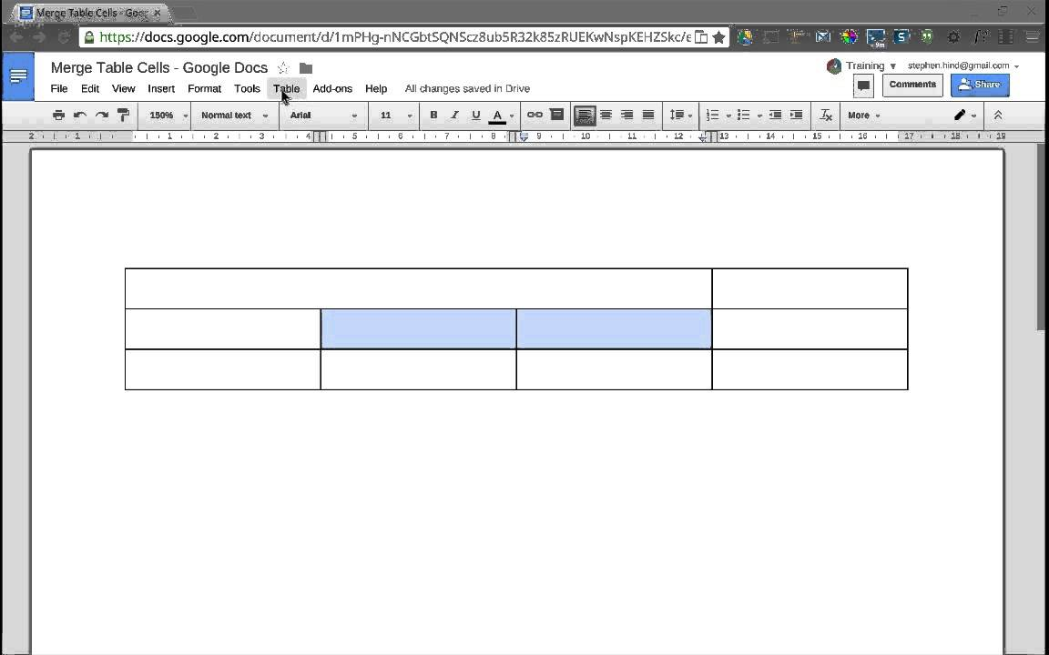
Walkthrough
Bring Donuts to Church on Sunday
Make your doc with a table…
Sunday
Donuts
Cookies
Juice
Feb. 5th

Slide 17
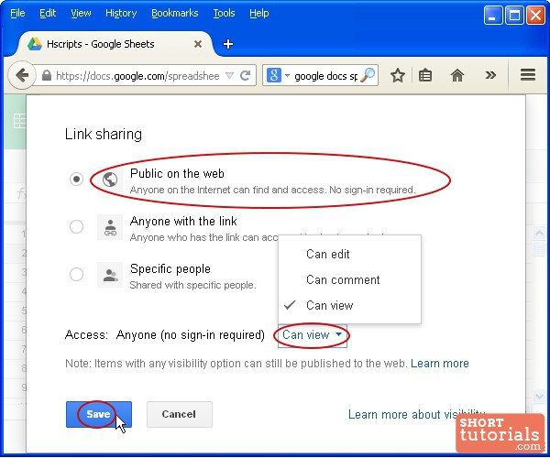
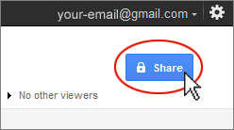
Walkthrough
Sharing

Slide 18
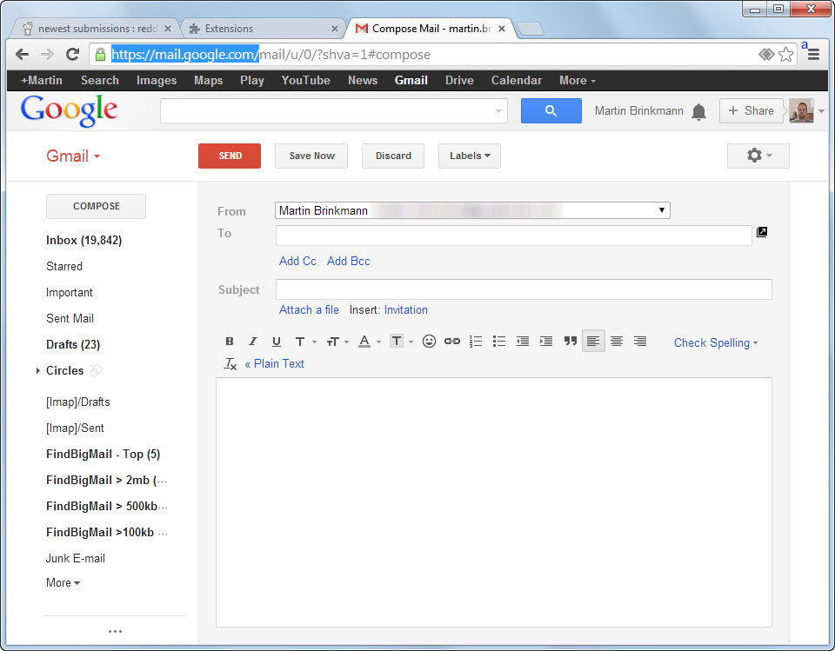
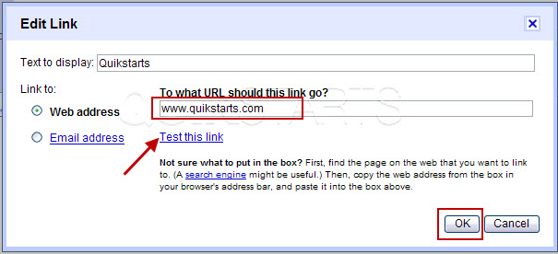
Walkthrough
Emailing

Slide 19
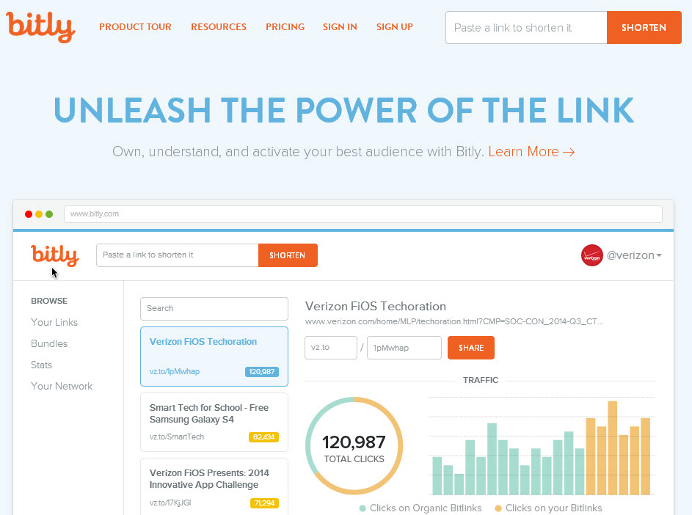
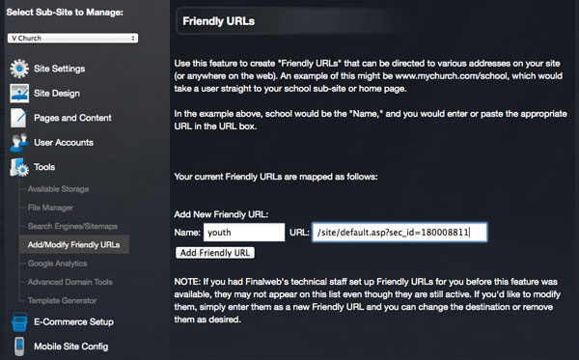
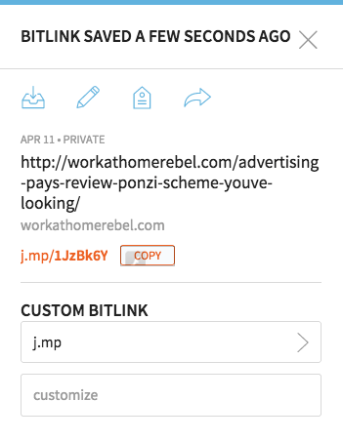
Walkthrough
Hint: Friendly URLs

Slide 20
Walkthrough
Matt Zimpelmann

Slide 21
Walkthrough
Matt Zimpelmann
Matt Zimpelmann

Slide 22
Benefits of Online Sign-Up Sheets
Thanksgiving Potluck 2017
November 22nd @ 11am
Guenther
Joel Nitz
Jason Strong

Slide 23
Increase Your Volunteer Participation
With Free Google Tools

