Slide 1
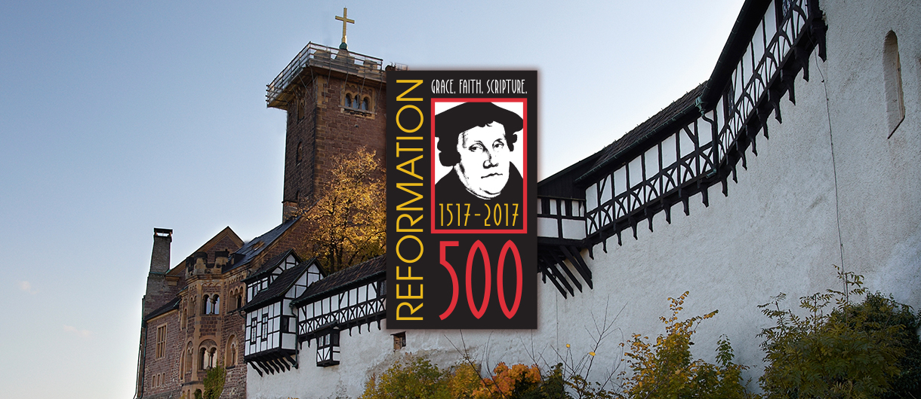
Notes:
At the “year 2000” anniversary…now 17 years ago!
Martin Luther 3rd most influential person (Johann Gutenberg (mass media--movable type for printing) / Isaac Newton (gravity) / Martin Luther (Protestant Reformation)
Reformation 2nd most important event (Printing press / Reformation / Discovery of the “New World.”)

Slide 2
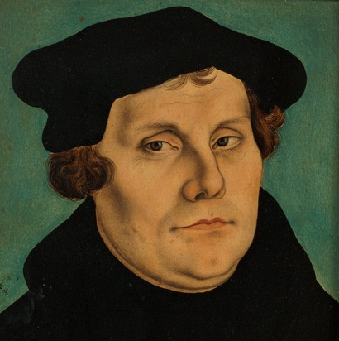
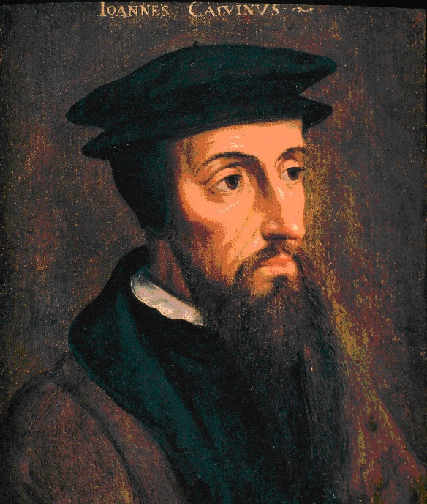
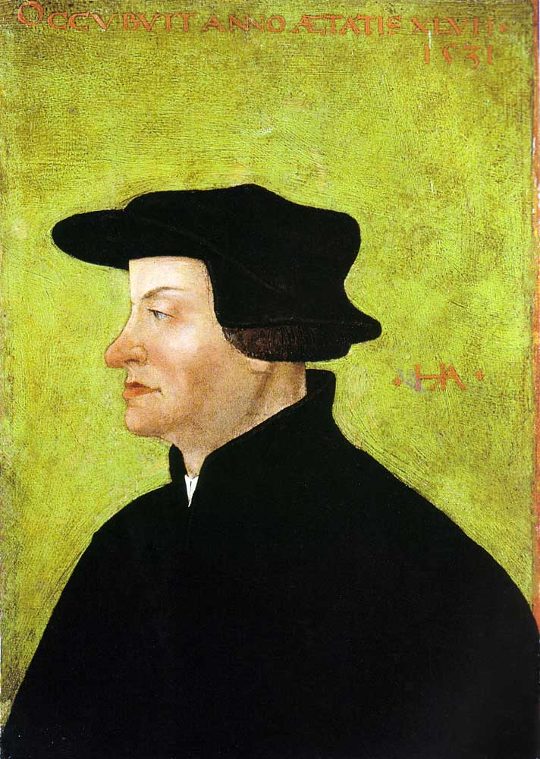
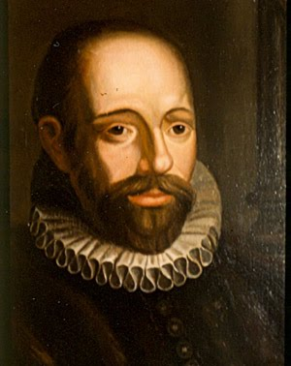
Luther, Zwingli, Calvin, Arminius
Martin Luther 1483-1546
Huldrych Zwingli 1484-1531
John Calvin – 1509-1564
Jacobus Arminius 1560-1609
Notes:
Martin Luther 1483-1546
Huldrych Zwingli 1484-1531
John Calvin – 1509-1564
Jacobus Arminius 1560-1609

Slide 3
STILL divideD!
Notes:
Jacobus Arminius
Dutch Jacob Harmensen orJacob Hermansz (born October 10, 1560, Oudewater, Netherlands—died October 19, 1609, Leiden), theologian and minister of the Dutch Reformed Church who opposed the strict Calvinist teaching on predestination and who developed in reaction a theological system known later as Arminianism.
His father died when Arminius was an infant, and one Theodore Aemilius adopted the child and provided for his schooling in Utrecht. On the death of Aemilius in 1575, Rudolf Snellius (Snel van Roijen, 1546–1613), a professor at Marburg and a native of Oudewater, became the patron for his further education at the universities of Leiden (1576–82), Basel, and Geneva (1582–86).
After brief stays at the University of Padua, in Rome, and in Geneva, Arminius went to Amsterdam. He was ordained there in 1588. In 1603 Arminius was called to a theological professorship at Leiden, which he held until his death. These last six years of his life were dominated by theological controversy, in particular by his disputes with Franciscus Gomarus, his colleague at Leiden.
Considered a man of mild temperament, Arminius was forced into controversy against his own choice. He had earlier affirmed the Calvinist view of predestination, which held that those elected for salvation were so chosen prior to Adam’s fall, but he gradually came to have doubts about this teaching. To him predestination seemed too harsh a position, because it did not provide a place for the exercise of human free will in the process of salvation. Hence, Arminius came to assert a conditional election, according to which God elects to eternal life those who will respond in faith to the divine offer of salvation. In so doing, he meant to place greater emphasis on God’s mercy.
After his death some of his followers gave support to his views by signing the Remonstrance, a theological document written by Johannes Uyttenbogaert, a minister from Utrecht, in 1610. Remonstrant Arminianism was debated in 1618–19 at the Synod of Dort (Dordrecht), an assembly of the Dutch Reformed Church. The synod included delegates from Reformed churches in England, Germany, and Switzerland, as well as delegates from the Dutch church, all of whom were supporters of Gomarus. Arminianism was discredited and condemned by the synod, the Arminians present were expelled, and many others suffered persecution.
In 1629, however, the works of Arminius (Opera theologica [“Theological Works”]) were published for the first time in Leiden, and by 1630 the Remonstrant Brotherhood had achieved legal toleration. It was finally recognized officially in the Netherlands in 1795. In its emphasis on the grace of God, Arminianism influenced the development of Methodism in England and the United States.

Slide 4
Order of influence on American Christianity? Arminius, Calvin, Luther, Zwingli?
Notes:
Martin Luther 1483-1546
Huldrych Zwingli 1484-1531
John Calvin – 1509-1564
Jacobus Arminius 1560-1609

Slide 5
“PRIMING THE PUMP”
As you think of the “fundamental doctrines” found in the Scriptures, which stand out as the most challenging to human reason?

Slide 6
“PRIMING THE PUMP”
Come up with at least three responses to this familiar criticism: “Why are there so many different Christian churches if they all claim to follow the same Bible?”

Slide 8
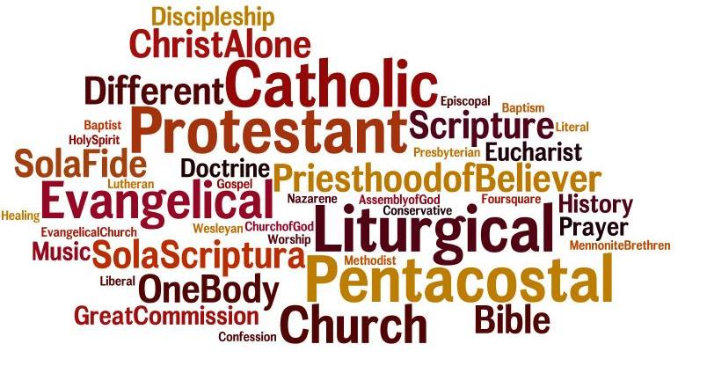
“PRIMING THE PUMP”
If no Lutheran churches (conservative or liberal) existed which church body would you join and why?

Slide 9
outlinE of “doctrines that divide”
Predestination, Election, or Free Will?
Can a Believer Fall from Grace?
The Sacraments—Symbols or Substance?

Slide 10
Predestination, Election, or Free Will?

Slide 11
AS TO WHY SOME ARE SAVED WHILE SOME ARE NOT, THE SCRIPTURES PRESENT US WITH TRUTHS THAT ARE DIFFICULT TO HARMONIZE.
According to the Scriptures God “gets the credit” for those who are saved. | And yet, those who are condemned for unbelief receive the blame for their damnation.
You did not choose me, but I chose you and appointed you so that you might go and bear fruit—fruit that will last…(John 15:16 ) ⁹ But you are a chosen people, a royal priesthood, a holy nation, a people belonging to God, that you may declare the praises of him who called you out of darkness into his wonderful light. (1 Peter 2:9) | Jerusalem, Jerusalem, you who kill the prophets and stone those sent to you, how often I have longed to gather your children together, as a hen gathers her chicks under her wings, and you were not willing. (Matthew 23:37) There is a judge for the one who rejects me and does not accept my words; the very words I have spoken will condemn them at the last day. (John 12:48 )
Therefore I tell you that no one who is speaking by the Spirit of God says, “Jesus be cursed,” and no one can say, “Jesus is Lord,” except by the Holy Spirit. (1 Corinthians 12:3) | “You stiff-necked people! Your hearts and ears are still uncircumcised. You are just like your ancestors: You always resist the Holy Spirit! (Acts 7:51 )
…who has saved us and called us to a holy life—not because of anything we have done but because of his own purpose and grace. This grace was given us in Christ Jesus before the beginning of time. (2 Timothy 1:9) | He will punish those who do not know God and do not obey the gospel of our Lord Jesus. (2 Thessalonians 1:8)

Slide 12
DIGGING INTO THE PASSAGES
In small groups compare and contrast the two columns. Prepare at least 3 brief attempts at using these passages to answer the question of “why some, and not others” in connection with salvation.
______________________
______________________
______________________
Notes:
http://thefederalist.com/2017/09/01/heres-answer-rob-bell-wont-give-aaron-rodgers-salvation-people-remote-rainforest/

Slide 13
Election and Predestination in the Scriptures.
The words “elect” or “election” are used numerous times in the Bible. | The word “predestined” is also used to describe God’s choice of some to be saved.
Jesus used the word “elect” 3 times in Matthew 24 and also used it 3 times in Mark 13. | ²⁹ For those God foreknew he also predestined to be conformed to the image of his Son, that he might be the firstborn among many brothers and sisters. ³⁰ And those he predestined, he also called; those he called, he also justified; those he justified, he also glorified. (Romans 8:29-30)
The Apostle Paul used the word “elect” or “election” 3 times in Romans (9:11; 11:7; 11:28) and 3 times in the pastoral epistles (1 Timothy 5:21; 2 Timothy 2:10; Titus 1:1). | ⁵ he predestined us for adoption to sonship through Jesus Christ, in accordance with his pleasure and will…(Ephesians 1:5)…¹¹ In him we were also chosen, having been predestined according to the plan of him who works out everything in conformity with the purpose of his will…(Ephesians 1:11 )
Peter used the word “elect” in 1 Peter 1:1 and the word “election” in 2 Peter 1:10. | When the Gentiles heard this, they were glad and honored the word of the Lord; and all who were appointed for eternal life believed. (Acts 13:48)

Slide 14
discussion
In small groups discuss the passages above (in their context as time permits) and note the application(s) of the doctrine of election.
_________________________________________
_________________________________________
_________________________________________
Notes:
http://thefederalist.com/2017/09/01/heres-answer-rob-bell-wont-give-aaron-rodgers-salvation-people-remote-rainforest/

Slide 15
Digging Deeper into god’s Word
Ephesians 1:3-14

Slide 16
Digging Deeper into god’s Word
Romans 8:28-39

Slide 18
Notes:
Prescient View – Knowledge beforehand / foreknowledge….God looks ahead and knows who will believe in him and who won’t…then predestines believers to heaven. Salvation rests with us.
Augustinian View (Reformation View) – Some are predestined for salvation…predestined to believe. God decided to save you…Salvation rests with God.

Slide 19
Digging Deeper into god’s Word
2 Thessalonians 2:13-17

Slide 20
“Who decides a person’s salvation?” “who is responsible for a person’s damnation?”

Slide 21
` Salvation & Damnation
Calvinism – “God’s eternal decree by which he decided in himself what he wanted to happen to each and every man we call predestination. Eternal life is foreordained for some, eternal damnation for others. I confess that it is indeed a horrible decree.” | God’s will | God’s will
Arminianism – Synergism, Pelagianism Semi-Pelagianism. | Human will “I decide to be saved” or “I finished what God started” | Human will “I reject God’s offer”
Election Controversy – “Does the faith which was foreseen of God flow out of the election of grace, or does the election of grace flow out of the foreseen faith? Is the election of grace based alone on God’s mercy and Christ’s merit, or also upon the conduct of man which God foresaw? Can and should a believing Christian become certain of his election and thus of his salvation, or can and should he not become certain of them?” C.F.W Walther 1881 | God’s will “in view” of the faith that those he chose would have, or their response to God’s election of them. | No “volitional” resistance to conversion and God’s offer of salvation
Notes:
Arminianism (as derived from the Five Articles of Remonstrance, 1610):
1. The salvation or ultimate condemnation of a person is “conditioned” by or is the result of the God-given faith or unbelief of that person;
2. The divinely provided atonement is sufficient for all persons but is applied only to those who trust in Christ. Thus it is limited to believers, not by God but by the person who trusts or fails to trust;
3. No person can save himself or herself. Without the help of the Holy Spirit, no one can respond to God’s will that all be saved;
4. God’s grace, applied by the Holy Spirit, is the sole source of good and of human salvation, yet this grace may be resisted;

Slide 22
` Salvation & Damnation
Lutheranism - (Scripture) | God’s will “Election / predestination” | Human will “Why did you reject me?”

Slide 23
conclusion
Reflecting on our discussion propose at least three reasons why correctly teaching the doctrine of “predestination” as it is presented in the Scriptures is important.

Slide 24
conclusion
Offer a brief summary of the Doctrine of Election and at least three ways to properly apply it in the life of a Christian.

Slide 25
conclusion
Describe some ways in which we can talk to others about a Bible truth like predestination even though it remains a mystery to us.

Slide 26
conclusion
Should the Doctrine of Election influence our evangelism efforts in any way?

Slide 27
Session 2

Slide 28
Can a Believer Fall from Grace?

Slide 29
Introduction
I walk in danger all the way;
The thought shall never leave me
That Satan, who has marked his prey,
Is plotting to deceive me.
This foe with hidden snares
May seize me unawares
If e'er I fail to watch and pray;
I walk in danger all the way.

Slide 30
Introduction
I pass through trials all the way,
With sin and ills contending;
In patience I must bear each day
The cross of God's own sending.
Oft in adversity I know not where to flee
When storms of woe my soul dismay;
I pass through trials all the way.

Slide 31
Introduction
Grim death pursues me all the way; Nowhere I rest securely.
He comes by night, he comes by day,
And takes his prey most surely.
A failing breath, and I
In death's strong grasp may lie
To face eternity today.
Grim death pursues me all the way.
.

Slide 32
Introduction
I walk with angels all the way;
They shield me and befriend me.
All Satan's pow'r is held at bay
When heav'nly hosts attend me.
They are my sure defense;
All fear and sorrow, hence!
Unharmed by foes, do what they may,
I walk with angels all the way.
.
.

Slide 33
Introduction
I walk with Jesus all the way;
His guidance never fails me.
He takes my ev'ry fear away
When Satan's pow'r assails me,
And, by his footsteps led,
My path I safely tread.
In spite of ills that threaten may,
I walk with Jesus all the way.
.
.
.

Slide 34
Introduction
My walk is heav'nward all the way;
Await, my soul, the morrow,
When you farewell can gladly say
To all your sin and sorrow.
All worldly pomp, begone!
To heav'n I now press on.
For all the world I would not stay;
My walk is heav'nward all the way. .
.
.
.

Slide 35
Introduction
Underline some of your favorite Scriptural truths which you find confessed in these verses. In one sentence provide what you believe could serve as a summary of the thoughts expressed by the author in this hymn. ________________________________________________________________________

Slide 36
Focusing our thoughts
The person who perseveres in faith does so only through God’s gracious preservation; the believer’s perseverance is a work of divine grace and omnipotence.
The person that falls from faith does so through his own fault; the cause of unbelief is in every case rejection of God’s Word and resistance to the operation of the Holy Spirit through the Word.

Slide 37
Laying the foundation
The Scriptures present us with two sets of passages regarding whether a believer can fall from grace which reason finds it difficult to harmonize. In the following columns we see how they stand in sharp contrast to each other.

Slide 38
The Scriptures present us with passages on this doctrine, which reason finds it difficult to harmonize. In the following columns we see how they stand in sharp contrast to each other.
God’s promises to preserve believers in the faith! | God’s warnings to believers against falling from the faith!
No temptation has seized you except what is common to man. And God is faithful; he will not let you be tempted beyond what you can bear. But when you are tempted, he will also provide a way out so that you can stand up under it. (1 Corinthians 10:13) | So, if you think you are standing firm, be careful that you don't fall! (1 Corinthians 10:12)
I give them eternal life, and they shall never perish; no one can snatch them out of my hand. (John 10:28) | Those on the rock are the ones who receive the word with joy when they hear it, but they have no root. They believe for a while, but in the time of testing they fall away. (Luke 8:13)
My Father, who has given them to me, is greater than all; no one can snatch them out of my Father's hand. (John 10:29) | Holding on to faith and a good conscience. Some have rejected these and so have shipwrecked their faith. (1 Timothy 1:19)

Slide 39
That is why I am suffering as I am. Yet I am not ashamed, because I know whom I have believed, and am convinced that he is able to guard what I have entrusted to him for that day. (2 Timothy 1:12) | No, I beat my body and make it my slave so that after I have preached to others, I myself will not be disqualified for the prize. (1 Corinthians 9:27)
Being confident of this, that he who began a good work in you will carry it on to completion until the day of Christ Jesus. (Philippians 1:6) | It is impossible for those who have once been enlightened, who have tasted the heavenly gift, who have shared in the Holy Spirit, who have tasted the goodness of the word of God and the powers of the coming age, if they fall away, to be brought back to repentance, because to their loss they are crucifying the Son of God all over again and subjecting him to public disgrace. (Hebrews 6:4-6)
For it is God who works in you to will and to act according to his good purpose. (Philippians 2:13) | Continue to work out your salvation with fear and trembling. (Philippians 2:12)
He will keep you strong to the end, so that you will be blameless on the day of our Lord Jesus Christ. (1 Corinthians 1:8) | Do not be arrogant, but be afraid. For if God did not spare the natural branches, he will not spare you either. Consider therefore the kindness and sternness of God: sternness to those who fell, but kindness to you, provided that you continue in his kindness. Otherwise, you also will be cut off. (Romans 11:20-22)

Slide 40
Can a believer fall from grace?
In small groups, discuss the similarities, differences, and the possible applications of the two sets of passages.)

Slide 41
Digging Deeper into god’s promises
1 Peter 1:3-9

Slide 42
Digging Deeper into god’s promises
1 Thessalonians 5:23-24

Slide 43
Looking more closely at god’s warnings
Jeremiah 23:33-40

Slide 44
Looking more closely at god’s warnings
Matthew 26:33-35.

Slide 45
Application / discussion
Agree / Disagree:
Since God will hold me accountable if I fall from faith it is my responsibility to keep myself in the faith through the Means of Grace (the Word and Sacraments).

Slide 46
Application / discussion
Agree / Disagree:
Those who rely on their own perseverance rather than on the preserving grace of God for their salvation will naturally live in a continual state of spiritual and emotional torment.

Slide 47
UNDERSTANDING THE REASONS WHY CHRISTIANS CAN LOSE SAVING FAITH
God alone can give faith. God alone can preserve faith, which he does through the Means of Grace (the gospel in the Word and Sacraments.) We, however, can lose our faith. Discuss the reasons which the Bible identifies as potential pitfalls for the Christian’s faith:

Slide 48
UNDERSTANDING THE REASONS WHY CHRISTIANS CAN LOSE SAVING FAITH
• People can lose their faith when they base it on how they feel about God.
• People can lose their faith when they place themselves in the way of temptation.
• People can lose their faith when they trust in their own works to save them.

Slide 49
UNDERSTANDING THE REASONS WHY CHRISTIANS CAN LOSE SAVING FAITH
• A lack of self-discipline also can destroy faith.
• The love of money and what it buys can also destroy faith.
• The fear of persecution can cause people to lose their faith.

Slide 50
UNDERSTANDING THE REASONS WHY CHRISTIANS CAN LOSE SAVING FAITH
• People can lose their faith when they reject a fundamental doctrine of the Bible.

Slide 51
conclusion
1. Which description of the doctrine we are discussing best reflects the teaching of Scripture?
A. Perseverance of the Saints
B. Preservation of the Saints

Slide 52
conclusion
2. Reflecting on our discussion propose at least three reasons why correctly teaching what the Bible says about how God “preserves” believers in faith and yet warns them about falling away from faith is important.

Slide 53
conclusion
3. Propose three ways that the truth about a believer’s perseverance / preservation in faith might be used in our witnessing.
______________________
______________________
______________________

Slide 54
conclusion
4. What preaching / teaching applications might be made with the truth about a believer’s perseverance / preservation in the faith?

Slide 55
Lesson 3

Slide 56
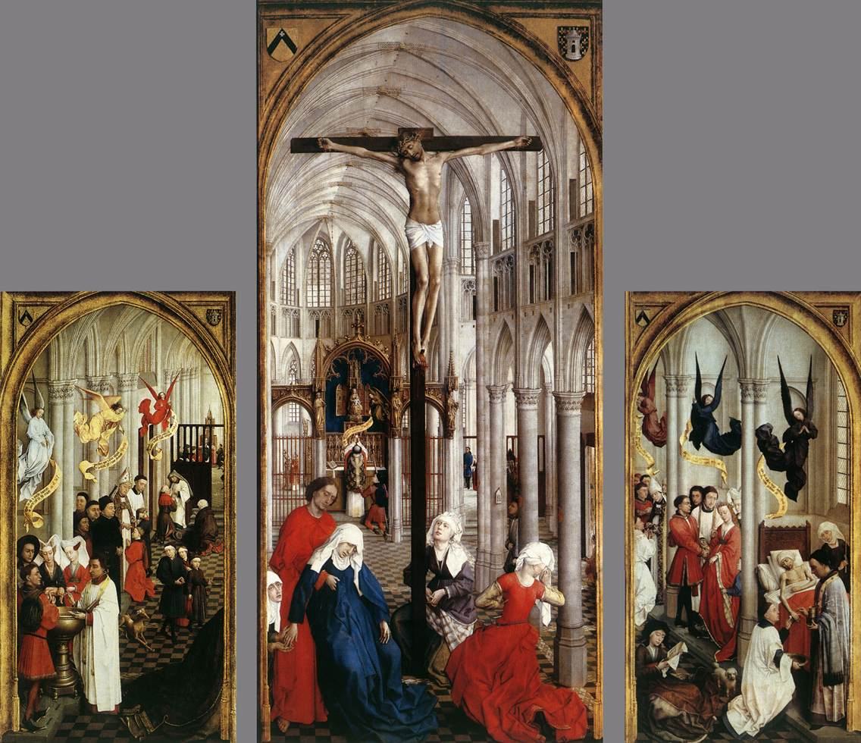
Sacraments: Symbols or Substance?

Slide 57
introduction
From your own experiences with members of other Christian churches discuss some of the divisions that have taken place regarding the sacraments.

Slide 58
The Means of Grace
God's Reservoir
God's Word (Bible)
GOSPEL
Forgiveness
New Life
Salvation
Forgiveness
New Life
Salvation
Sacraments
Baptism and Lord's Supper

Slide 59
Defining a sacrament…
A Sacrament is a sacred act,
Instituted by Jesus
uses visible elements connected with God's Word
Offers and gives forgiveness of sins, new life and salvation

Slide 60
“Office”
OFFers and gives forgiveness of sins, new life and salvation
Instituted by Christ
Connected to God’s Word
External elements or signs

Slide 61
What does “Baptism” mean?

Slide 62
Digging Deeper into god’s Word
Mark 7:1-4

Slide 63
Digging Deeper into god’s Word
Matthew 28:18-20

Slide 64
What is the purpose of baptism?

Slide 65
What are the blessings of baptism? [Small Group Work]

Slide 66
Group discussion
1. What are some of the attitudes and practices of Baptism that Christians might develop if they believe that baptism is merely a ceremony to demonstrate a person’s commitment (or renewed commitment to God)?

Slide 67
Group discussion
2. Discuss ways in which believers can more fully “live in our baptismal grace all the days of our life.”

Slide 68
Why baptize babies?
[Small Group Work]

Slide 69
WHY DO SOME churches not Baptize infants?
They view baptism as a work of the individual. They call it an “outward sign of an inward change.” Since it is a work of the individual, only those who know about it and can ask for it will be baptized. This is taught nowhere in Scripture and came into practice during the 1600’s through the Anabaptists. Some say that infants are either not sinful or that God doesn’t hold them accountable for their sin until they reach the “age of accountability” (about 9-12 years old).

Slide 70
WHY DO SOME churches not Baptize infants?
There are those who say that infants cannot believe in Christ since they are incapable of rational thinking. They view baptism as an act of obedience, a good work which a believer does for God, rather than as a Means of Grace, a blessed work which God does for them.

Slide 71
DID THE EARLY CHURCH BAPTIZE BABIES?
Ireanaeus (202 A.D.), who was a student of Polycarp, who was a disciple of the Apostle John, wrote: “Christ came to save all men by himself; all, I say, who through him are reborn into God; infants, little children, boys, young men and old men.”
The church father, Origen, born 185 A.D., tells us the practice of baptizing children was handed down to them from the apostles.

Slide 72
DID THE EARLY CHURCH BAPTIZE BABIES?
Augustine, born 353 A.D., said he never heard of anyone who accepted the Bible as God's Word who also rejected infant baptism.
Numerous inscriptions on the graves in the catacombs, dating back to the very first centuries of Christianity, testify to the fact that the early Christians baptized their children. For example they might say, “Aristus lived 8 months; he was recently baptized.”

Slide 73
Group discussion
1. Under what circumstances and in what ways might the Scriptural truths about baptism be used in our witnessing?

Slide 74
Group discussion
2. Are there ways that our teaching about baptism might provide an outreach opportunity for our congregations?

Slide 75
The sacrament of holy communion
There are those who view the Lord’s Supper as an act of obedience, a good work which a believer does for Christ, rather than as a Means of Grace, a blessed work which Christ does for them.

Slide 76
Digging Deeper into god’s Word
Matthew 26:17-30

Slide 77
What do I receive in the lord’s supper?

Slide 78
Digging Deeper into god’s Word
1 Corinthians 10:14-16
&
1 Corinthians 11:17-34

Slide 79
What do we receive?
Bible
Bread & Wine
Body & Blood
a. Real Presence
Roman Catholic
**********
Body & Blood
b. Transubstantiation
Most Non-Lutheran churches
Bread & Wine
**********
c. Representation

Slide 80
OUR CONFESSION ABOUT THE Lord’s Supper
We believe, teach, and confess that the body and blood of Christ are received with the bread and wine, not only spiritually by faith, but also orally; yet not in a cannibalistic way, but in a supernatural, heavenly mode, because of the sacramental union; as the words of Christ clearly show, when Christ gives direction to take, eat, and drink.

Slide 81
For discussion
What are some of the attitudes and practices related to Holy Communion which Christians might develop if they believe that Holy Communion is merely ceremony to demonstrate obedience to God re-enact what Jesus did as a remembrance?

Slide 82
For discussion
Give some examples of appropriate places to highlight the Lord’s Supper in our preaching and teaching.

Slide 83
For discussion
What are some of the attitudes and practices related to Holy Communion which Christians might develop if they believe that Holy Communion is just a dramatic ceremony in which Christ’s sacrifice is re-enacted and his body and blood are once again sacrificed for those who receive it?

Slide 84
What about “other” sacraments?
The Roman Catholic Church has 7:
Baptism
Lord's Supper
Penance
Holy Orders
Confirmation
Extreme Unction
Matrimony

Slide 85
Final Take aways for us
What other doctrines would you add to this study? End Times? Justification? Sanctification?

Slide 86
Final Take aways for us
Summarize some of the key facts that make a “ Lutheran Christian’s approach to the Bible” unique or different in comparison to those in many other Christian churches.

Slide 87
Final Take aways for us
List some of the ways that we can communicate the importance of a “Lutheran approach to interpreting the Bible” in our witnessing.

Slide 88
The source of Doctrinal conflicts / false teaching?
Underestimation of the greatness of God.
Overestimation of the greatness of mankind.

Slide 89
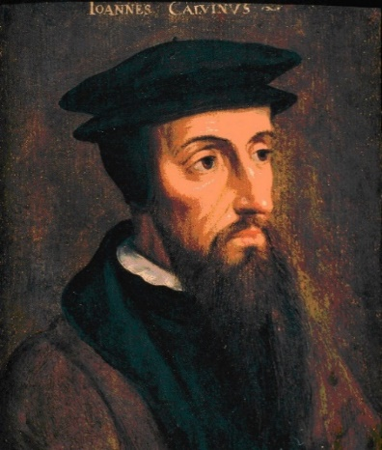
The source of Doctrinal conflicts / false teaching?
In the first place, I hear that when you come together as a church, there are divisions among you, and to some extent I believe it. No doubt there have to be differences among you to show which of you have God’s approval.
(1 Corinthians 11:18–19)

Slide 90
WHY DOES EVERY DOCTRINE MATTER?
In an age when being “divided” over anything will be met with disdain why should we continue to “stand where Luther stood” when it comes to all that God’s Word teaches?

Slide 91
WHY DOES EVERY DOCTRINE MATTER?
Apply these verses of Scripture to our discussion of “standing where Luther stood” as we celebrate “Reformation 500.”
“But in your hearts revere Christ as Lord. Always be prepared to give an answer to everyone who asks you to give the reason for the hope that you have.” (1 Peter 3:15)
“Be wise in the way you act toward outsiders; make the most of every opportunity. Let your conversation be always full of grace, seasoned with salt, so that you may know how to answer everyone.” (Colossians 4:5–6)

Slide 92
Closing thoughts

