Slide 1
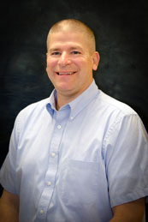
Conference of presidents
Boram pages 5 to 12

Slide 3
COP ORGANIZED FOR ACTION
DOCTRINE – FAITHFUL, UNIFIED
CALLED WORKERS – CANDIDATES FOR CALLS, ADVICE
CONGREGATIONS – COUNSEL
FINANCES – SUPPORT, STEWARSHIP, MISSION OFFERINGS
COMMUNICATION – MISSION AND MINISTRY

Slide 4
Overseeing matters of doctrine and practice
Discipline
Study and statements

Slide 5
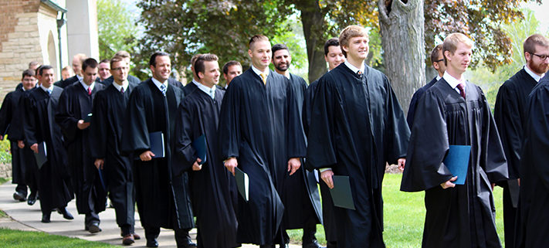
Assignment of ministerial candidates

Slide 6
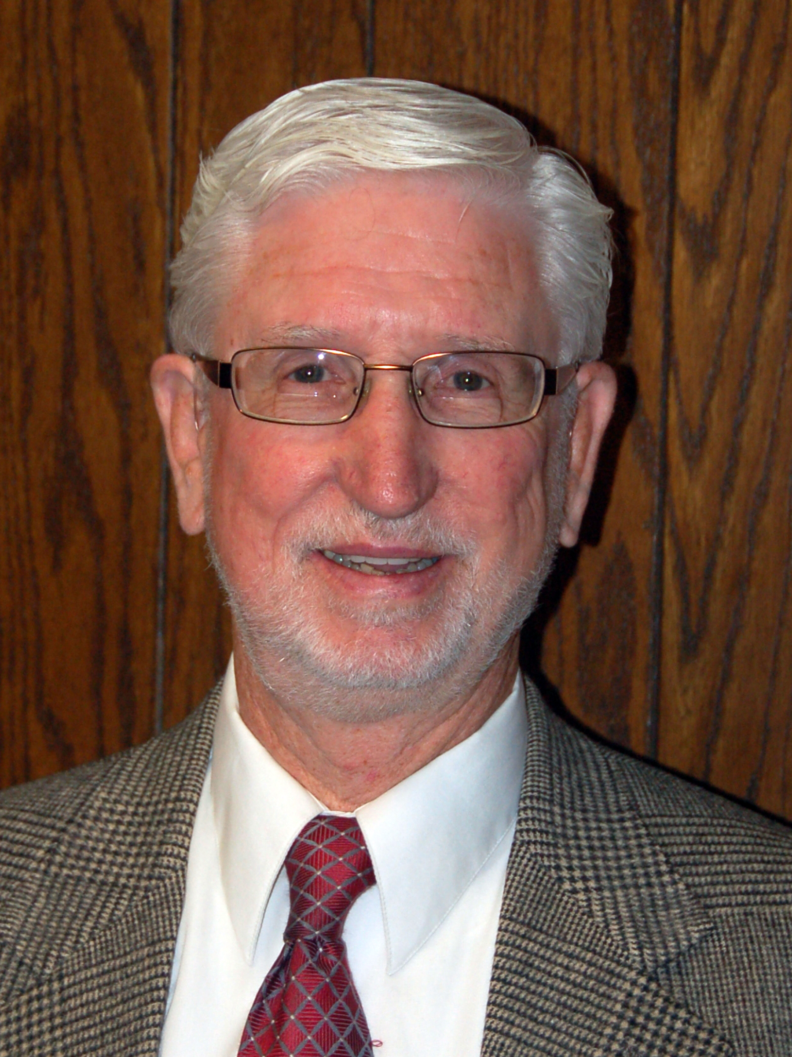
Continuing education for called workers
2017 Pastor’s Institute
History of Christian Doctrine:
Pre-Reformation, Reformation,
and Post-Reformation Periods
June 6-7, 2017
At Evergreen Lutheran High School
7306 Waller Road East, Tacoma, WA 98443

Slide 7
Process for regaining eligibility to serve as a called worker
Restoration of crm (pastors)
Or E & A (eligible and available, teachers)
Decisions now brought to entire cop

Slide 8
Funding for the synod’s mission and ministry
CMO – CONGREGATIONAL MISSION OFFERING REMAINS FOUNDATIONAL
MISSION AND MINISTRY SUNDAY IN THE WORKS

Slide 9
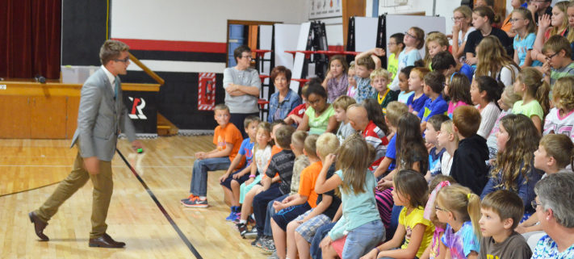
Need for called worker recruitment

Slide 10
Capital debt retired ahead of schedule

Slide 11
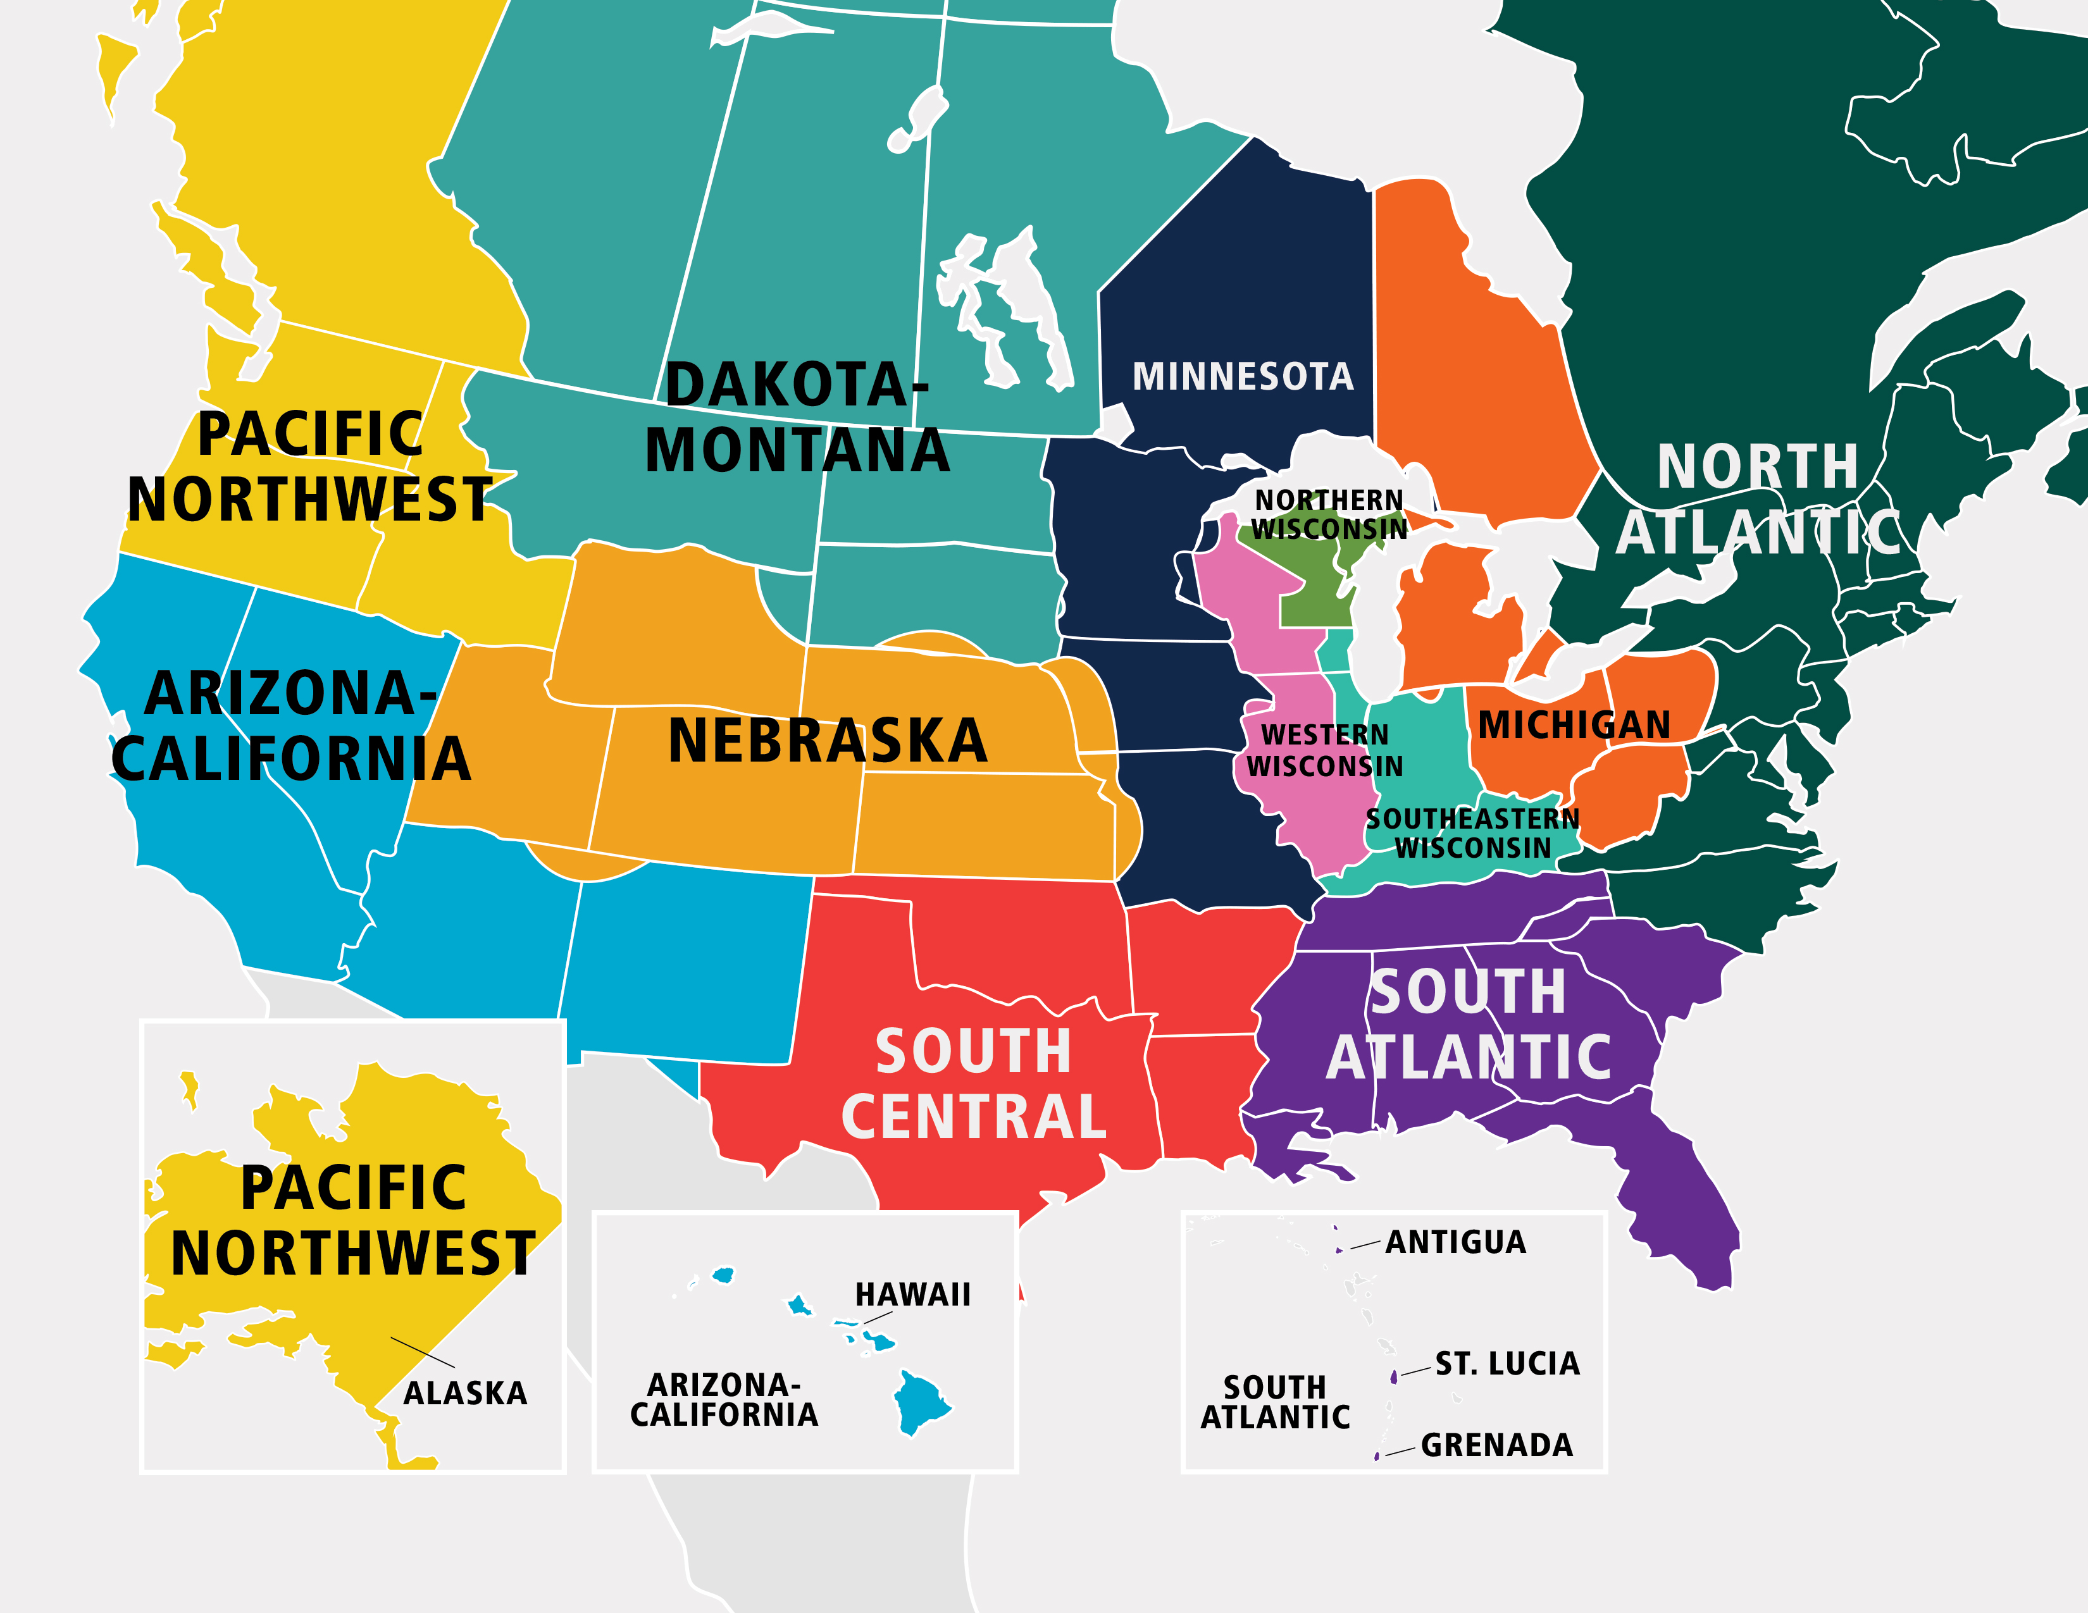
Ministry of Christian Giving review
Thorough review and analysis, cf. boram pg. 35

Slide 12
Congregation and Ministry Support Group
Direct supervision by cop
Full time directors for Lutheran schools, worship, evangelism, special ministries, congregational counseling
Calling for director of discipleship

Slide 13
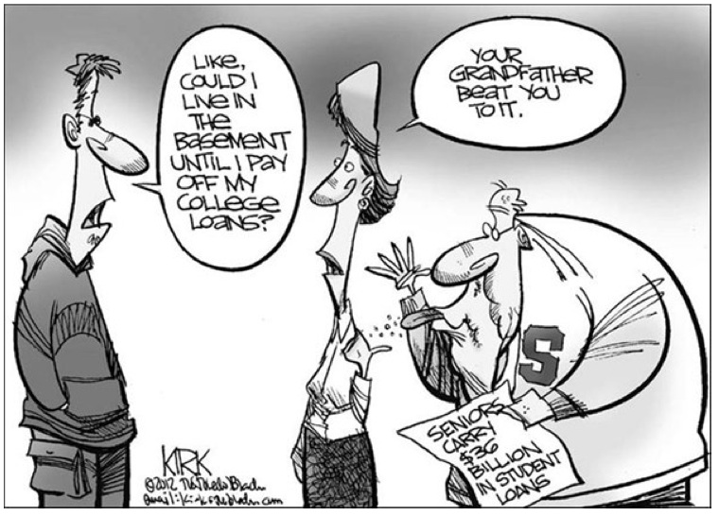
Student debt at the ministerial education schools

Slide 14
Reformation 500

Slide 15
Principal training and urban ministry
Principal training program
One-year apprenticeship in urban settings

Slide 16
Guidelines for special conferences and events
Ask for DP or COP guidance
Plan carefully
Honor god-given roles for men and women
Good theology presented

Slide 17
Bible translations

Slide 18
Fellowship practices in our schools
Carefully studied using 2015 materials
Ongoing study includes the els

Slide 19
Using the gifts of women in administrative roles
ONGOING STUDY

Slide 20
Calling at synodical schools
Committee to review and propose necessary and beneficial changes in the bylaws

Slide 21
Preparation of delegates to the synod convention
Improvements made
Analysis after 2017

Slide 22
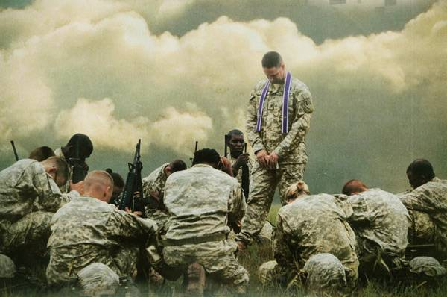
Military chaplaincy
Re-examined
Military chaplaincy has changed but not in the ways that would allow us to participate
WELS Military contact pastors continue to serve

Slide 23
Revisions to the bylaws
Pages 213-225 in boram
Clarifications and some changes
Memorize for entrance into celestial kingdom

Slide 24
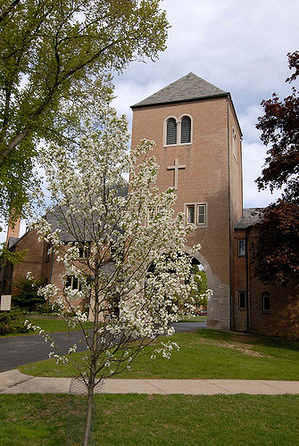
Meetings with the faculty of Wisconsin Lutheran Seminary
Beneficial communication
Areas of common interest

Slide 25
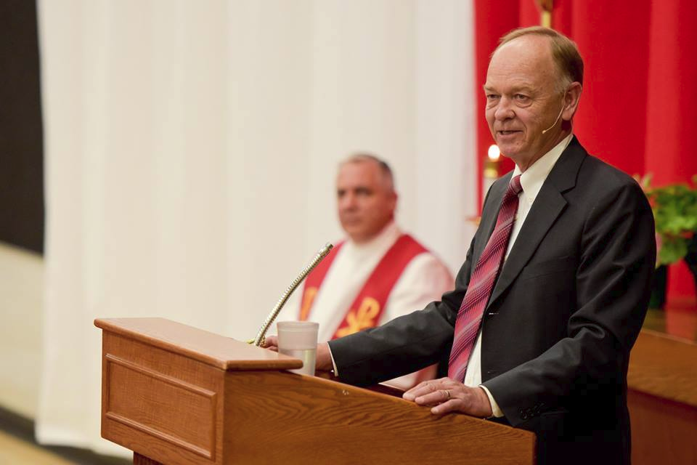
Mid-year assignments
Welcome Austin, joel, desiree, Kristin, and galen

Slide 26
Our thanks and our welcome
Thanks for cop service of john guse, herb prahl, david rutschow, earle treptow
Welcome chuck westra, Michael Jensen, david kolander, phil Hirsch
Thanks to carl voss for special service

Slide 27
A look ahead
Hymnal project
Recruit, train called workers
Congregational polity and organization
Better communication with parasynodical organizations
Stewardship growth
Better Communicate WELS identity
Strong and healthy congregational growth

