Slide 1

Preparing, Planting, Proclaiming: Home Missions at Work
District Convention – June 2022
Home Missions Report

Slide 2

WELS HOME MISSIONS
141 home missions; 1,264 WELS missions
5 new mission starts / 5 enhancements /
2 unsubsidized missions in 2022
78 mission starts & 41 enhancements since 2011
Give thanks to the Lord!
Notes:
WELS Home Missions is blessed to plant churches and assist mission-minded congregations in the United States, Canada, and English-speaking West Indies. Home Missions currently supports 141 congregations with financial subsidy or district mission board/mission counselor assistance, with 29 of those being cross-cultural mission congregations. Home Missions also provides more than 30 campus ministries with financial support, while assisting hundreds of other congregations that serve college students around the United States and Canada.

Slide 3
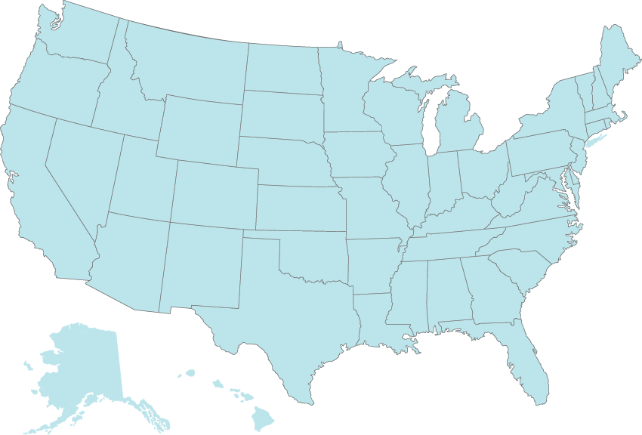




Approved New Starts – Spring 2022
Windsor, CO
Lodi, WI
Wichita, KS
Canton, GA
Conroe, TX
Notes:
So far in 2022, the Board for Home Missions has approved 12 new home mission starts, enhancements, and unsubsidized missions.
New Starts
Windsor, Colo.
Wichita, Kan.
Canton, Ga.
Conroe, Tex.
Lodi, Wis. (Unsubsidized)
Enhancements:
St. John’s – St. Paul, Minn.
Cross of Glory – Baton Rouge, La.
Divine Savior – Delray Beach, Fla.
Abiding Savior – Killeen, Tex.
Our Savior – Burlington, Iowa
Unsubsidized
Home Missions provides assistance to unsubsidized mission congregations through its district missions boards, mission counselors, synodical support staff, and special project funds, but does not provide direct financial support.
Mt. Calvary – Redding/Anderson, Calif.
Living Faith – Midlothian, Tex.

Slide 4

Share student information with
WELS Campus Ministry!
Notes:
WELS Campus Ministry, a ministry of WELS Home Missions, provides resources, support, and encouragement to WELS congregations that serve college students. These congregations are vital in connecting college students with fellow Christians, strengthening their faith with the gospel, and encouraging them to share that faith with other college students.
Almost every university in the United States and Canada has an assigned campus ministry contact pastor. Each contact pastor receives a list of WELS student that are attending their school. By sharing information with WELS Campus Ministry, these contact pastors know who the students are and can help them stay connected to Christ and strengthen their faith while at school.
We need your help in this process! Please work with the high school/college age students at your congregation and get them signed up with WELS Campus Ministry. Instructions on how to share student information was shared as supplemental information in your District Convention resources, and you can encourage students to sign up directly at wels.net/college.

Slide 5

Our Mission
The Pacific Northwest (PNW) District Mission Board (DMB) will, in accordance with Christ's command and by His grace, proclaim the gospel to reach the lost and the unchurched by strengthening believers, preparing and equipping God’s people for mission activity work, and partnering with congregations, groups, individuals, and the WELS to identify and cultivate mission work in the Pacific Northwest.

Slide 6
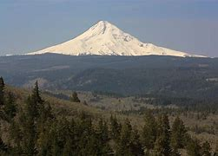
Pacific Northwest District
Missions

Slide 7
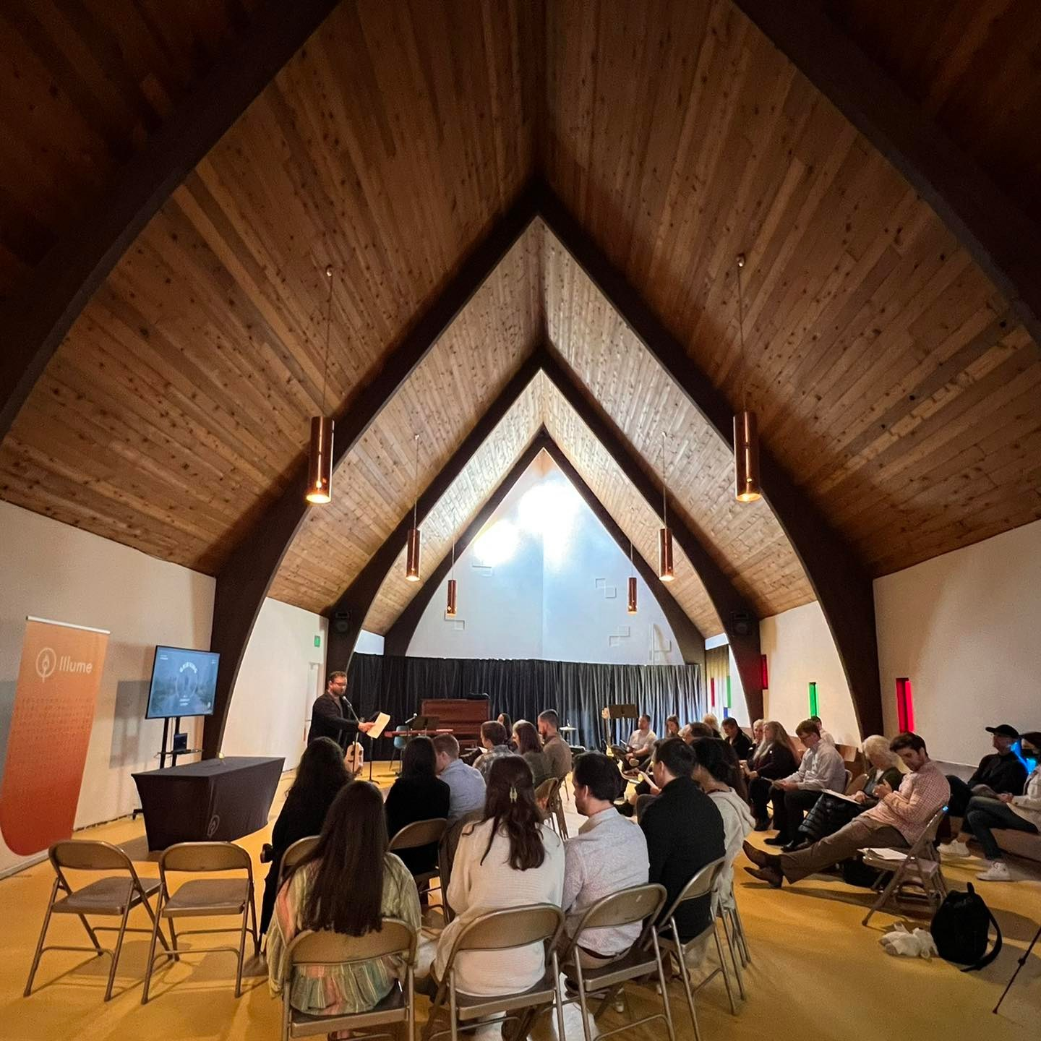
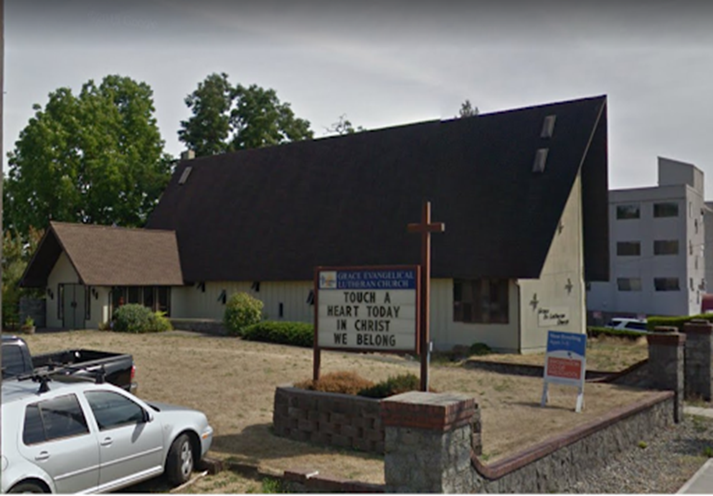
Illume – Seattle, WA

Slide 8
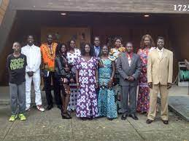
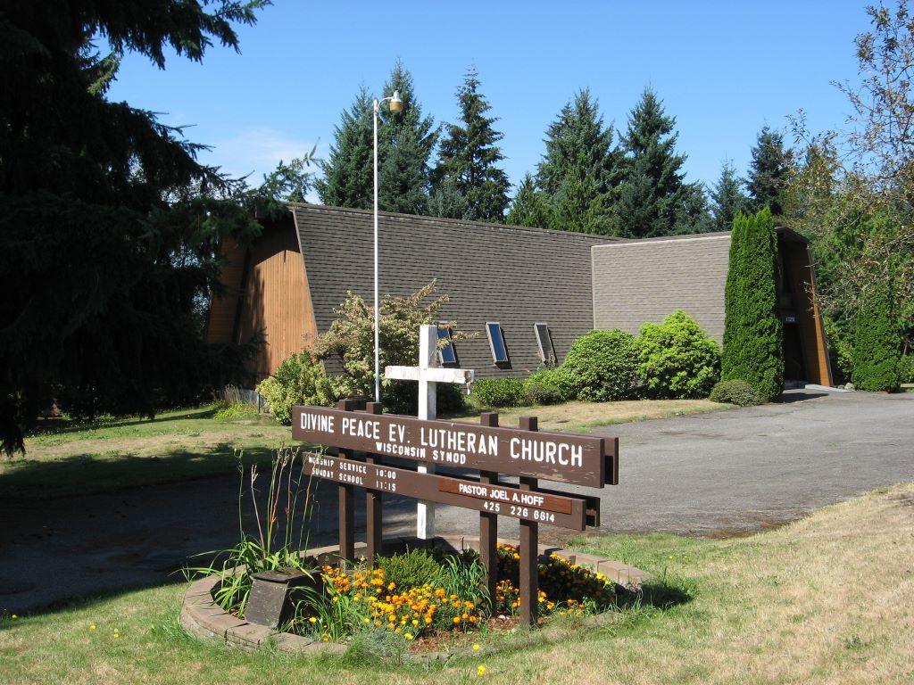
Divine Peace – Renton, WA

Slide 9
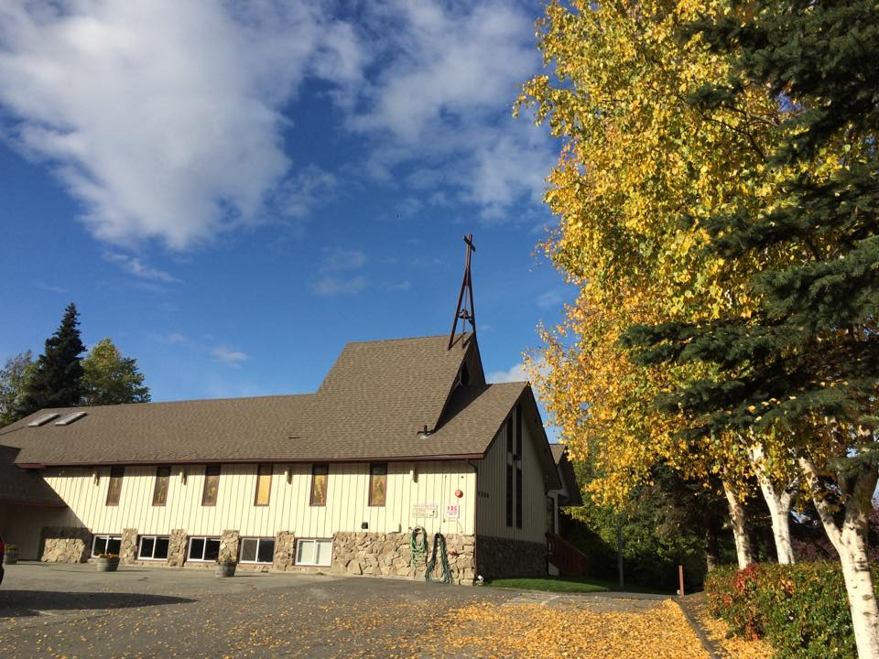
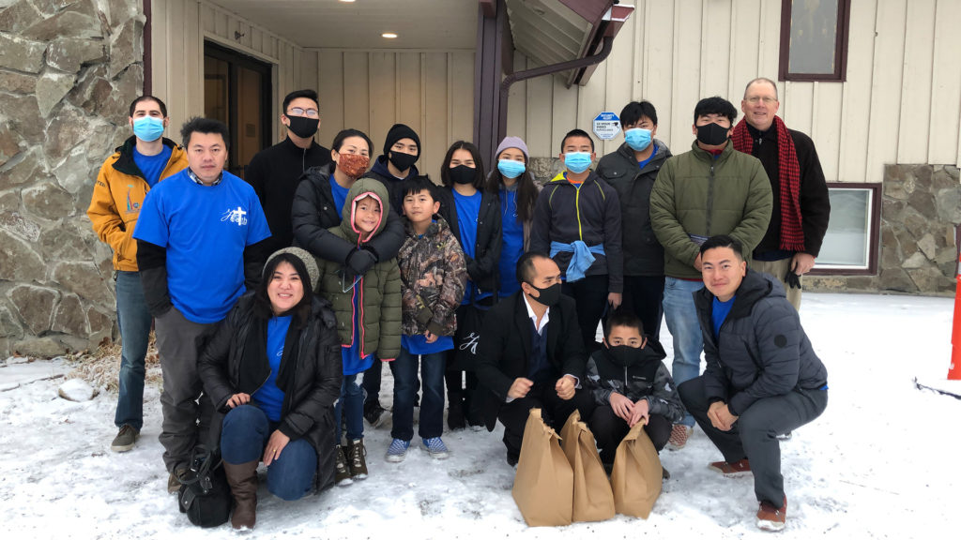
Faith Hmong, Anchorage, AK

Slide 10
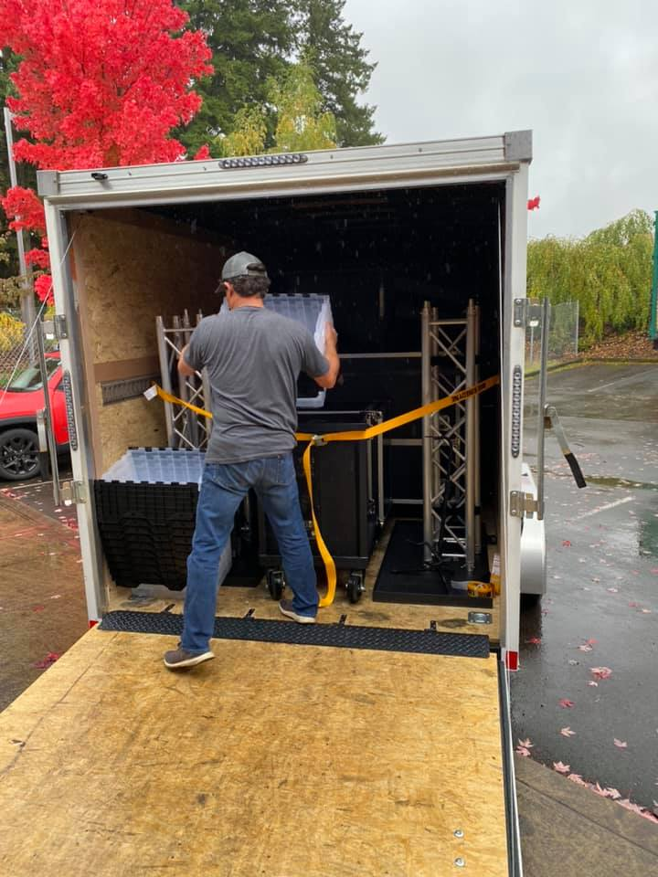
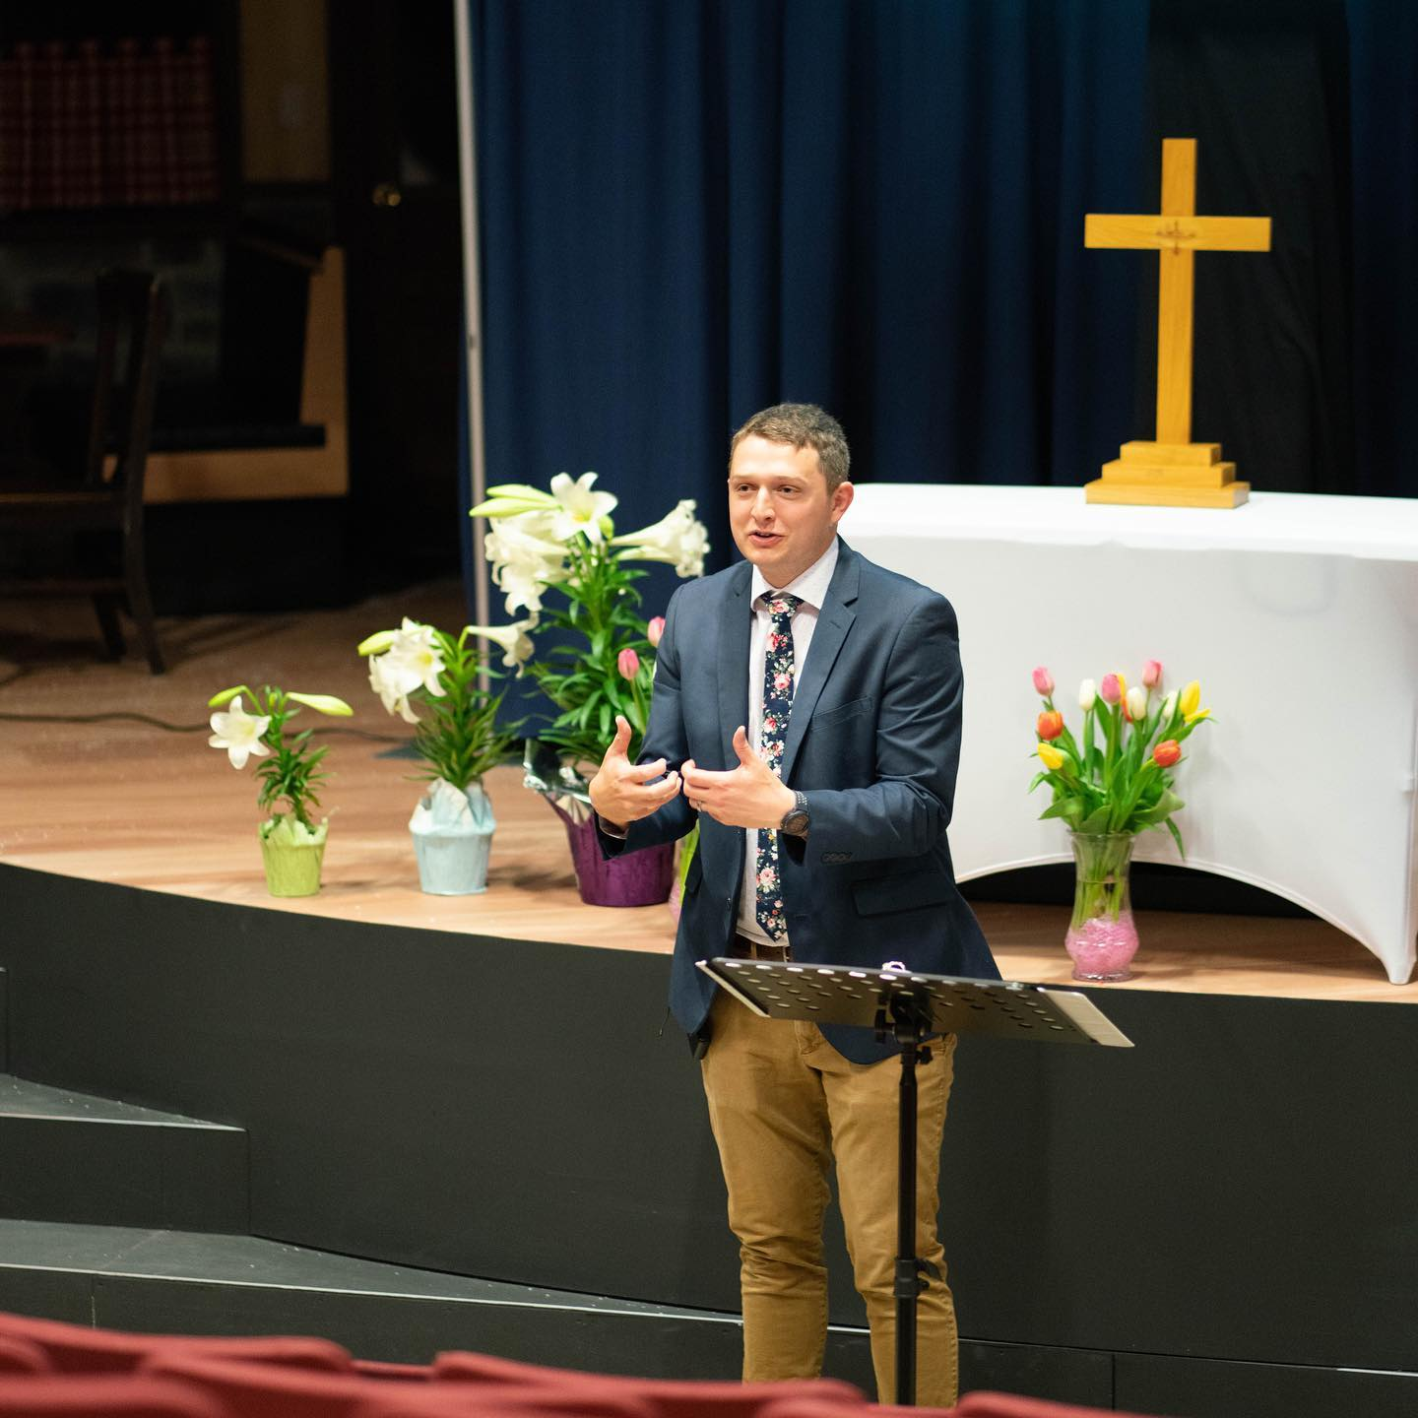
Hope – Tigard, OR

Slide 11
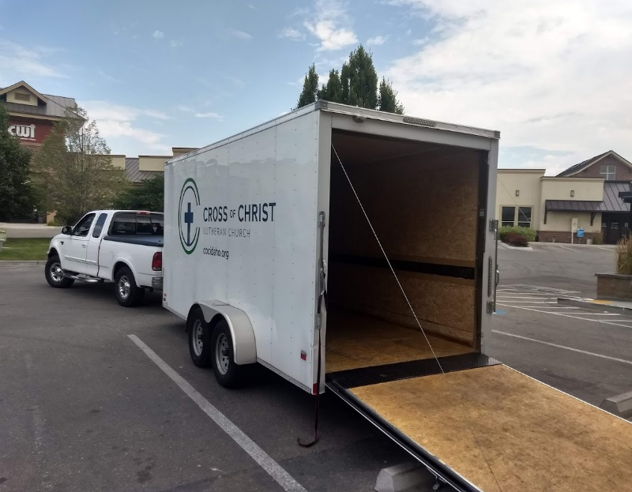
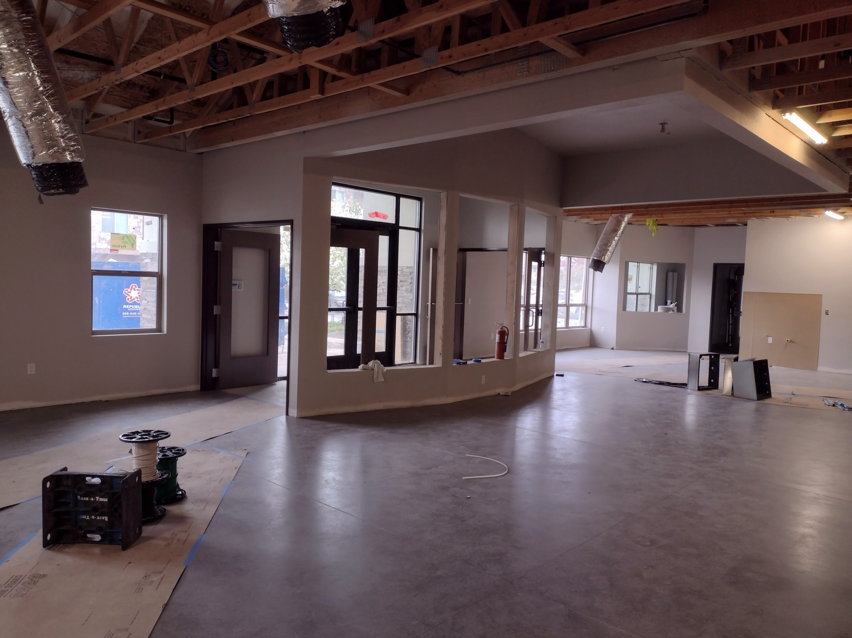
Cross of Christ – North Nampa, ID

Slide 12
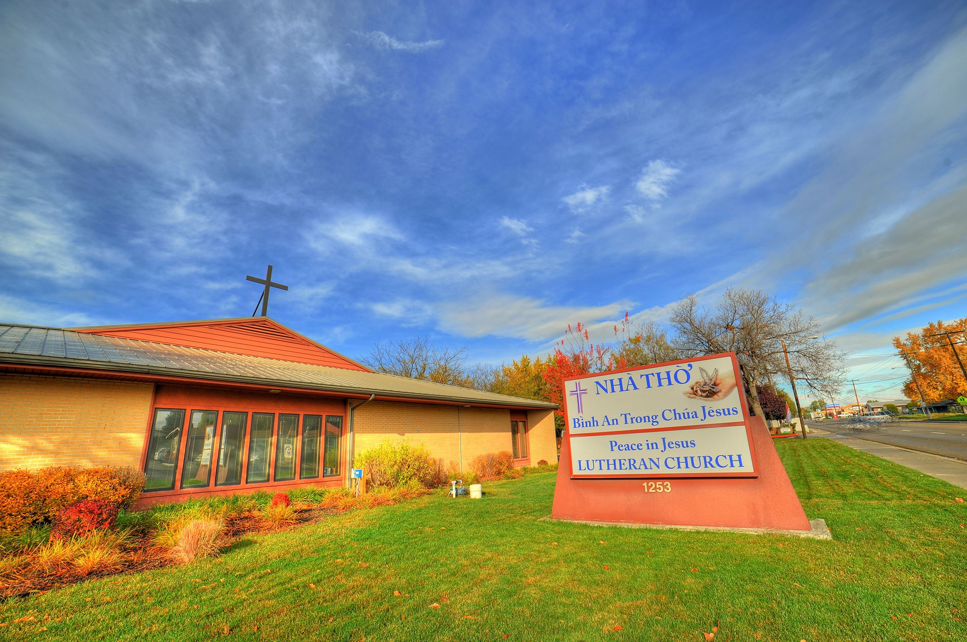
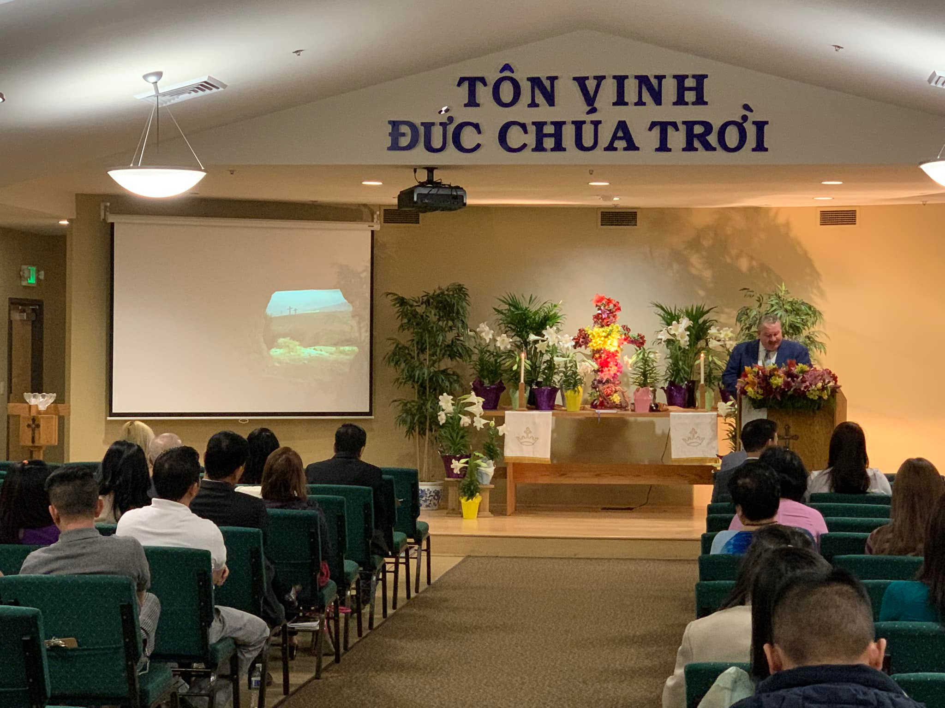
Peace in Jesus Vietnamese, Boise, ID

Slide 13

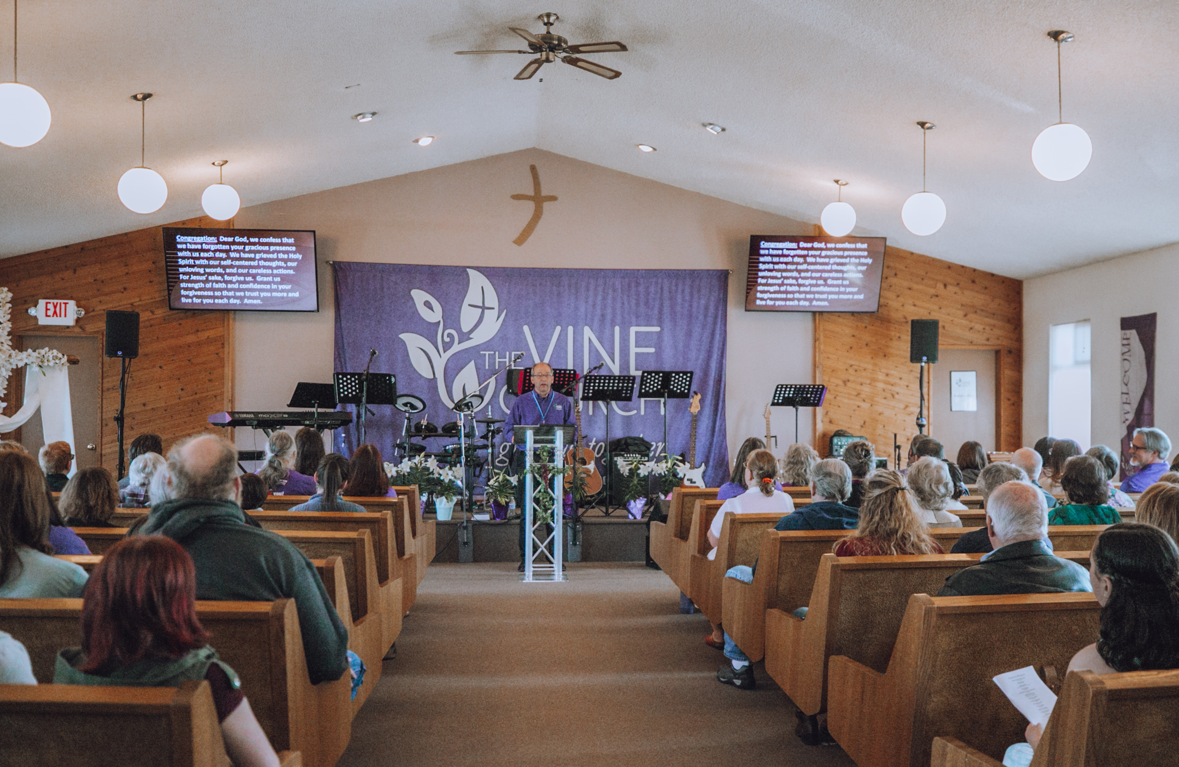
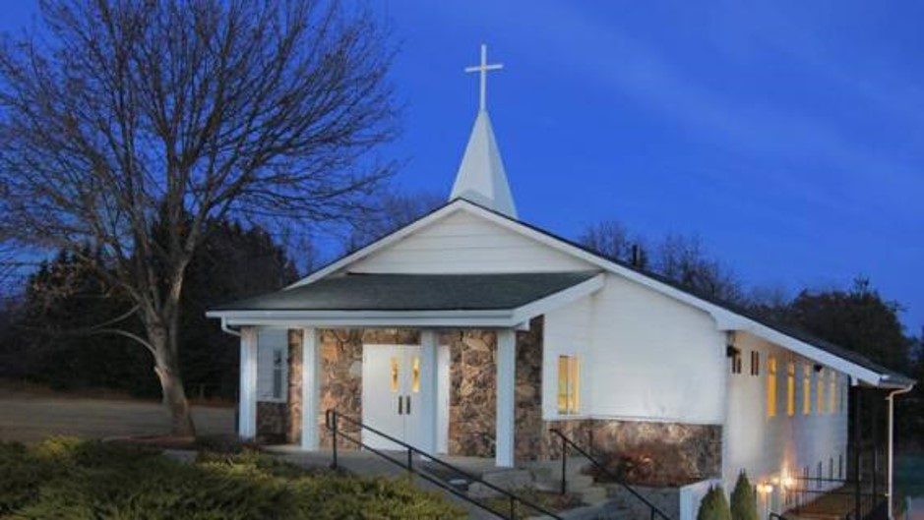
The Vine – Coeur d’Alene, ID

Slide 14
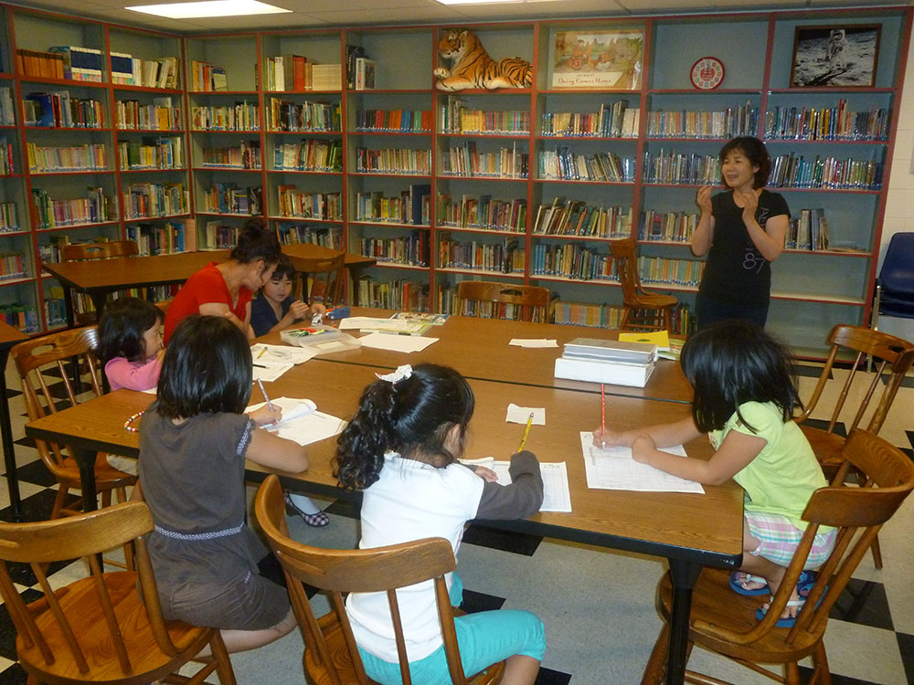
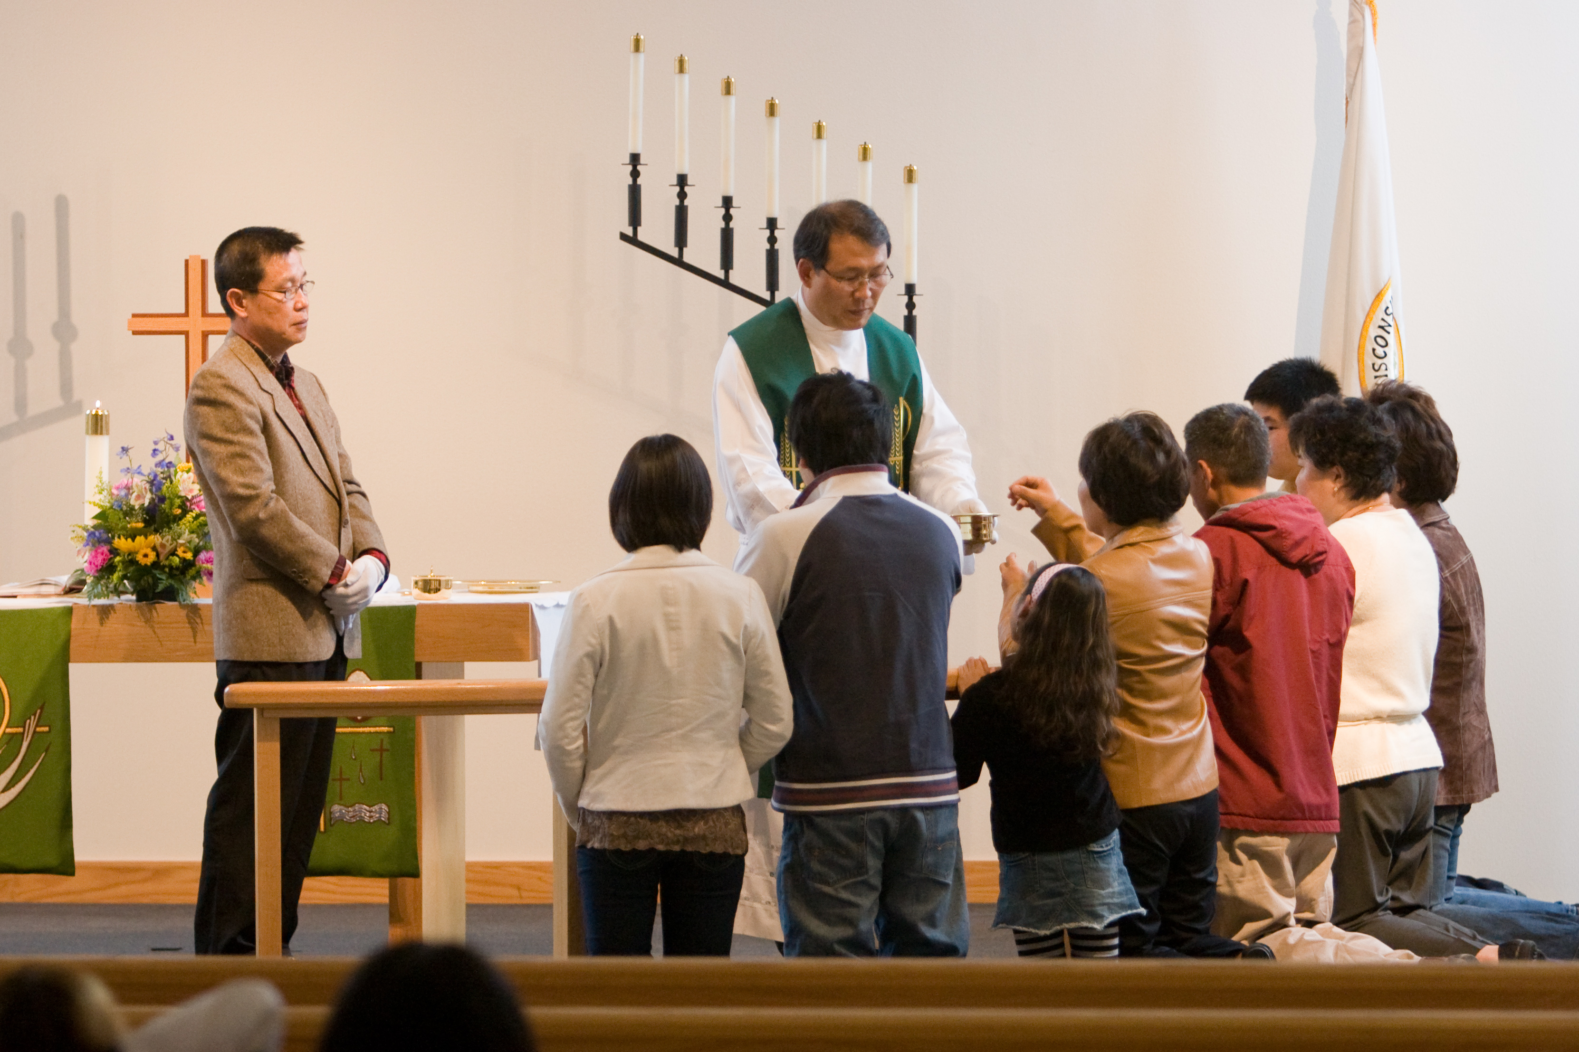
Korean Ministry, Des Moines, WA

Slide 15

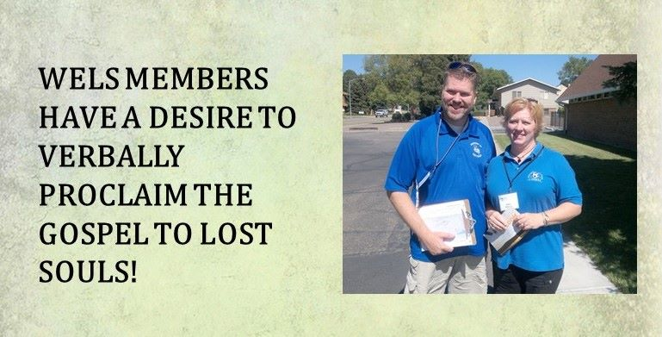
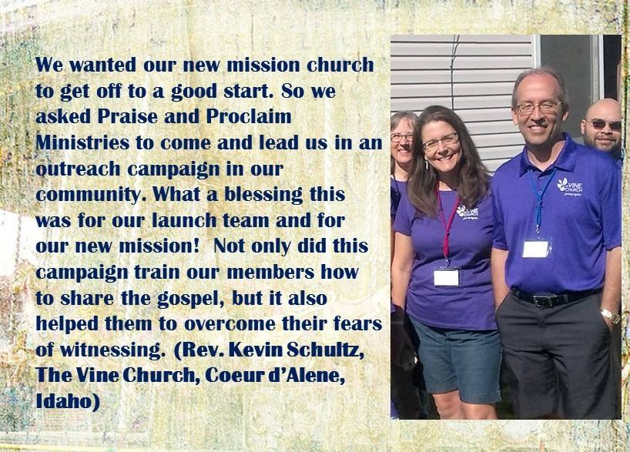

Slide 16


Slide 17


Slide 18
