Slide 1
Pacific Northwest District
REGIONAL MISSION TEAM

Slide 2
Our Mission
THE Mission of the WELS Kingdom Workers (WKW) Pacific Northwest (PNW) Chapter, by the Grace of God and to His praise and glory, is to work with WELS congregation members and those in fellowship with the WELS, to foster outreach work here in the Pacific Northwest and our country.

Slide 3
RMT Leadership
Ted Weiss (Christ The King, Bremerton, WA)
Augie Gabert (Amazing Grace, Milwaukie, OR)
Treasurer - Charlie Mills (Messiah, Olympia, WA

Slide 4
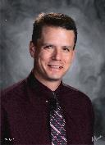
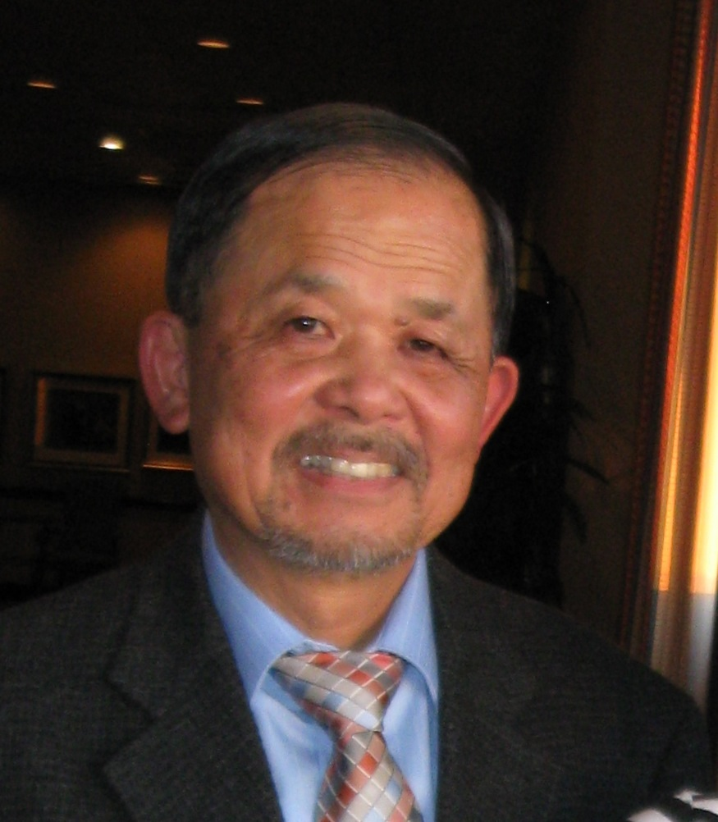
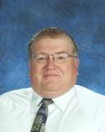
RMT Leadership
Spiritual Advisor – Pastor Thad Bitter (Grace, Portland, OR)
Mel Kam (Faith, Tacoma, WA)
Jeff Kurbis (Faith, Tacoma, WA)

Slide 5
2017 PARTNERSHIPS
The Vine, Coeur d’Alene
Soccer Camp
First church service outreach
Grace, Portland
Posada

Slide 6
2018 PARTNERSHIPS
Grace/Salem, Seattle - planned
Volunteers for canvasing, outreach projects, grounds upkeep, building improvements
How can the RMT partner with your congregation?
Volunteers, individual help, community, outreach costs (volunteer travel, promotional items, etc.)

Slide 7
VOLUNTEERs
Background: Kingdom Workers has been evolving over the last several years – FIA (US) and CVC (World) with constantly changing levels of support and funding.
Three different Volunteer Help Programs now in place:
Martin Luther College - Daylight Teams
Synod - Mission Journey
Kingdom Workers - Lutheran Volunteer Connect (Local)
web site to post help requests & volunteers pay own costs
How can RMT be of assistance?
Help with volunteer travel costs
Contact congregations and schools for volunteers

Slide 8
MEMBERSHIP
Follow us on Facebook: https://www.facebook.com/KWPNW/
Survey on how best to reach your congregations
Gifts to the PNW-RMT: https://kingdomworkers.myetap.org/fundraiser/PNWChapter/donate.do OR through the Kingdom Workers regular giving site - add to Additional Comments under Payment Information state: “Gift for PNW Regional Mission Team”
Regular monthly gifts are matched 50 cents for each dollar for the Kingdom Worker National only. No matching for gifts to RMT.

Slide 9
Thank you
COME JOIN US

