Slide 1
2022 PNW Fall Conference
District Schools Coordinators’ Report
Evergreen Lutheran HS Wed-Fri, Oct 19-21, 2022
bit.ly/2022PNWConf

Slide 2
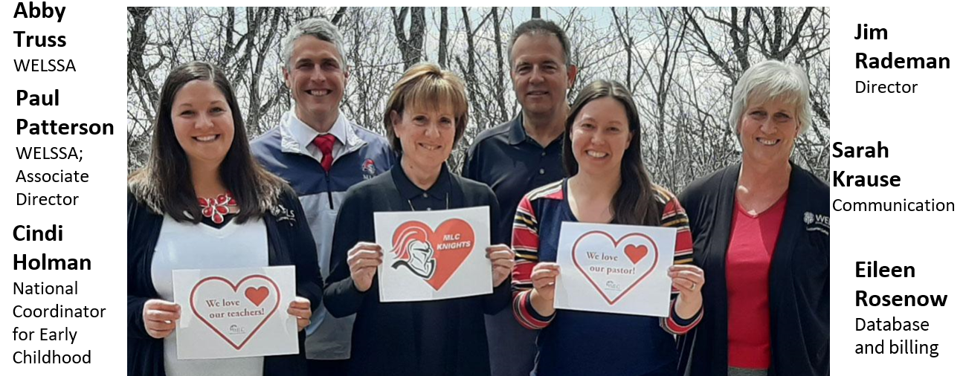
WELS Lutheran Schools
Notes:
Chris and Brigetta

Slide 3
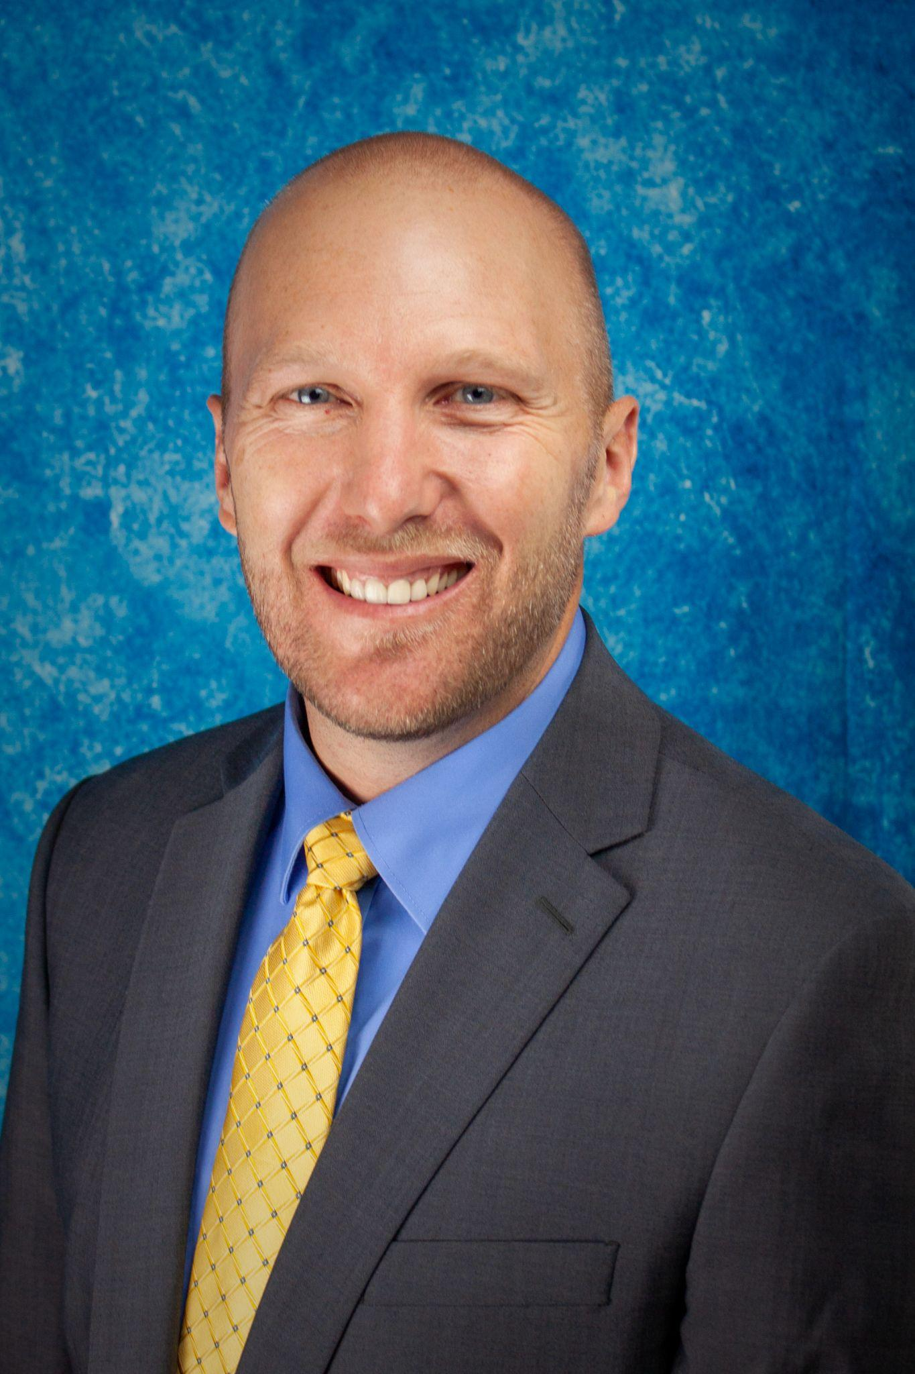
Your District School Coordinators
Brigetta Guelker - PNW ECDC
Southridge - Kennewick, WA
951-520-3390
guelkerbrigetta@gmail.com
Chris Hintz - PNW DSC
Christ the King - Bremerton, WA
602-803-9209
principal@ctk-wels.org
bit.ly/2022PNWConf
Notes:
Chris and Brigetta

Slide 4
Ministerial Growth and Evaluation Process (MGEP)
Teaching Standards
Ministry Development Plans
Formative Assessments
Summative Assessments
Training for new teachers and review for current teachers cls.welsrc.net/mgep
bit.ly/2022PNWConf
Notes:
Chris and Brigetta

Slide 5
Teacher Shortage Task Force
Training Subcommittee
Recruitment – Every Corner ​
Competency Based Education​
Inservice Early Childhood Training ​
Identifying WELS/ELS Members with education​ degrees from public colleges
In Location Training – Internships​
bit.ly/2022PNWConf
Notes:
Cindi

Slide 6
Teacher Shortage Task Force
School Culture Subcommittee​
Retention​
New Teacher Expectations​
Positive Cultures – Toxic Cultures​
Funding – Scholarships – Rebates​
MLC Experience​
Call and Assignment Process
bit.ly/2022PNWConf
Notes:
Cindi

Slide 7
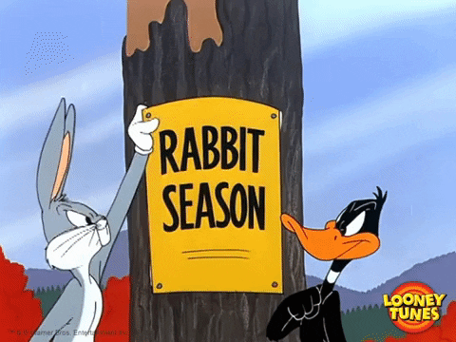
Lutheran Schools Calling Process
It’s Call Season
Calling Window: Oct 12 - Apr 16
Call Requests
Consider local teachers when possible
Request approval for Call from your DP
Submit a request for a Call List cls.welsrc.net at least two weeks in advance of Call Meeting
Watch for confirmation of the date prior to finalizing date with your congregation
Lists are sent to the district president in advance for their vetting
Expect a list on the day of your meeting
bit.ly/2022PNWConf
Notes:
Cindi

Slide 8
Lutheran Schools Profiles
3000 Teachers
1000 No Data
550 No updates since 2017
bit.ly/2022PNWConf
Notes:
Chris and Brigetta

Slide 9
Lutheran Schools Profiles
Why?
Lutheran Schools and the COP use this data for call list consideration
Accurate information is critical
The blessings for calling bodies and Called Workers
When?
At least once a year
When you complete a PD class, training, or conference
Life events: engagement, new child, family circumstances, etc.
bit.ly/2022PNWConf
Notes:
Chris and Brigetta

Slide 10
Lutheran Schools Profiles
How?
Go to cloud.wels.net/my-wels-cloud
Support
lutheranschools@wels.net
WELS HELP Desk support@wels.net
414.259.4357
bit.ly/2022PNWConf
Notes:
Chris and Brigetta

Slide 11
Lutheran Schools Statistics
cls.welsrc.net/stats
Due Oct 7 (64% collected to date)
Please still submit if you missed the due date
Need help? sarah.krause@wels.net
2021 Lutheran School Stats
Notes:
Cindi

Slide 12
Lutheran School Annual Support
What Your Funds Support
Leadership Development Programs
Teaching Continuing Education Initiatives
Congregational, school, and individual support and consulting
DSC and ECDC efforts in
each district
Notes:
Chris and Brigetta

Slide 13
Lutheran School Annual Support
Additional Benefits for Your School:
Preferred rates on CLS services and event registrations
Electronic Subscription Vector Safe Schools
$4,000 for District Continuing Ed and Program Support
One annual onsite visit from your school counselor or district representative
Discounts for PowerSchool, WELSSA Annual Fees, and Conferences/Seminars
bit.ly/2022PNWConf
Notes:
Chris and Brigetta

Slide 14
Lutheran School Annual Support
Cost to your school
$3.75 half-time ECE students, $7.50 per full-time student in PreK-8th, $4.00 per high school student
Current Supporting Schools for 2022-2023
Evergreen Lutheran High School: Tacoma, WA
Christ the King Lutheran School: Bremerton, WA
Holy Trinity Lutheran School: Des Moines, WA
Light of Life Preschool: Covington, WA
clsservices.wels.net
bit.ly/2022PNWConf
Notes:
Chris and Brigetta

Slide 15
School Accreditation
Quality assurance that a school is
doing good things and working towards school improvement
Meet or exceed a set of 200+
standards of high performing schools
Process: Self-study > Peer visitation > School improvement plan
Accreditation assistance:
Chris Hintz: principal@ctk-wels.org 602-803-9209
bit.ly/2022PNWConf
Notes:
Cindi

Slide 16
School Resources cls.welsrc.net
Notes:
Cindi

Slide 17
School Leader Initiatives
Principal Credential Cohort
Early Childhood Emerging Leader Cohort​
Principal Training Program​
Early Childhood Director Training Program​
​Apprentice Mentoring ​
MSOE Business Certificate for School Leaders
bit.ly/2022PNWConf
Notes:
Cindi

Slide 18
Taskforce Activity
Teacher Shortage
Special Education
Gender Identity
Institute on Lutheran Apologetics
Religion Curriculum
Curriculum and Instruction (K-12)
Early Childhood Training and Support
NAEYC/Youngstar/WELSSA Crosswalk
Starred Standard Review
bit.ly/2022PNWConf
Notes:
Cindi

Slide 19
PNW Continuing Education
2022-2023
National Lutheran Leadership Conference - Jan 16-18, Chicago
Info and register at lutheranleadership.com
Spring Teachers’ Conference - Mar 16-17 at Grace in Portland, OR
Pastor and Teacher Summer Quarter - June 12-15 at Evergreen Lutheran
Please share any continuing education ideas you have with your DSCs or conference program committees
bit.ly/2022PNWConf
Notes:
Chris and Brigetta

Slide 20
Your District School Coordinators
Brigetta Guelker - PNW ECDC
Southridge - Kennewick, WA
951-520-3390
guelkerbrigetta@gmail.com
Chris Hintz - PNW DSC
Christ the King - Bremerton, WA
602-803-9209
principal@ctk-wels.org
bit.ly/2022PNWConf
Notes:
Chris and Brigetta

